Slide 1
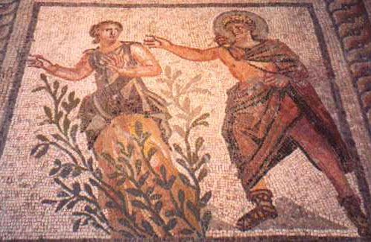
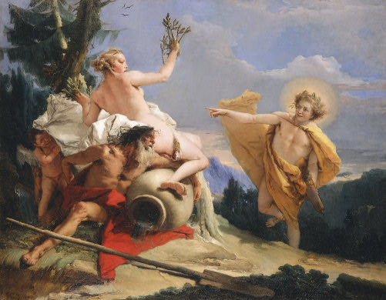
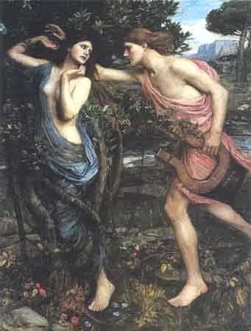
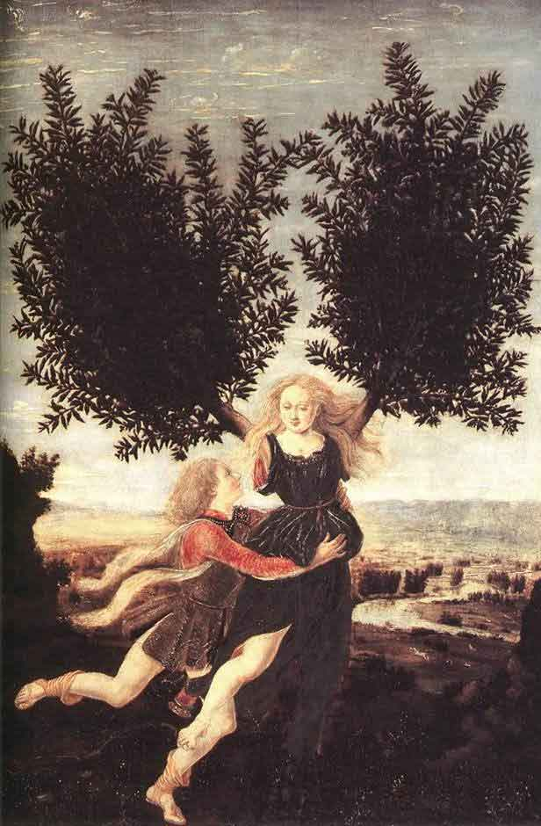
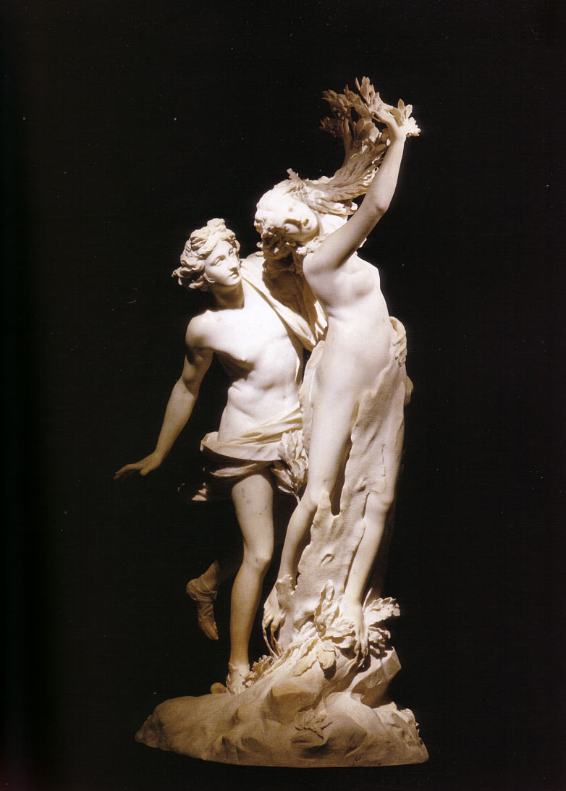
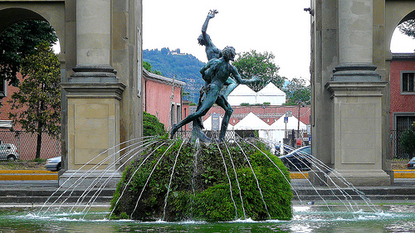
Ovid’s Metamorphoses
Apollo and Daphne

Slide 2
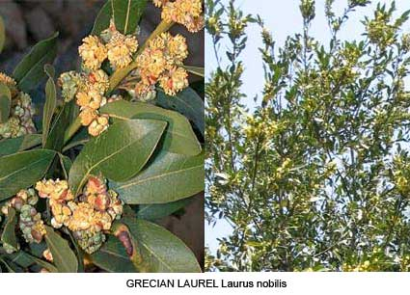
http://www.theoi.com/Nymphe/NympheDaphne.html

Slide 3
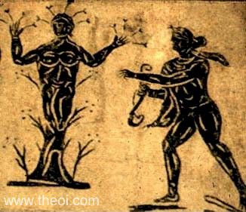
APOLLON & DAPHNE
Museum Collection: Ostia Antica, Rome, Italy
Catalogue Number: TBA
Type: Floor Mosaic
Context: Ostia
Date: --
Period: Imperial Roman

Slide 4
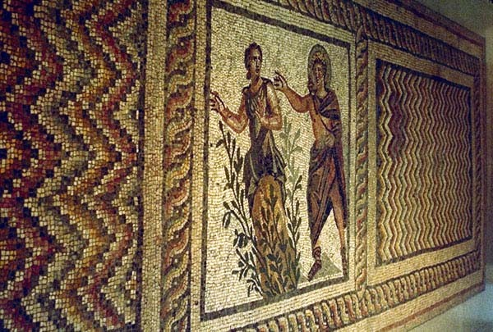
Apollo & Daphne, Greco-Roman mosaic from Antioch
C2nd-3rd A.D., Antakya Museum, Turkey

Slide 5
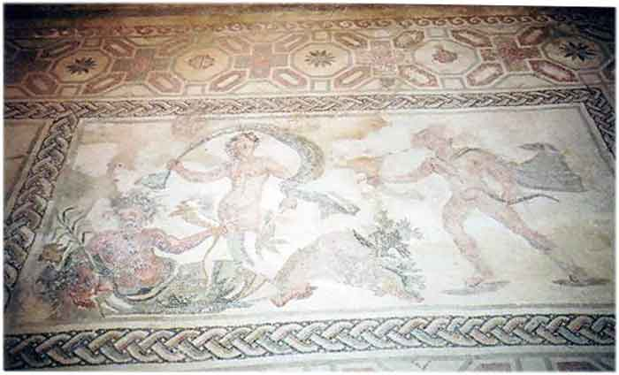
The River god Peneus, Daphne and Apollo
House of Dionysus,
Paphos., Cyprus
3rd c. AD

Slide 6
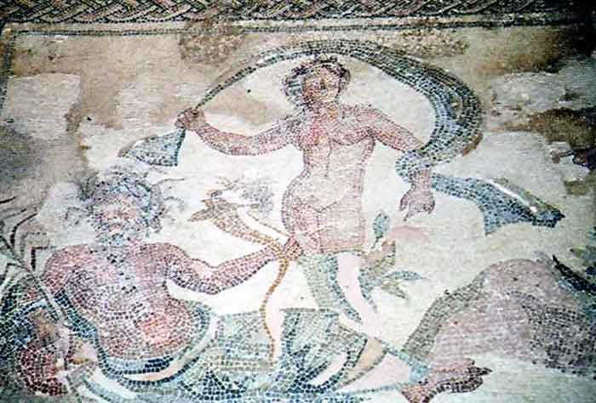

Slide 7
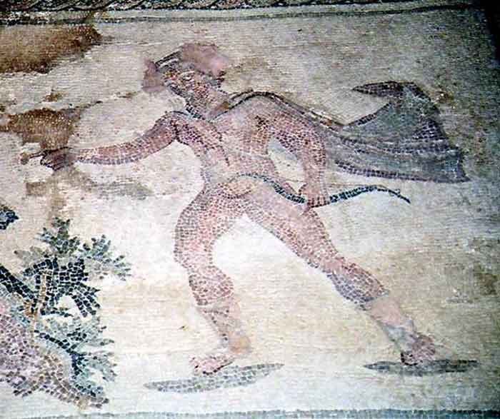

Slide 8
Apollo and Daphne
probably 1470-80, Antonio del Pollaiuolo
National Gallery, London

Slide 9
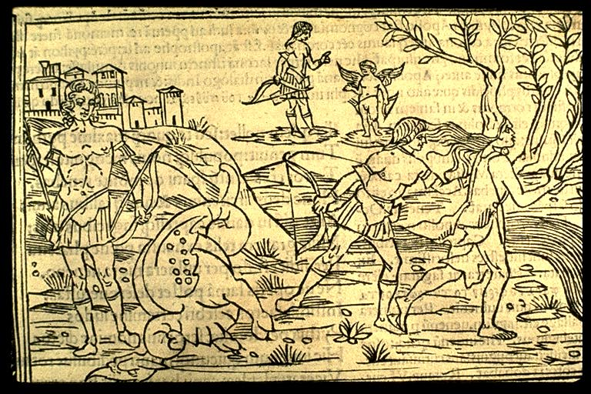
Anonymous: Raphael Regius (died 1520), Venice ca. 1513

Slide 10
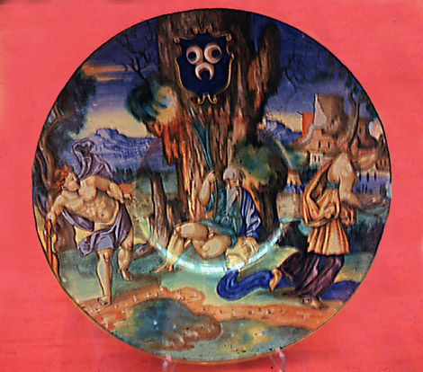
Daphne & Apollo Venetian Plate (16th century), Glasgow, Kelvingrove Museum.

Slide 11
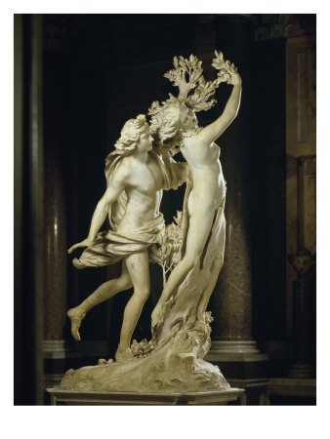
Apollo and Daphne
Gian Lorenzo Bernini, 1622-1625
Marble, height 243 cm
Rome, Galleria Borghese

Slide 12
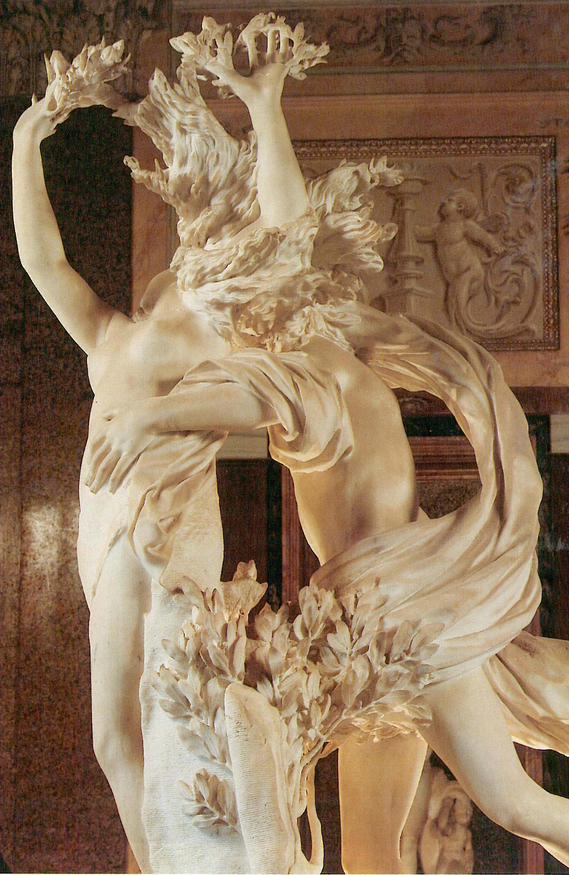
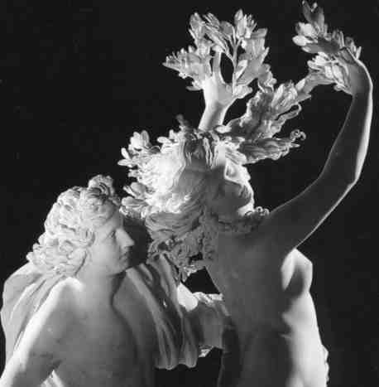

Slide 13
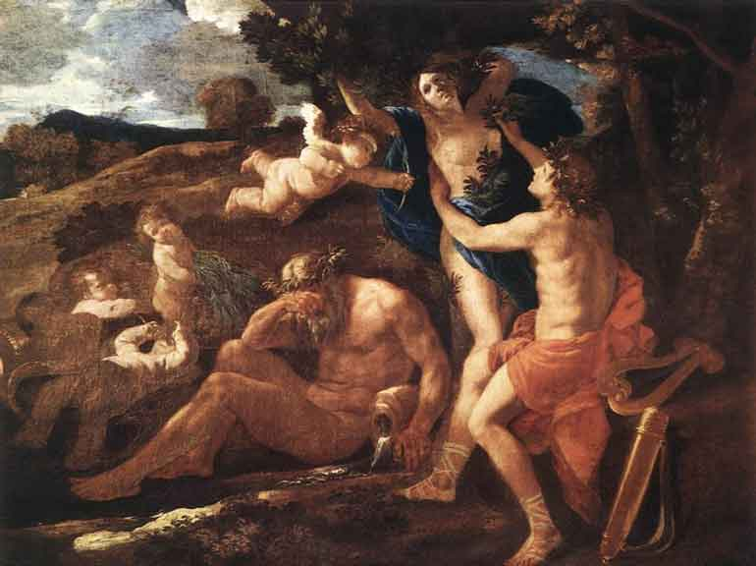
Title: Apollo and Daphne 1625
Painted by: Nicolas Poussin
Location: Alte Pinakothek, Munich, Bavaria, Germany
Year: 1625
Dimensions: 51.58 inch wide x 38.19 inch high
Orientation: Landscape

Slide 14
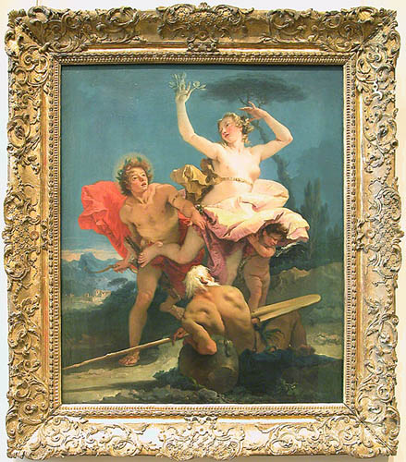
Giovanni Battista TIEPOLO (Venice, 1696 - Madrid, 1770)
Apollo and Daphne
c. 1743-44
© Musée du Louvre/A. Dequier - M. Bard

Slide 15
Giovanni Battista Tiepolo
Apollo Pursuing Daphne, c. 1755/1760
Samuel H. Kress Collection
1952.5.78, National Gallery of Art, Washington, D.C.

Slide 17
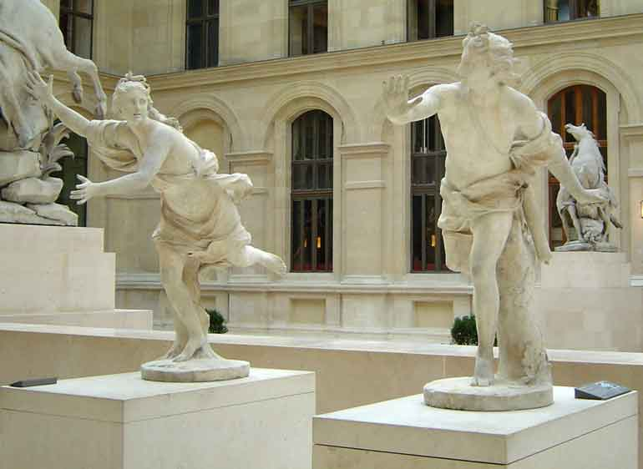
Daphne chased by Apollo, (1677-1746), marble, Louvre, Paris,
Guillaume Coustou the elder
1714
Accession number M.R. 1807 ; M.R. 1805
Location Richelieu

Slide 18
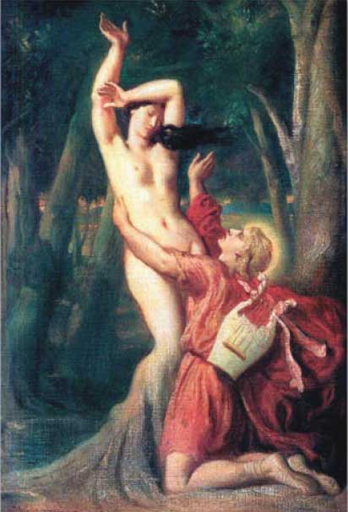
Apollo and Daphne (Apollon et Daphne)
Theodore Chasseriau (1819-1856)
(1846) Louvre, Paris

Slide 19
Apollo and Daphne, 1908
John William Waterhouse
Oil on canvas
Private collection

Slide 20
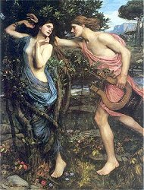
Gilbert and Sullivan
“The Martyr of Antioch"
The plot may be briefly described. Olybius is in love with Margarita, and she returned his love. This, however, was in her heathen days. She is now a Christian, and with her conversion, of which both her lover and her father are ignorant, she, although still not indifferent to him, rejects all idea of union with a heathen. The piece opens with a chorus of sun-worshippers, preliminary to a solemn sacrifice. The Prefect calls for Margarita to take her accustomed place, and lead the worship. During her non-appearance the Priest charges her with lukewarmness in the cause of Apollo, and he avows his firm intention to put all Christians to death.
John William Waterhouse 1849-1917

Slide 21
Gilbert and Sullivan
“The Martyr of Antioch"
Youths:
Lord of the cypress grove, that here in baffled love,
The soft Thessalian maid didst still pursue.
Until her snowy foot in the green earth took root,
And in thine arms a verdant laurel grew.
Youths & Maidens
Lord of the cypress grove, that here in baffled love,
The soft Thessalian maid didst still pursue
Until her snowy foot in the green earth took root,
And in thine arms a verdant laurel grew.
And still thy tenderest beams over our falling streams
At shadowy eve delight to hover long.
They to Orontes' tide in liquid music glide
Through banks that blossom their sweet course along,
Through banks that blossom their sweet course along,
Their sweet course along.
Maidens:
And still in Daphne's bower thou wanderest many an hour,
Kissing the turf by her light footsteps trod,
And nymphs at noon-tide deep start from their dreaming sleep,
And in his glory see the bright-haired God.

Slide 22
Tomasso Tomassi
Florence

Slide 23
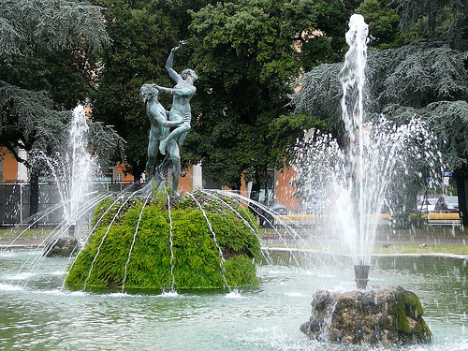

Slide 24
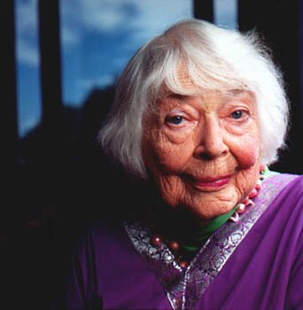
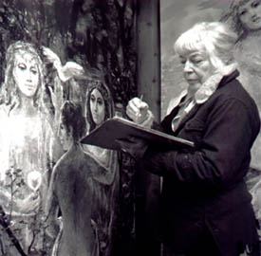
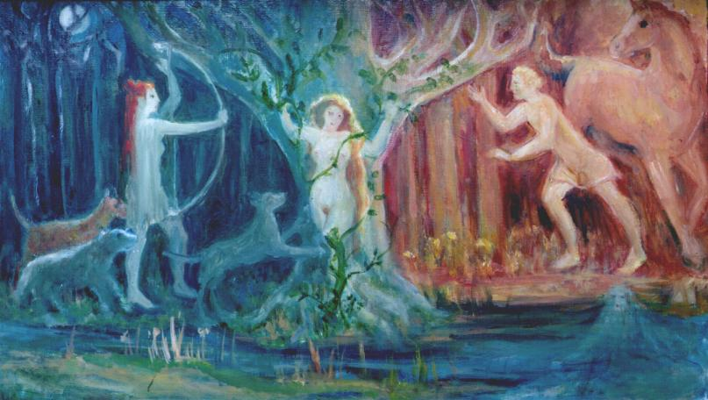
Mary Holmes

Slide 25
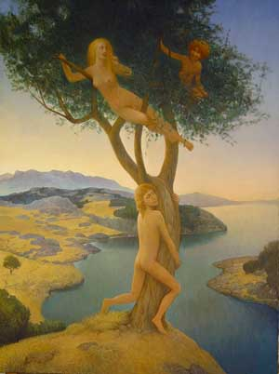
Azat Minnekaev 1999

Slide 26
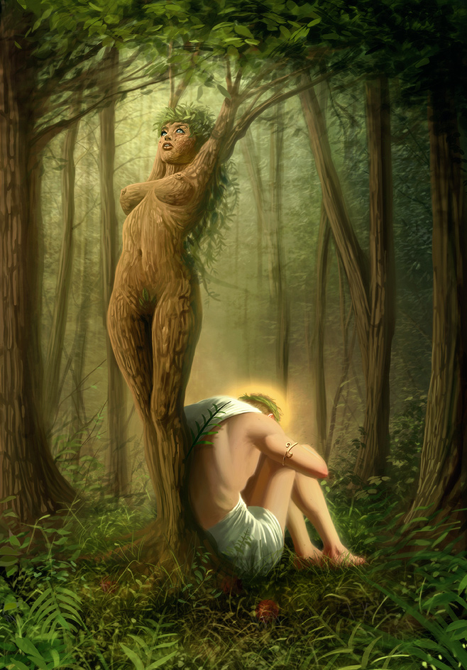


Slide 27
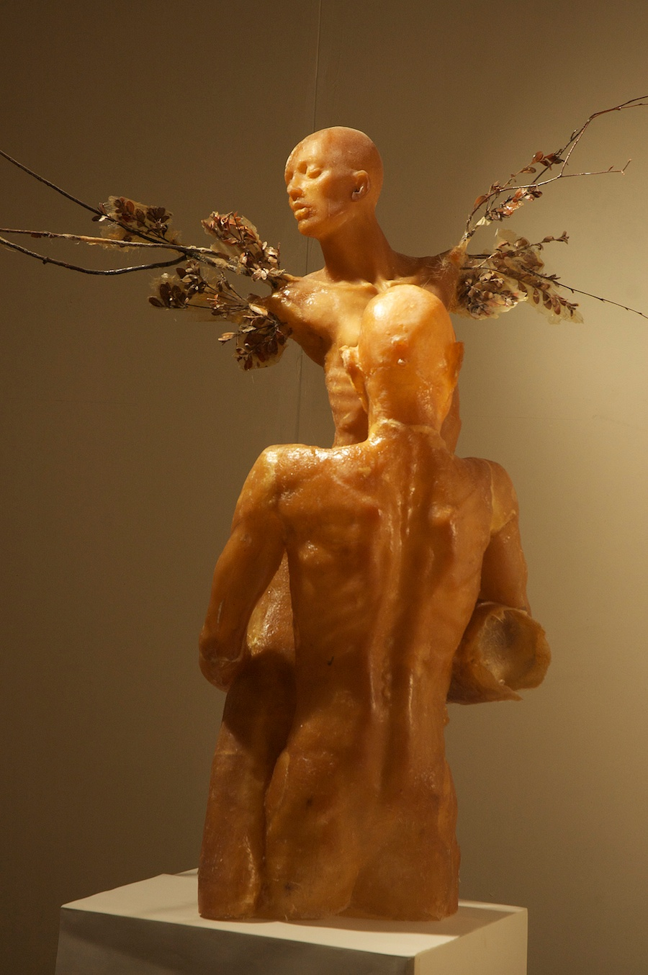
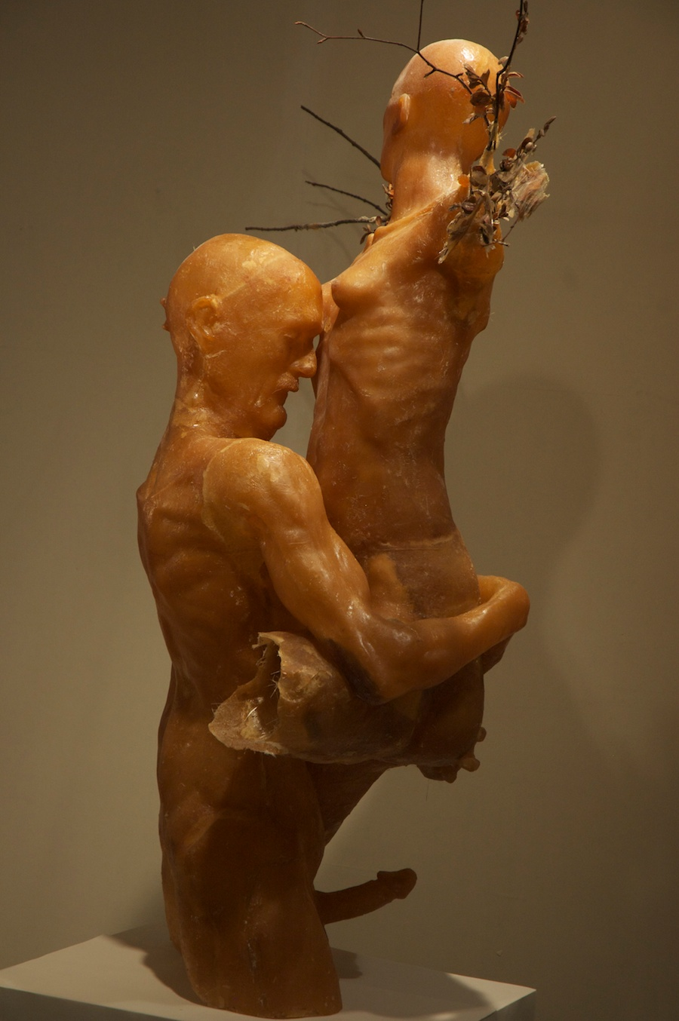
Absurd Nature! We get old, the body decays, but the libido, heedless, drives on. A paean to the biological imperative.--Geoffrey Koetsch (http://koetsch.squarespace.com/works/daphne-and-apollo/)

Slide 28

The Daphne Initiative
http://ec.europa.eu/justice/grants/results/daphne-toolkit/en/daphne-toolkit-%E2%80%93-active-resource-daphne-programme

Slide 29

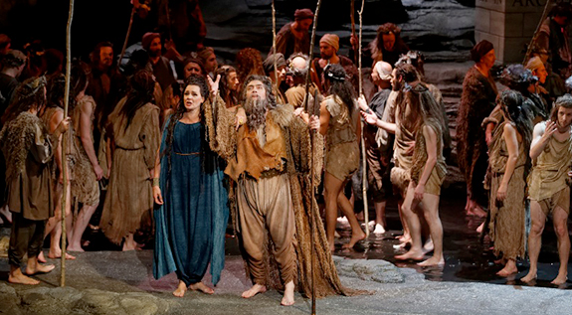

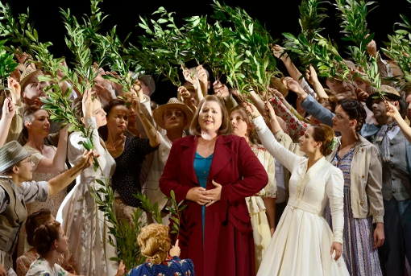
Richard Strauss’ “Daphne(1938)
https://www.youtube.com/watch?v=w7UJiRh5lD0

Slide 30
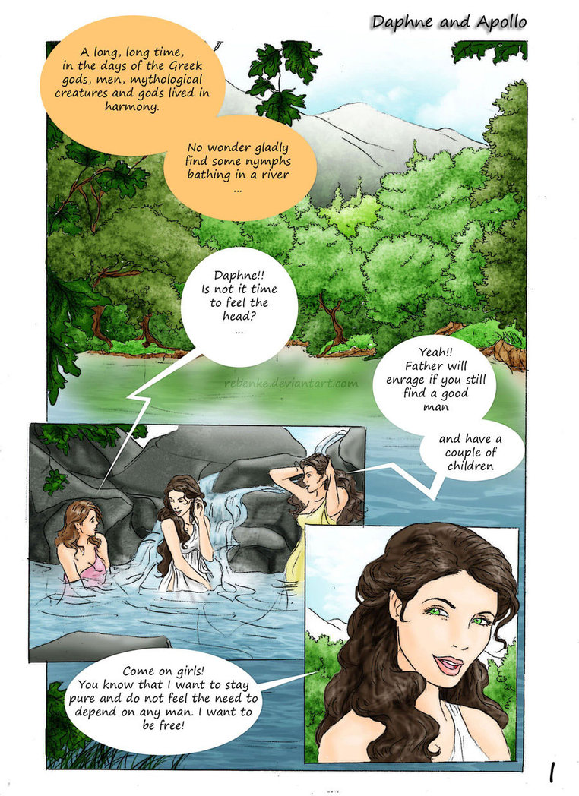
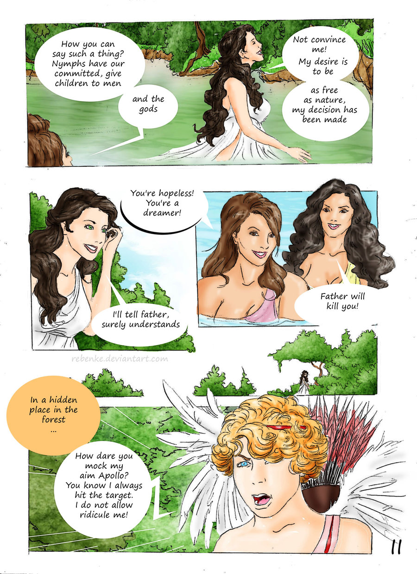
Jonas Rebenke (Deviantart.com)

Slide 31
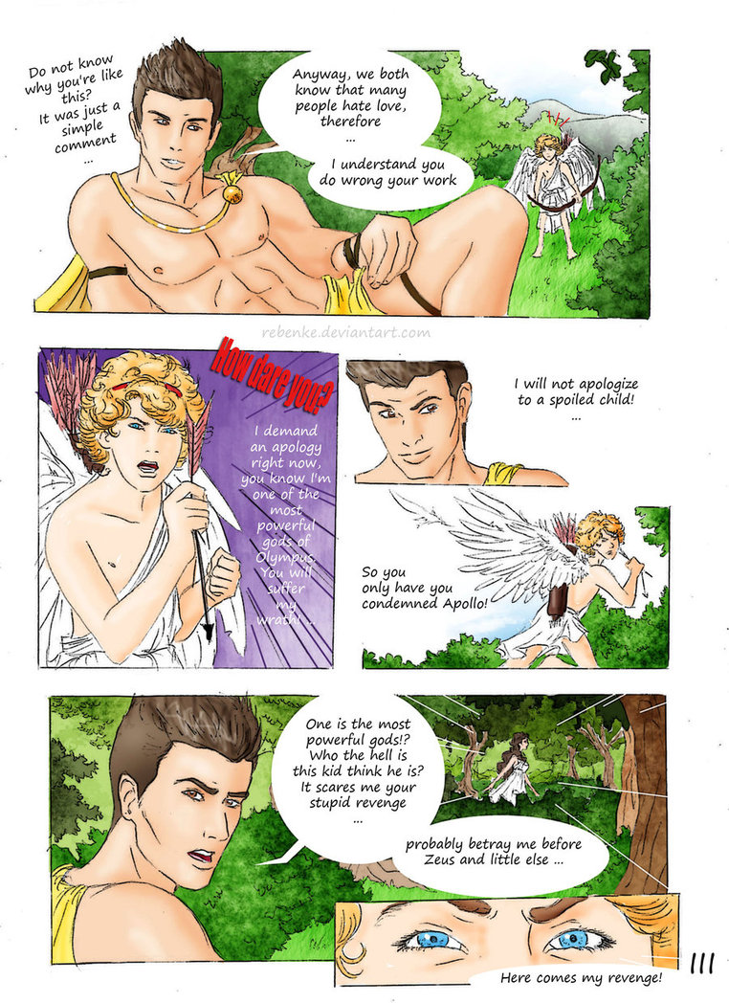
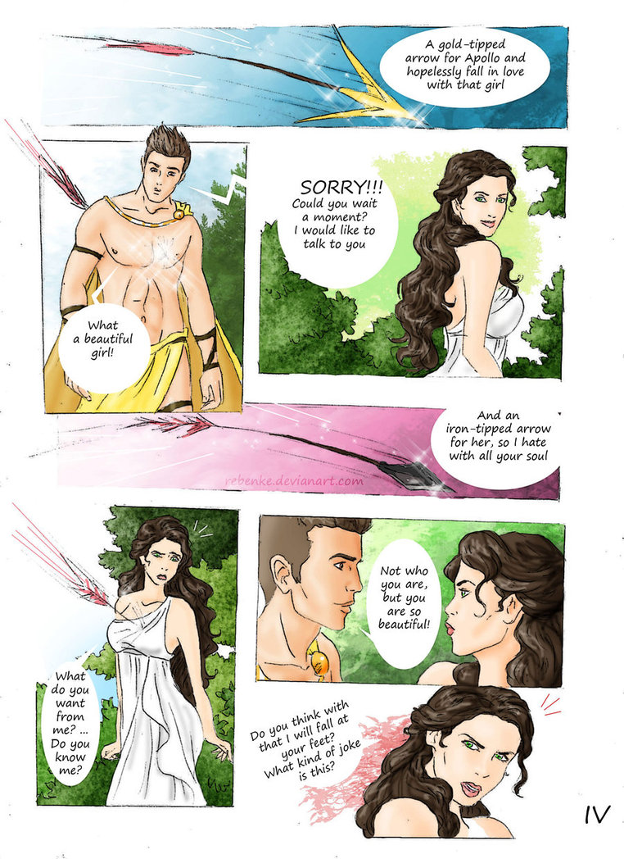

Slide 32
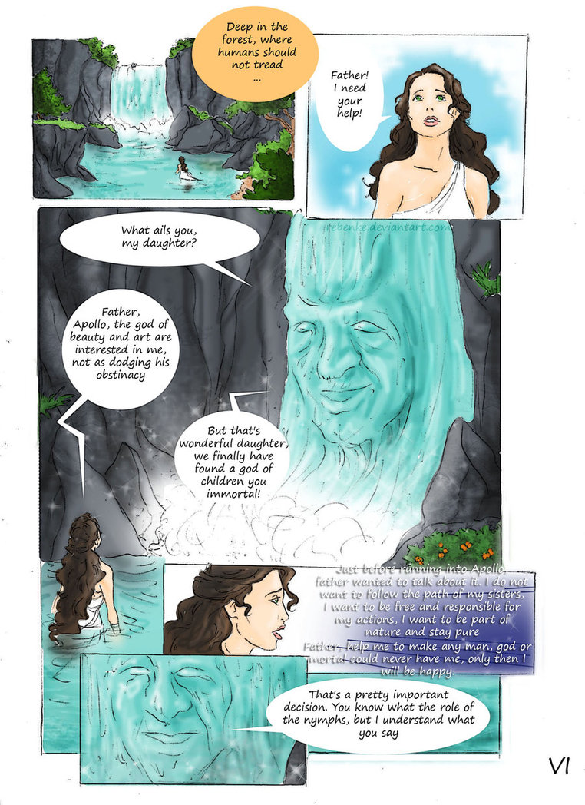
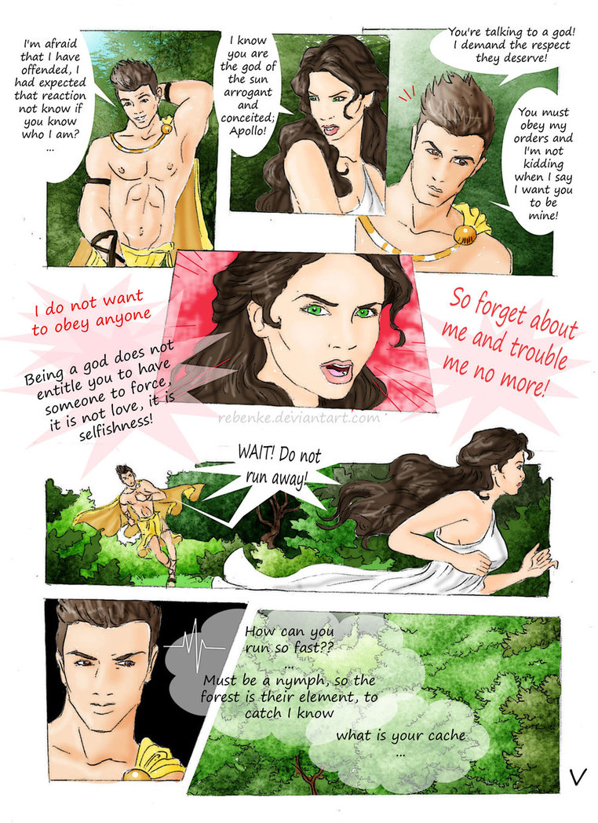

Slide 33
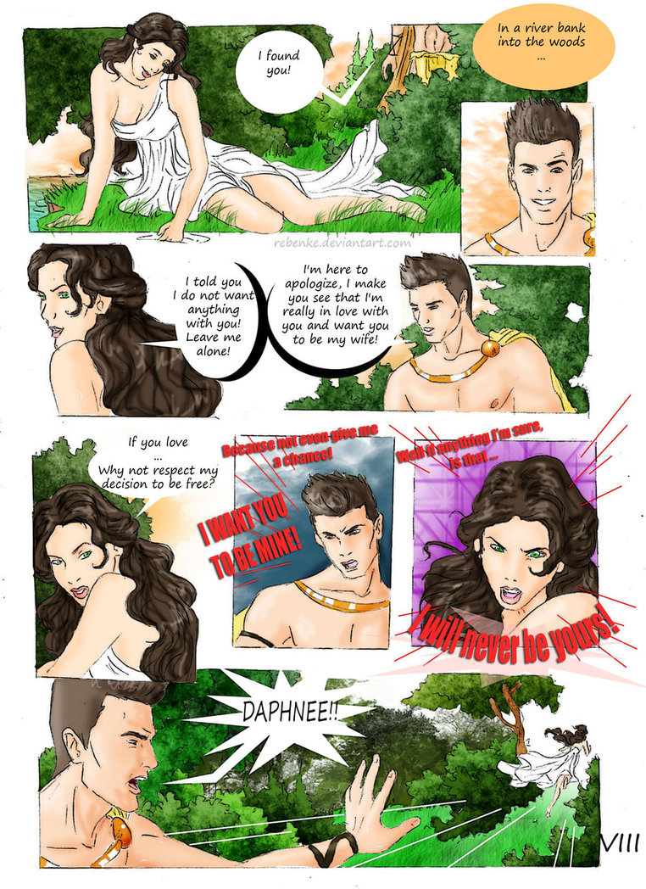
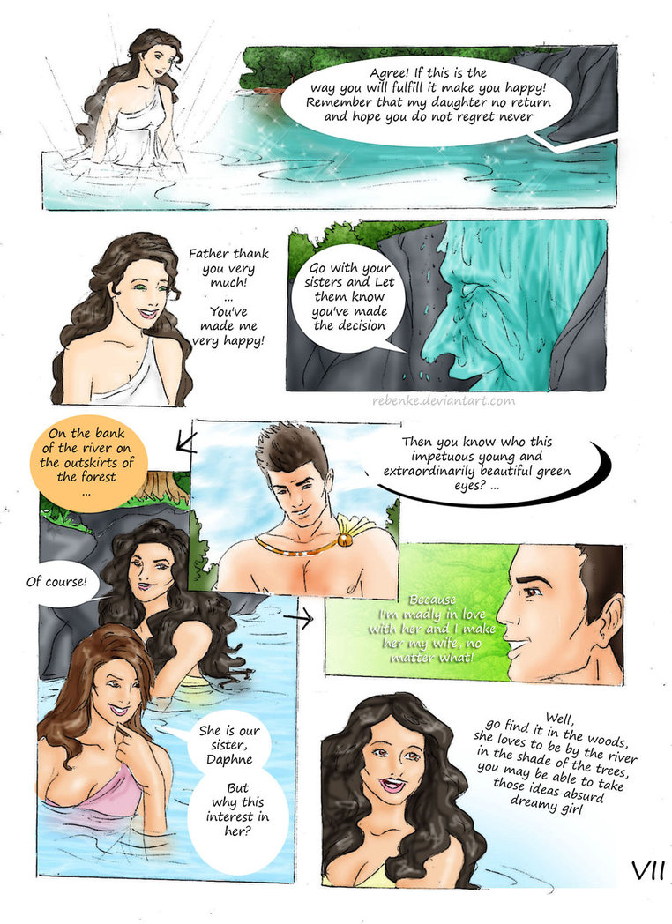

Slide 34
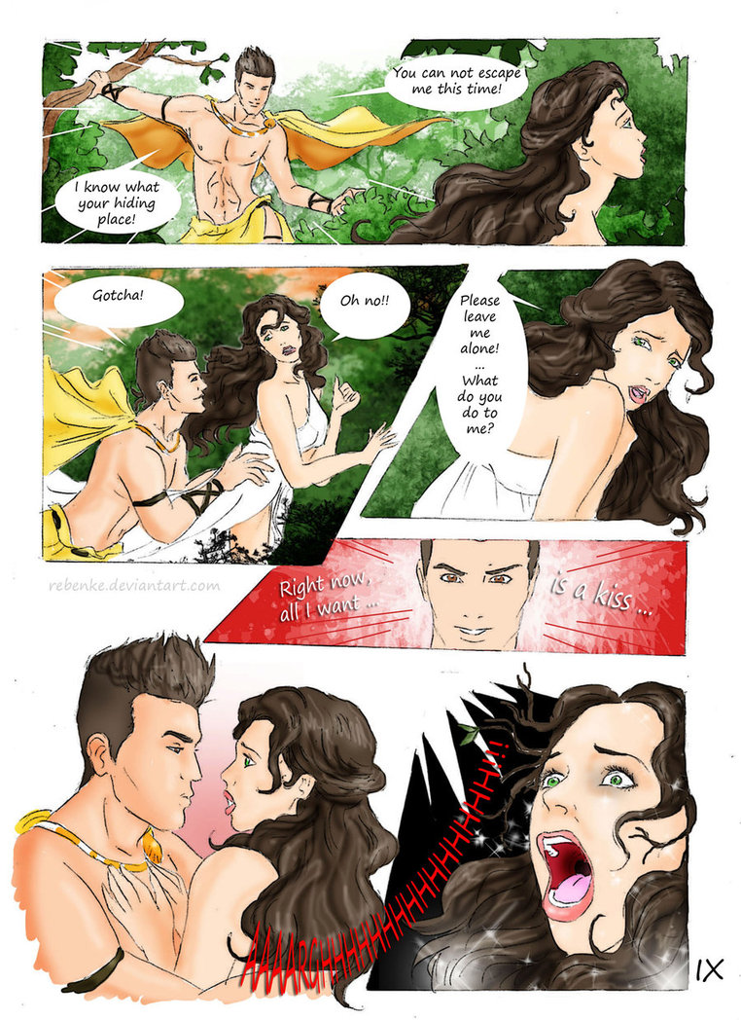
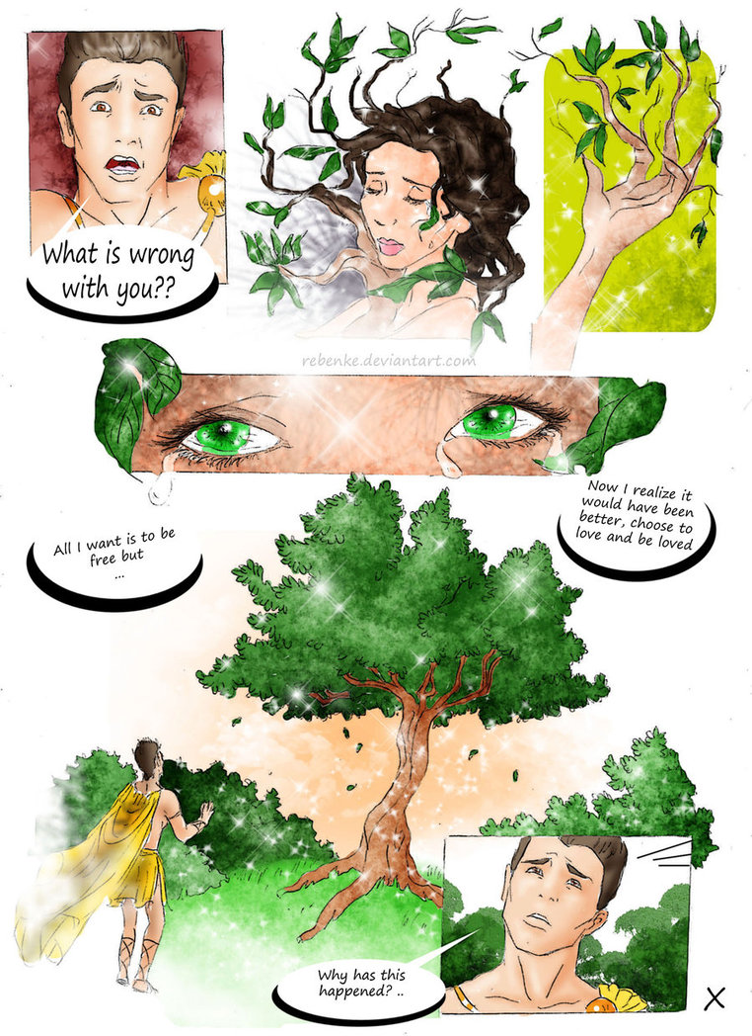

Slide 35
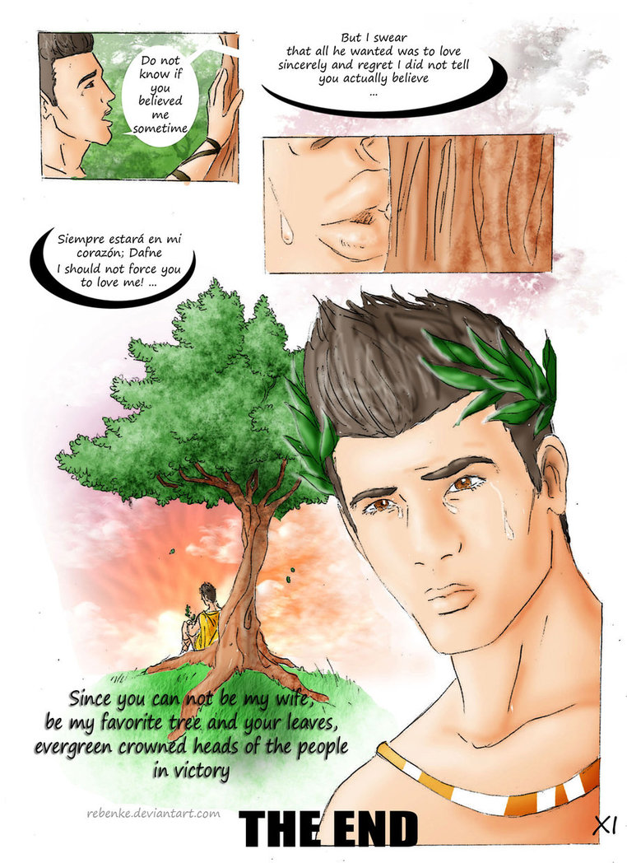

Slide 36
Rebenke
http://pre10.deviantart.net/7594/th/pre/f/2012/240/6/e/daphne_and_apollo_i_by_rebenke-d5c4hem.jpg
http://img14.deviantart.net/963d/i/2012/235/b/a/daphne_and_apollo_ii_by_rebenke-d5c4hiq.jpg
http://pre01.deviantart.net/93e7/th/pre/i/2012/235/e/b/daphne_and_apollo_iii_by_rebenke-d5c4hne.jpg
http://pre00.deviantart.net/b74c/th/pre/i/2012/235/d/9/daphne_and_apollo_iv_by_rebenke-d5c4hsr.jpg
http://pre06.deviantart.net/9bcd/th/pre/i/2012/235/8/f/daphne_and_apollo_v_by_rebenke-d5c4hvg.jpg
http://pre08.deviantart.net/e623/th/pre/i/2012/235/c/3/daphne_and_apollo_vi_by_rebenke-d5c4hy9.jpg
http://pre04.deviantart.net/d5a8/th/pre/i/2012/235/1/a/daphne_and_apollo_vii_by_rebenke-d5c4i1a.jpg
http://pre01.deviantart.net/79ae/th/pre/i/2012/235/5/9/daphne_and_apollo_viii_by_rebenke-d5c4i4m.jpg
http://pre05.deviantart.net/a726/th/pre/i/2012/235/4/2/daphne_and_apollo_ix_by_rebenke-d5c4i8t.jpg
http://pre00.deviantart.net/9b1c/th/pre/i/2012/235/e/f/daphne_and_apollo_x_by_rebenke-d5c4icq.jpg
http://pre01.deviantart.net/fbe2/th/pre/i/2012/235/1/e/dapne_and_apollo_xi_the_end_by_rebenke-d5c4igd.jpg
http://www.deviantart.com/browse/all/?section=&global=1&q=daphne

