Slide 1
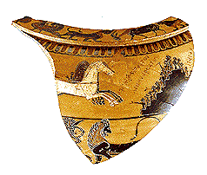
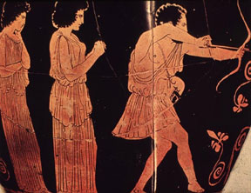
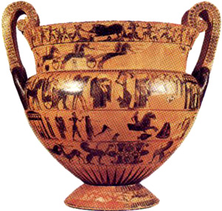
Athletics in Homer

Slide 2
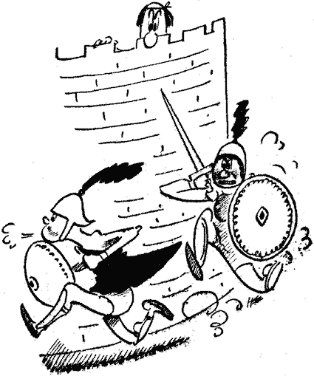
Death of Hector (Iliad XX.159-166)
Thereby they ran, one fleeing, and one pursuing. In front a good man fled, but one mightier far pursued him swiftly; for it was not for beast of sacrifice or for bull's hide [160] that they strove, such as are men's prizes for swiftness of foot, but it was for the life of horse-taming Hector that they ran. And as when single-hooved horses that are winners of prizes course swiftly about the turning-points, and some -- great prize is set forth, a tripod haply or a woman, in honour of a warrior that is dead; [165] even so these twain circled thrice with swift feet about the city of Priam; and all the gods gazed upon them.

Slide 3
Funeral Games of Patroclus. Iliad 23
Chariot Racing
Boxing
Wrestling
Footrace
Combat
Hurling (Pig Iron)
Archery
Spear Throwing

Slide 4
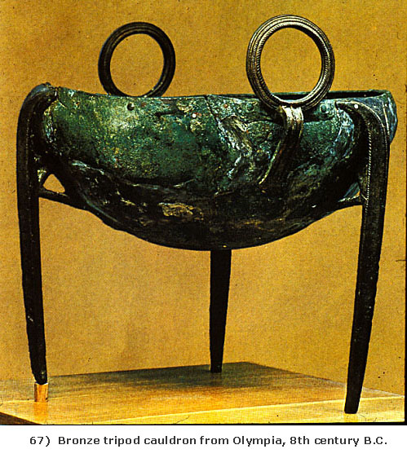
Prizes for the Chariot Race
1st: a woman faultless in her work and a tripod with ears holding 22 measures
2nd a six-year-old unbroken mare carrying an unborn mule foal
A beautiful unfired cauldron holding four measures, still new and shiny
Two gold talents
A two-handled unfired bowl

Slide 5
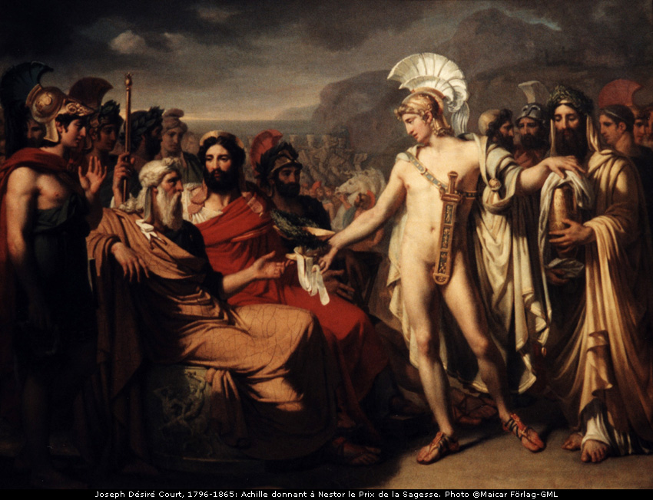
Joseph Court. (1796-1865.
Achilles Giving Nestor the Prize for Wisdom

Slide 7
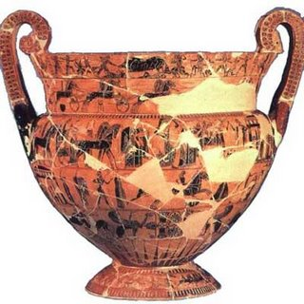
Francois Vase
"The Francois Vase" by Ergotimos and Kleitias is an Attic Black-figure Krater from Chiusi, c.575 B.C. and 26" height. Museo Archaeologico, Florence

Slide 8
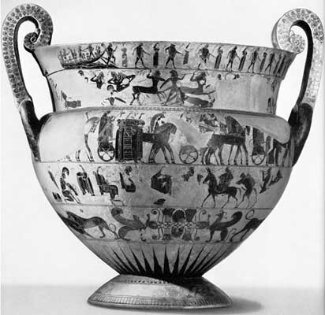
Calydonian Boar Hunt
Chariot Race at Funeral of Patroclus
Marriage of Peleus and Thetis
Theseus on Crete
Battle of Lapiths and Centaurs
Marriage of Peleus and Thetis
Return of Hephaestus

Slide 9
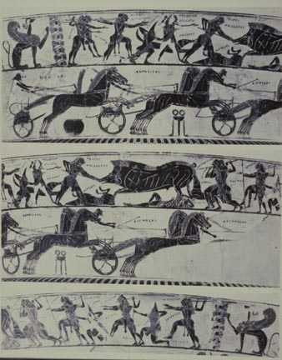
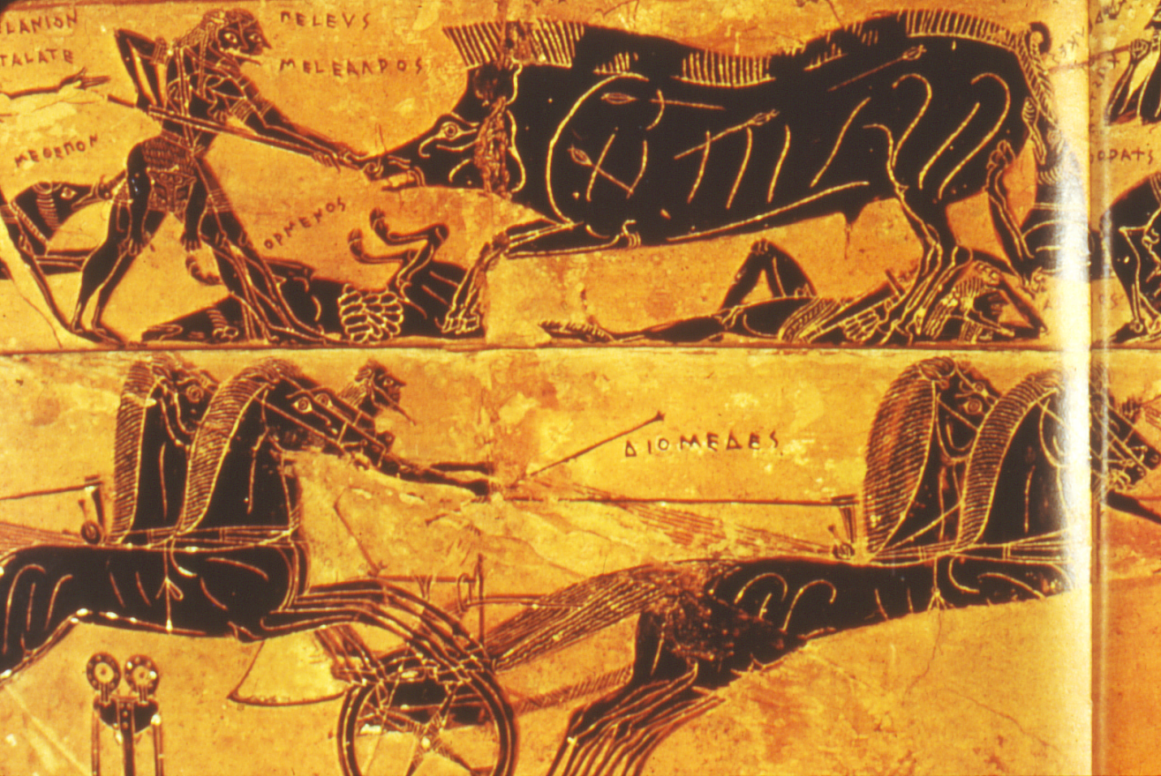

Slide 10
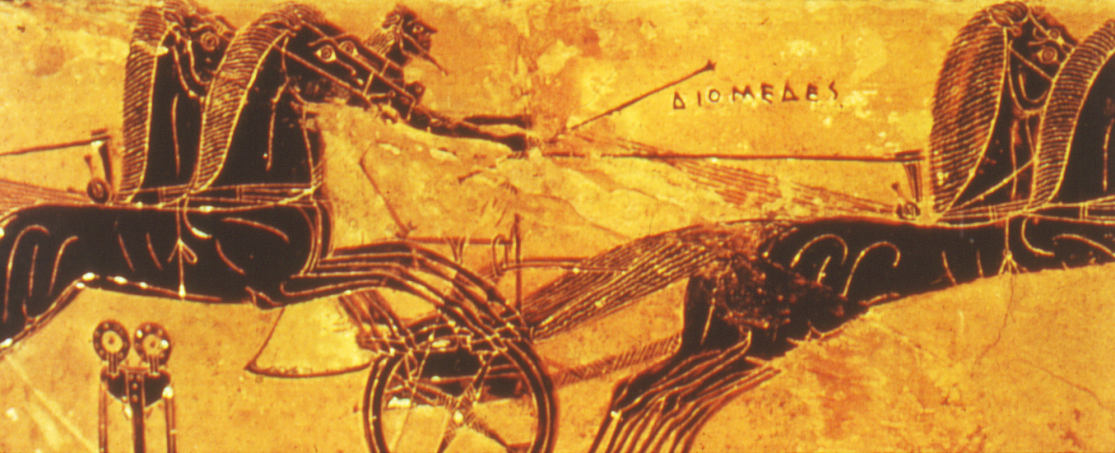
Chariot Race
Diomedes
Antilochos
Menelaos
Meriones
Eumelos

Slide 11
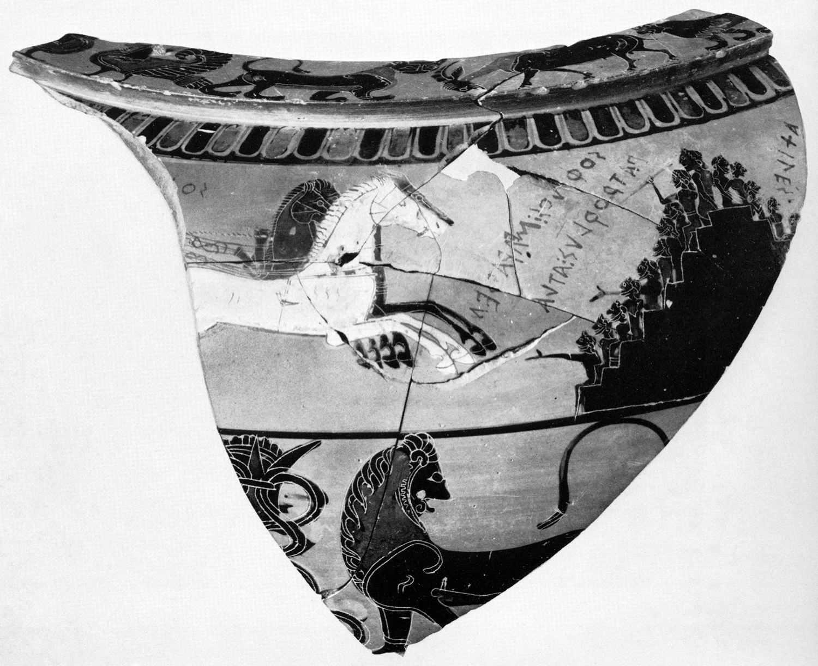

Slide 12
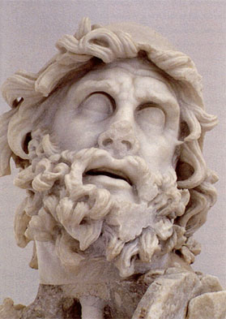
Odysseus
Games on Phaeacia
Odysseus and Iros
Odysseus and the Bow

Slide 13
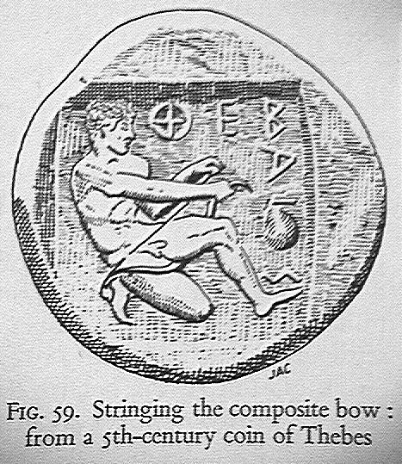

Slide 14
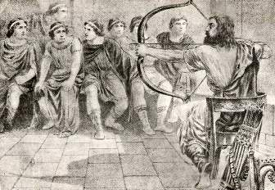

Slide 15
