Slide 1
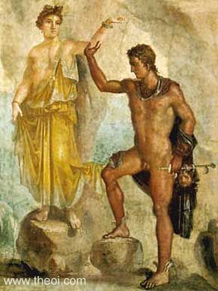
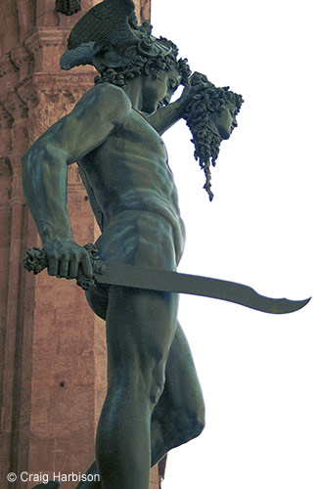
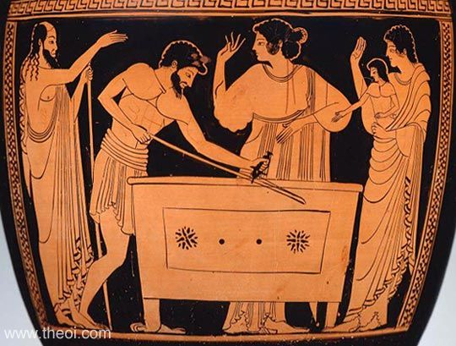
Perseus Danae Andromeda

Slide 2
Folktale Themes
The process of METAMORPHOSIS The Unwanted Child who Survives The Wicked Step-mother/Step-envy The Wicked Uncle The Rival Brothers The Curse on a Family The Curse and the Vendetta The Son's Responsibilities to his Father The Son's Search for his Father The Acquisition of Maturity The Offense against a God or Goddess and its Consequences The Unavoidable Truth of the Oracle The recognition Sign or the Test of Identity The Gift of the Culture Hero The Hero's Quest The Test of the Hero through Perils or Temptation (of irresponsibility, sensuality, violence) The Search for Immortality/the Conquest of Death/ the Descent to the Underworld/ the Harrowing of Hell Finding what is lost Freeing the Oppressed The Man who Returns The Hero's Betrayal of the Princess Rescue of the Princess Rescue by the Heroine (Women to the Rescue)
A Woman's Web A Woman's Wit The Revenge of the Woman Scorned
The Danger of the Feminine Civilization versus Chaos--Justice vs. Injustice--Love vs. Hate The Suitor Contest The Theft of the Bride The Deathly Wedding or the Fatal Marriage The Foundation Legend The Symbol upon which a Life Depends (Life Token) The Symbol upon which a City's Safety Depends The Unwanted or Unlucky Gift The Magical garment The Fatal Choice The Never-ending Punishment The Impossible Task The "Happily-ever-after" Ending Divine hostility/ Divine favor The Magic Spell or Charm The Hero's Loss of favor with his People and/or the Gods Mysterious Death of the Hero
Apotheosis of the Hero (Deification) Ingenious Device or Trick Disobedient Child or Spouse Harmful Curiosity The Solution of a riddle The breaking of a taboo/disobedience to divine instructions The skilled craftsman or possessor of a special talent Intelligence versus Brute Strength The Accidental Murder of a near relative

Slide 3
Perseus Danae Andromeda
Make a list of folktale themes

Slide 4
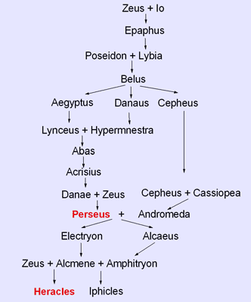

Slide 5
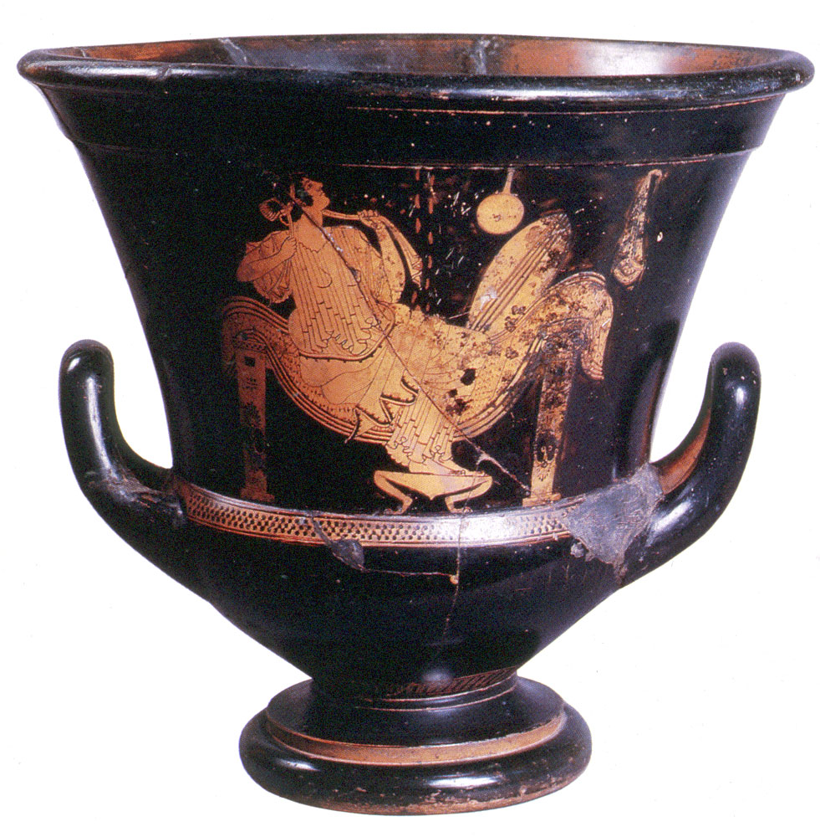
Attic Red-figure kalyx krater by the Triptolemos Painter, c. 490-480 BCE. St. Petersburg.

Slide 6
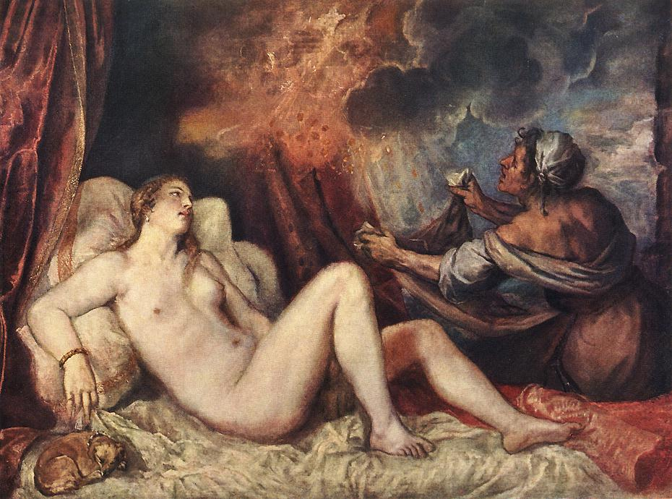
Titian, c. 1560. Kunsthistorische Museum, Vienna.

Slide 7
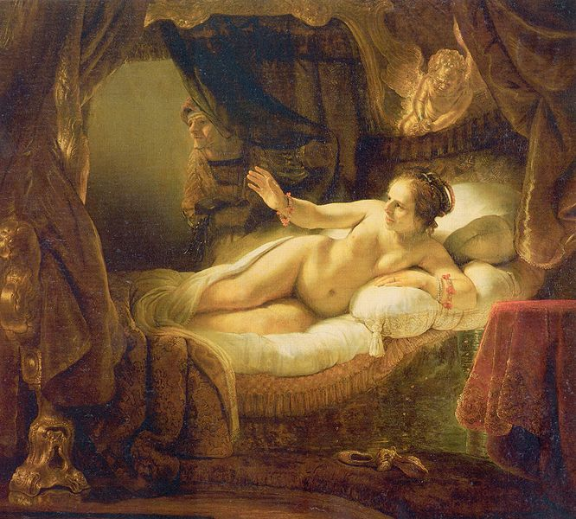
Rembrandt, 1636-1647. Hermitate Museum, St. Petersburg

Slide 8
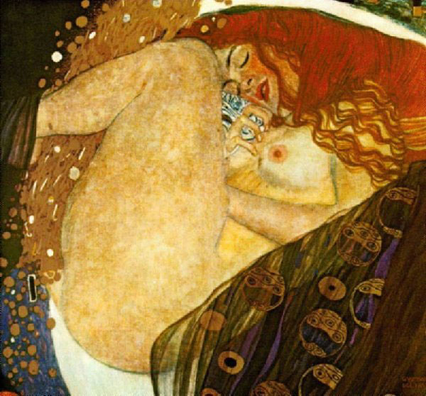
Gustav Klimt, 1907-1908. Private collection, Graz.

Slide 9
Museum Collection: Museum of Fine Arts, Boston, USA Catalogue No.: Boston 13.200 Beazley Archive No.: 202466 Ware: Attic Red Figure Shape: Hydria Painter: Attributed to the Gallatin Painter Date: ca 490 BC Period: Late Archaic

Slide 10
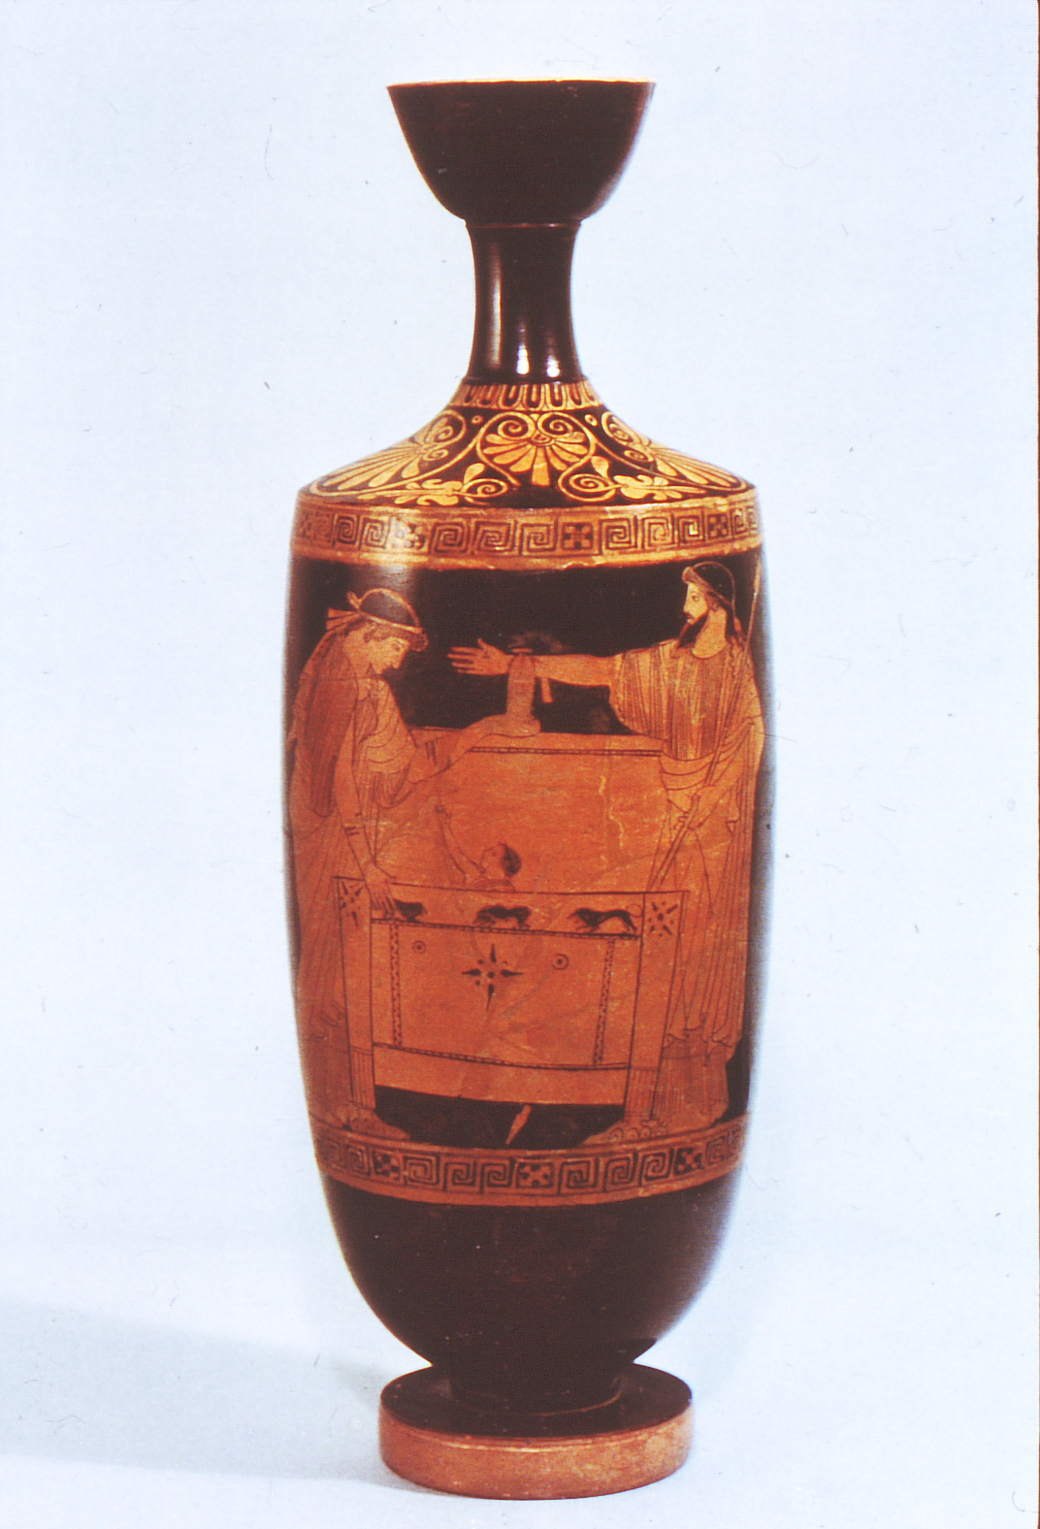
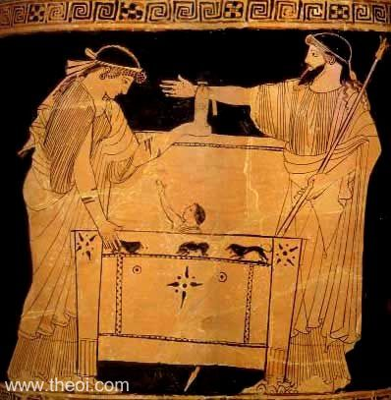
Museum Collection: Toledo Museum of Art, Catalogue No.: Toledo 1969.369 Beazley Archive No.: 694 Ware: Attic Red Figure Shape: Lekythos Painter: Attributed to the Providence Painter Date: ca 480 - 470 BC Period: Early Classical

Slide 11
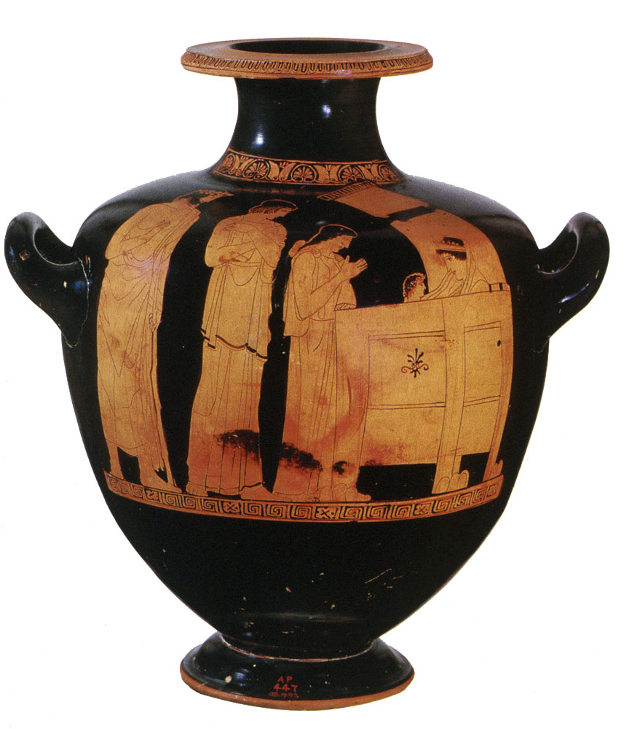
Danae Painter, c. 450 - 440 BCE. Attic hydria. Museum of Fine Arts, Boston.

Slide 12
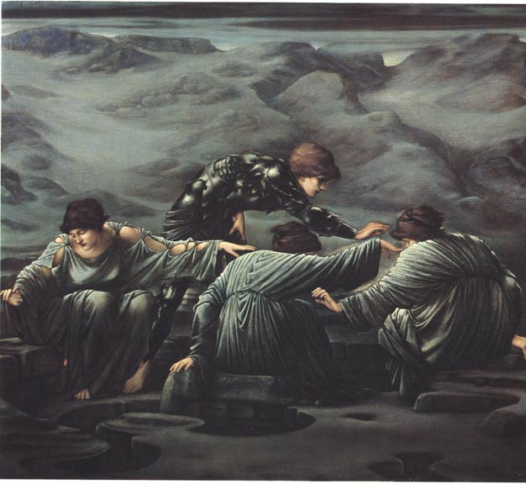
Perseus and the Graiae by Sir Edward Coley Burne-Jones, Bt ARA (1833-1898). Oil on canvas. 1892. [Number 2 in the Perseus Cycle]. Staatsgallerie Stuttgart.

Slide 13
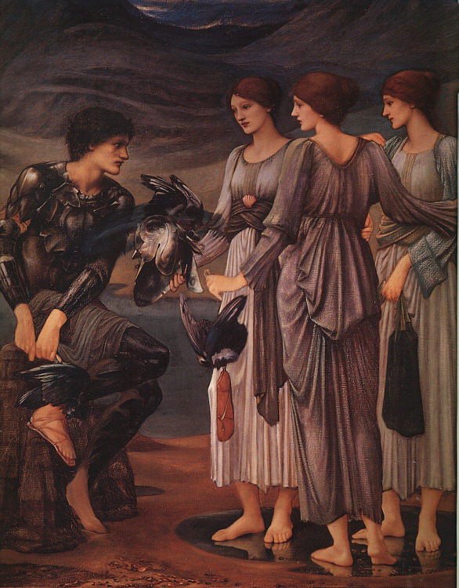
Perseus and the Graiae
Sir Edward Burne-Jones, 1885. Private collection.

Slide 14
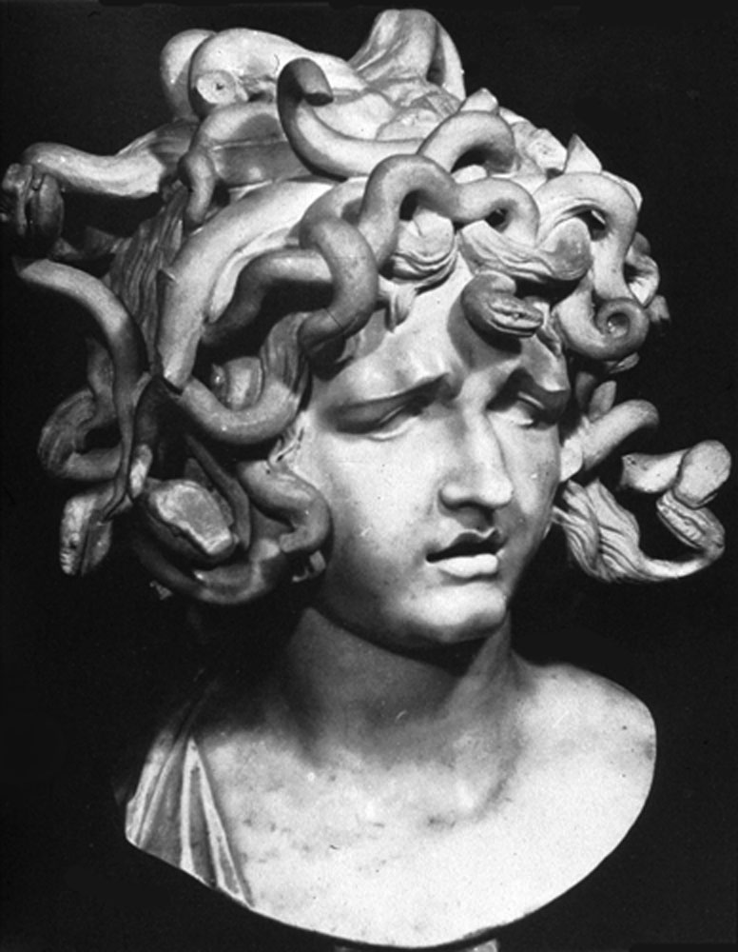
Giancarlo Bernini. Palazzo dei Conservatori, Rome.

Slide 15
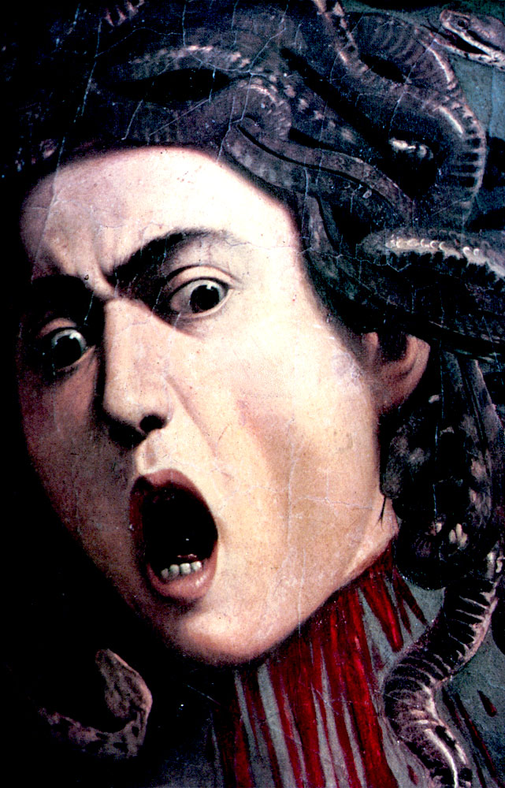
Caravaggio, 1598. Galleria degli Uffizi, Florence.

Slide 16
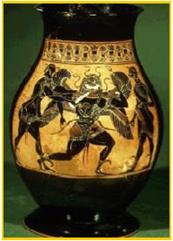
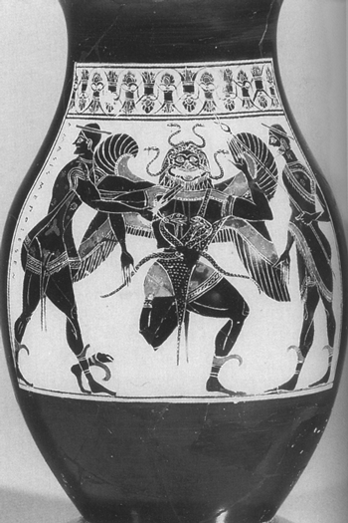
Attic black figure vase, ca. 550 BC.

Slide 17
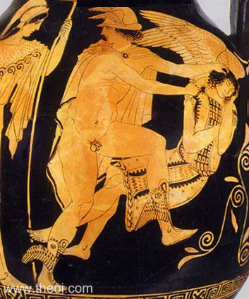
Museum Collection: Metropolitan Museum, New York, USA Catalogue Number: New York 45.11.1 Beazley Archive Number: 213438 Ware: Attic Red Figure Shape: Pelike Painter: Attributed to Polygnotos Date: ca 450 BC Period: Classical

Slide 18
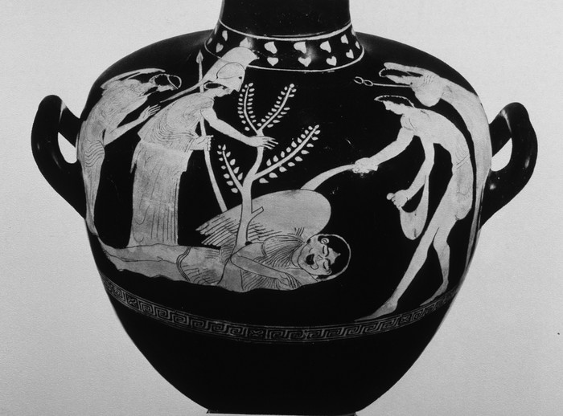
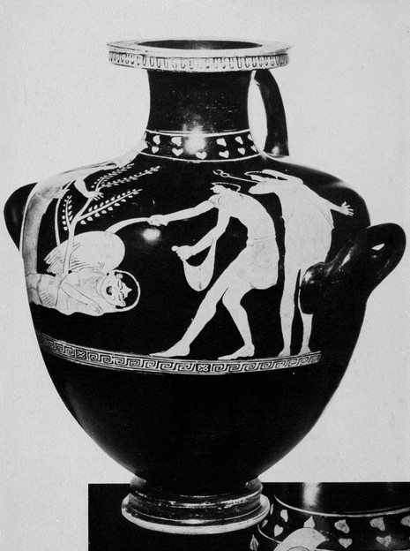
Nausicaa Painter (c. 450-440 BCE) Richmond, Virginia Museum 62.1.1

Slide 19
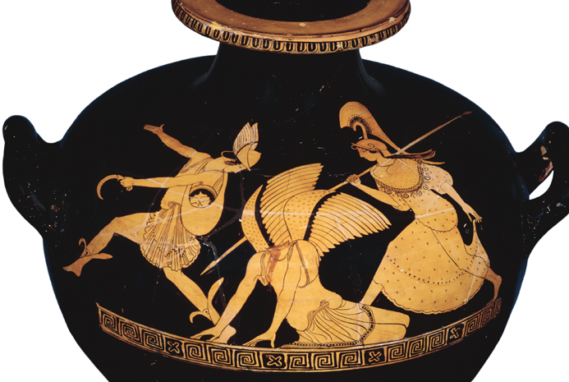
Red-figure amphora, showing the slaying of Medusa by Perseus

Slide 20
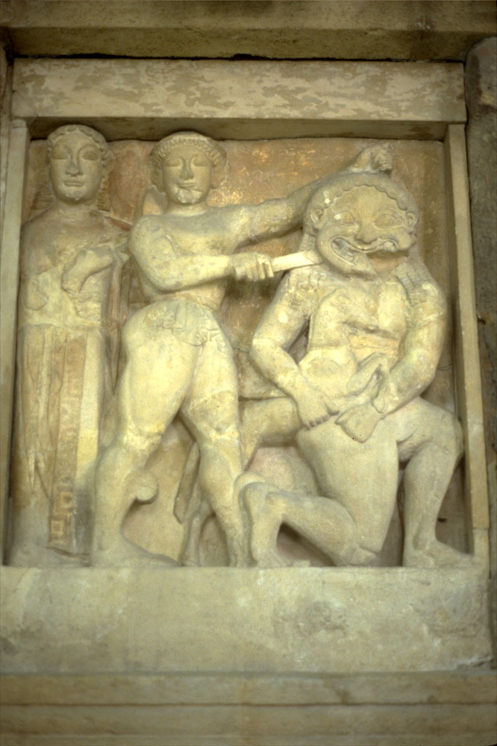
c. 560 - 550 BCE. Metope, Temple C at Selinus (Selinunte). Museo Archeologico, Palermo.

Slide 21
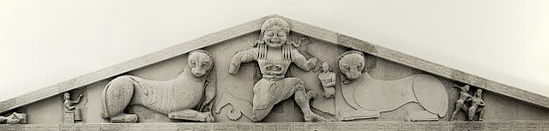
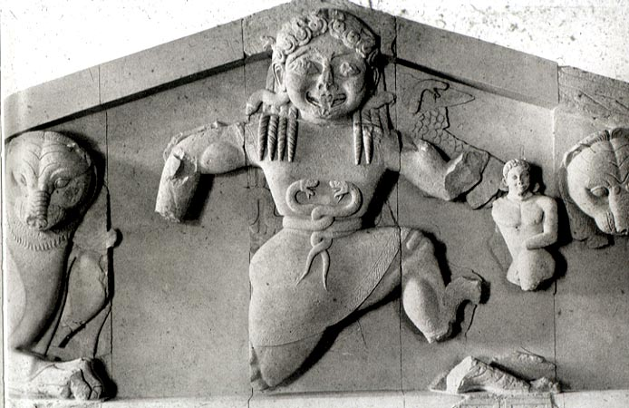
http://www.mlahanas.de/Greeks/Arts/ArtemisCorfuTemple.htm
Birth of Pegasus and Crysaor c. 580 BC. Temple Pediment, Corfu Selinus

Slide 22
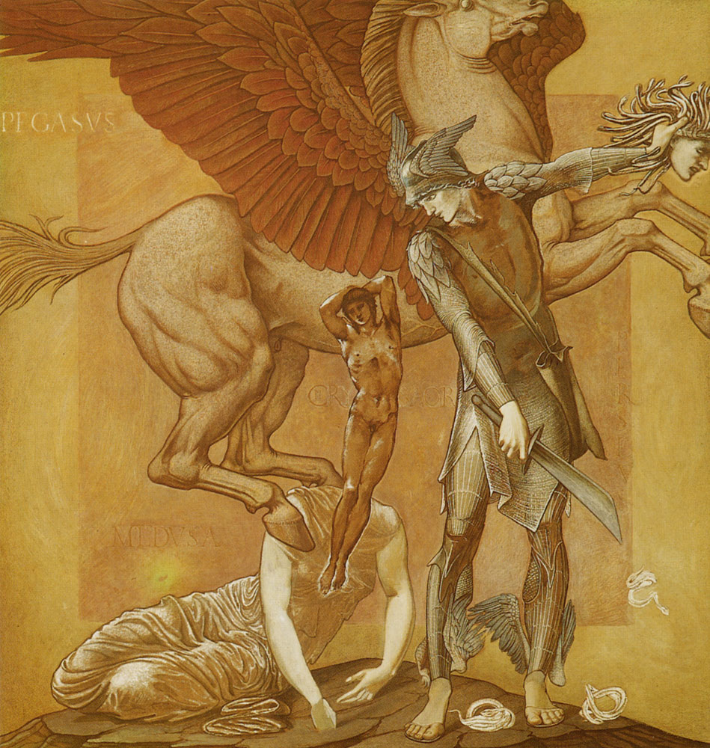
The Birth of Pegasus and Chrysaor from the blood of Medusa. Sir Edward Burne-Jones, 1876-1885. Southampton City Art Gallery.

Slide 23
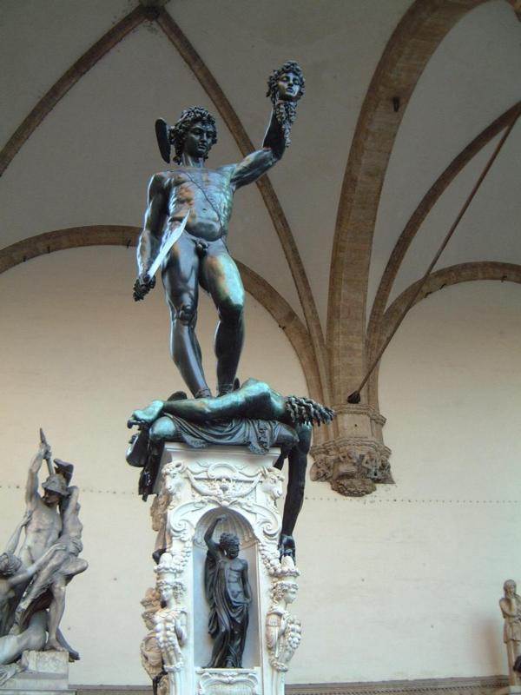
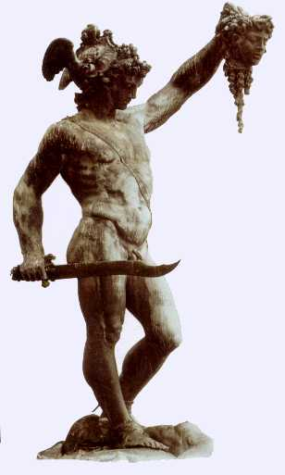
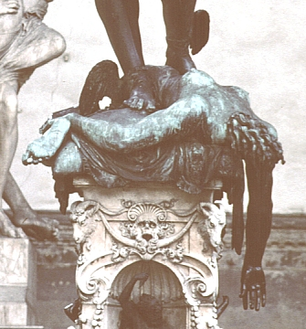
Perseus Beheading Medusa
Benvenuto Cellini
1645-1554
Loggia dei Lanzi, Florence
Bronze
18 feet high

Slide 24
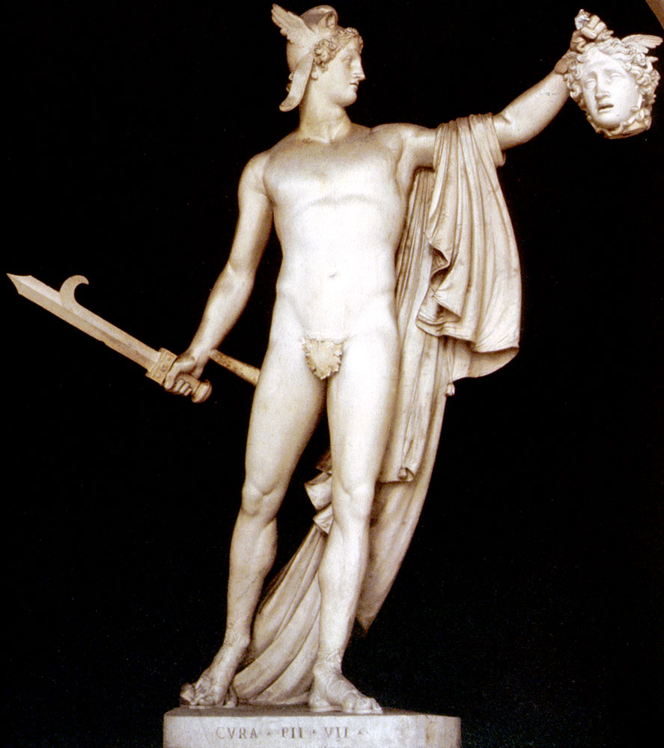
Antonio Canova, 1804-1808. Metropolitan Museum of Art, New York.

Slide 25
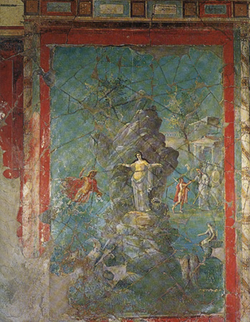
Perseus Liberating Andromeda, Pompeii.

Slide 26
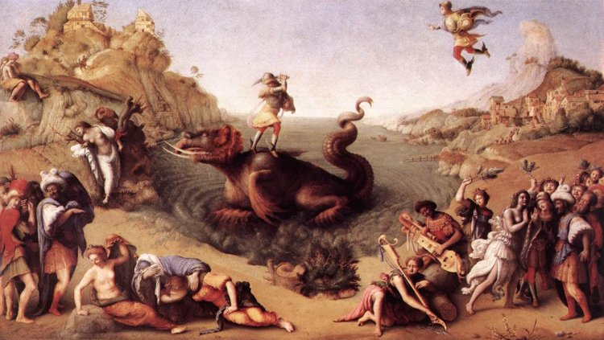
Andromeda
PIERO DI COSIMO. Perseus Frees Andromeda c. 1515 (Galleria degli Uffizi, Florence)

Slide 27
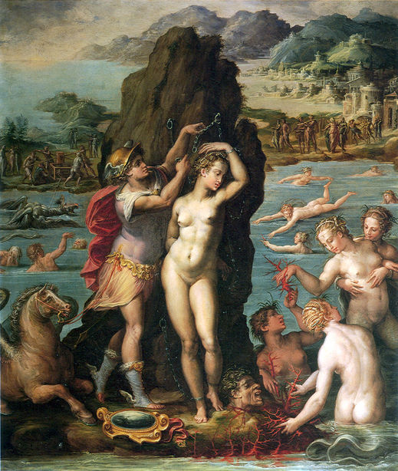
Andromeda
Perseus and Andromeda
Giorgio Vasari 1570-1572 Oil on slate, 45 ½ x 34’’ Florence, Palazzo Vecchio, Studiolo

Slide 28
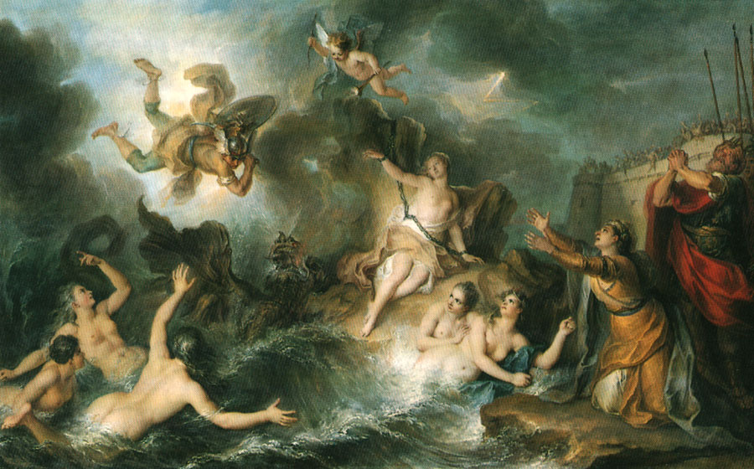
Charles-Antoine Coypel, c. 1726-1727. Musée du Louvre, Paris.

Slide 29
Museum Collection: Museo Archeologico Nazionale di Napoli, Naples, Italy Catalogue Number: TBA Type: Fresco, Imperial Roman Period: Imperial Roman

Slide 30
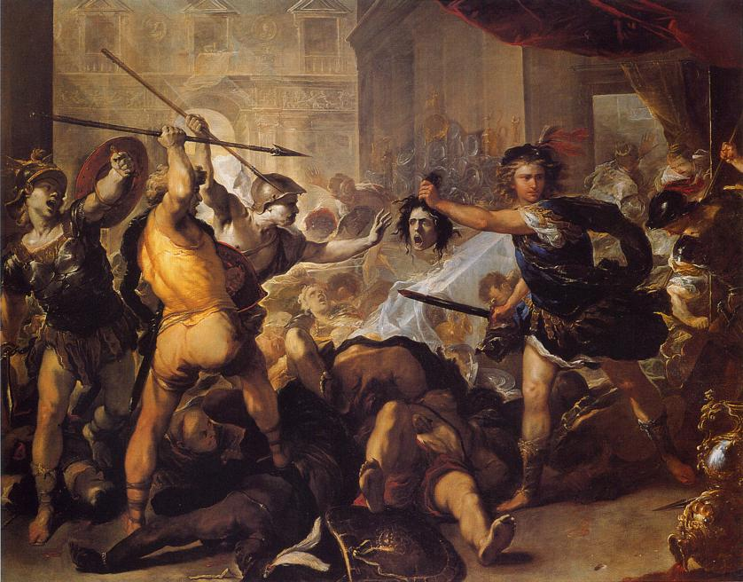
Lu
Luca Giordano “Perseus turning Phineas to Stone”
Early 1680s National Gallery London

Slide 31
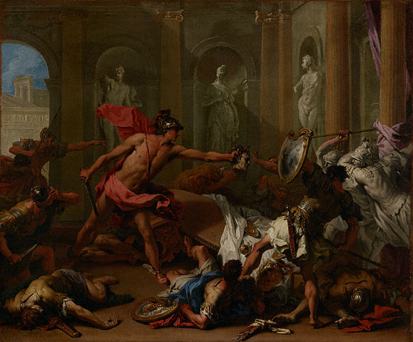
Sebastiano Ricci Italian, about 1705 - 1710 Oil on canvas 25 3/16 x 30 5/16 in. Getty Museum http://www.getty.edu/art/gettyguide/artObjectDetails?artobj=914

Slide 32
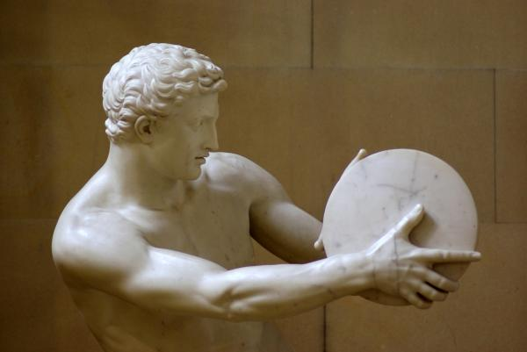
Death of Acrisius

Slide 33
Folktale Themes
The process of METAMORPHOSIS The Unwanted Child who Survives The Wicked Step-mother/Step-envy The Wicked Uncle The Rival Brothers The Curse on a Family The Curse and the Vendetta The Son's Responsibilities to his Father The Son's Search for his Father The Acquisition of Maturity The Offense against a God or Goddess and its Consequences The Unavoidable Truth of the Oracle The recognition Sign or the Test of Identity The Gift of the Culture Hero The Hero's Quest The Test of the Hero through Perils or Temptation (of irresponsibility, sensuality, violence) The Search for Immortality/the Conquest of Death/ the Descent to the Underworld/ the Harrowing of Hell Finding what is lost Freeing the Oppressed The Man who Returns The Hero's Betrayal of the Princess Rescue of the Princess Rescue by the Heroine (Women to the Rescue)
A Woman's Web A Woman's Wit The Revenge of the Woman Scorned
The Danger of the Feminine Civilization versus Chaos--Justice vs. Injustice--Love vs. Hate The Suitor Contest The Theft of the Bride The Deathly Wedding or the Fatal Marriage The Foundation Legend The Symbol upon which a Life Depends (Life Token) The Symbol upon which a City's Safety Depends The Unwanted or Unlucky Gift The Magical garment The Fatal Choice The Never-ending Punishment The Impossible Task The "Happily-ever-after" Ending Divine hostility/ Divine favor The Magic Spell or Charm The Hero's Loss of favor with his People and/or the Gods Mysterious Death of the Hero
Apotheosis of the Hero (Deification) Ingenious Device or Trick Disobedient Child or Spouse Harmful Curiosity The Solution of a riddle The breaking of a taboo/disobedience to divine instructions The skilled craftsman or possessor of a special talent Intelligence versus Brute Strength The Accidental Murder of a near relative

