Slide 1
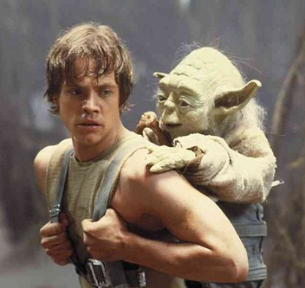
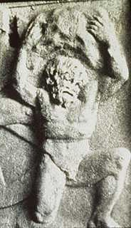
What is Myth?
Who is Sisyphus?
What is a Sisyphean Task?
Why is the study of myth a Sisyphean Task?
How is Star Wars a Myth? A Sisyphean Task?
“So certain are you. Always with you it cannot be done.
Hear you nothing that I say?”
– Yoda, from The Empire Strikes Back.

Slide 2
What is a Myth?
Myth is:

Slide 3
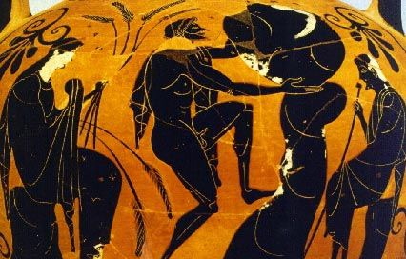
Who is Sisyphus?
What is a Sisyphean Task?
Hyginus: #60
Apollodorus 1.9.3
Achelous Painter
late 6th century BC

Slide 4
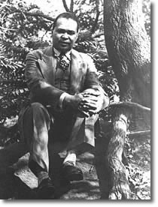
A Poetic Sisyphean Task
Yet Do I Marvel
by Countee Cullen (1903-1946)
I doubt not God is good, well-meaning, kind,
And did He stoop to quibble could tell why
The little buried mole continues blind,
Why flesh that mirrors Him must someday die,
Make plain the reason tortured Tantalus
Is baited by the fickle fruit, declare
If merely brute caprice dooms Sisyphus
To struggle up a never-ending stair.
Inscrutable His ways are, and immune
To catechism by a mind too strewn
With petty cares to slightly understand
What awful brain compels His awful hand.
Yet do I marvel at this curious thing:
To make a poet black, and bid him sing.

Slide 5
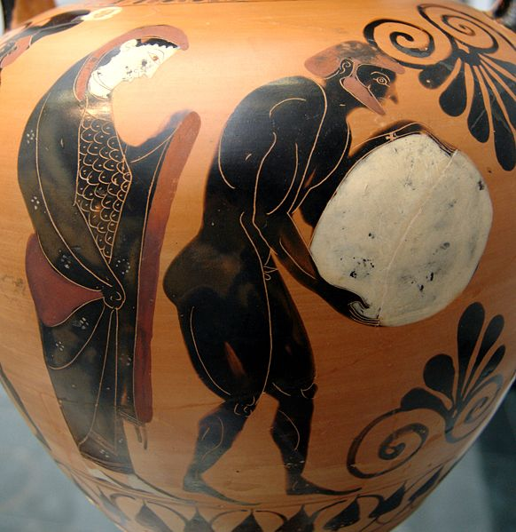
Why is the study of myth a Sisyphean Task?
Achelous Painter
late 6th century BC
Persephone supervising Sisyphus in the Underworld, Attic black-figure amphora, ca. 530 BC, Staatliche Antikensammlungen (Inv. 1494)
Notes:
But before we consider modern adaptations and uses of the myths of these sinners, a quick survey of some ancient visual treatments of these myths is in order. One early representation of Sisyphus is the one on the left, a detail from a vase by the Archelous Painter in which Persephone supervises as Sisyphus pushes his rock. A similar scene appears on the right in a detail from an Attic black-figure amphora.

Slide 6
Why is the study of myth a Sisyphean Task?

Slide 7
Why is the study of myth a Sisyphean Task?
Subject matter of myth
Myth and History
Universality
Myths as Lies
Myths as Truth
Myth as Religion
Myth, Ritual and Ceremony
Myth and Media
Myth and Geography

Slide 8
How is Star Wars a Myth?
How is studying Star Wars a Sisyphean Task?
Subject matter of myth
Myth and History
Universality
Myths as Lies
Myths as Truth
Myth as Religion
Myth, Ritual and Ceremony
Myth and Media
Myth and Geography

