Slide 1
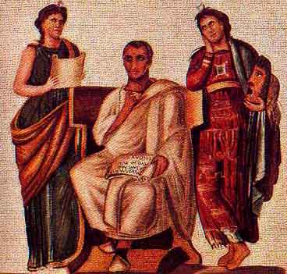
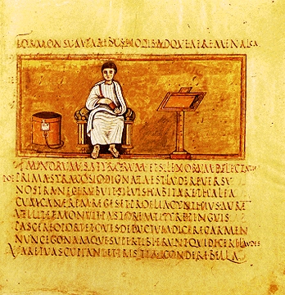
Aeneas
Vergil’s Aeneid
29-19 B.C.

Slide 2
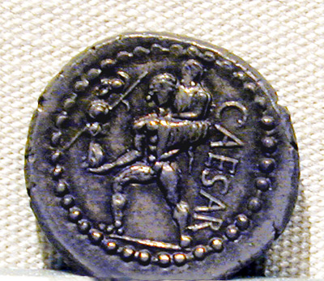
Roman Nationalism
denarius of Julius Caesar: 47-46 BC Aeneas leaves Troy carrying Anchises and Palladium

Slide 3
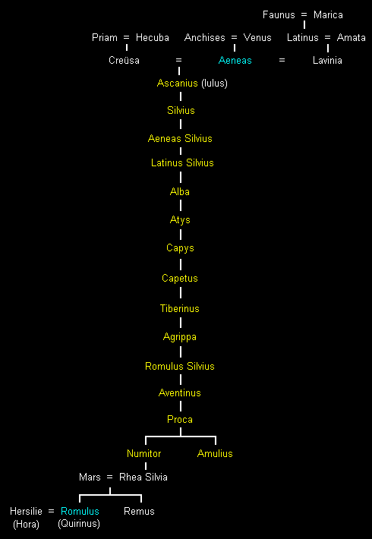
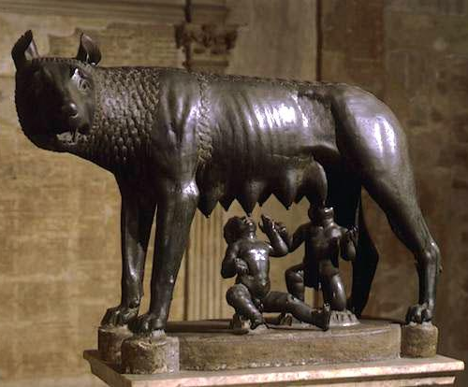
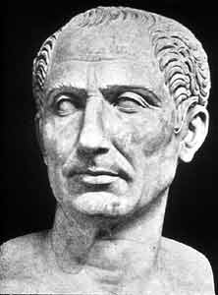
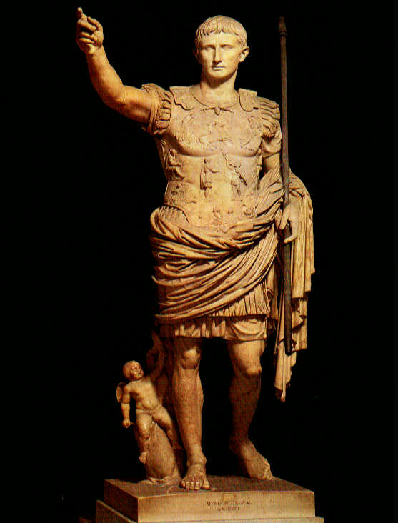

Slide 4
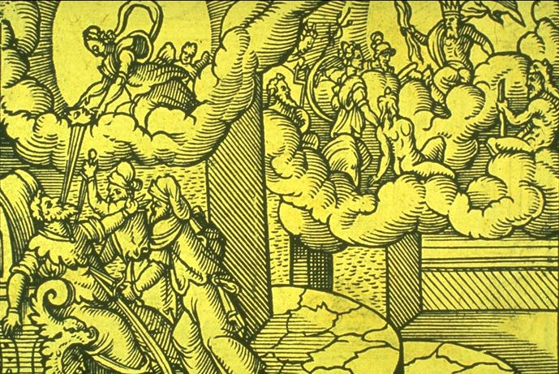
Apotheosis of Julius Caesar

Slide 5
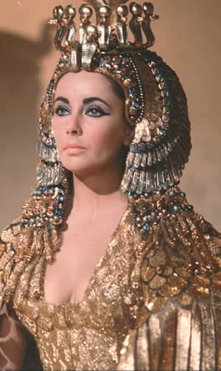
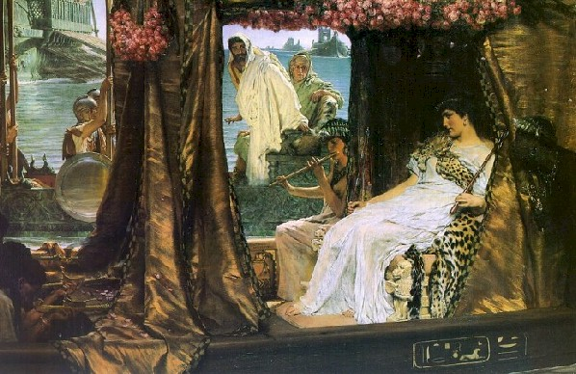
Actium (31 B.C.)
Alma-Tadema (1836-1912)
Antony and Cleopatra at Actium

Slide 6
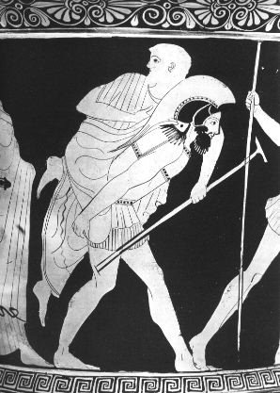
Aeneas as Hero
Some Definitions of "Hero" Lord Raglan's Hero Pattern The Hero Pattern applied to Women in Myth, History, and Literature The Hero Quest Stages in the Heroic Quest Variations on the Theme of the Heroic Quest Other Hero Patterns

Slide 7
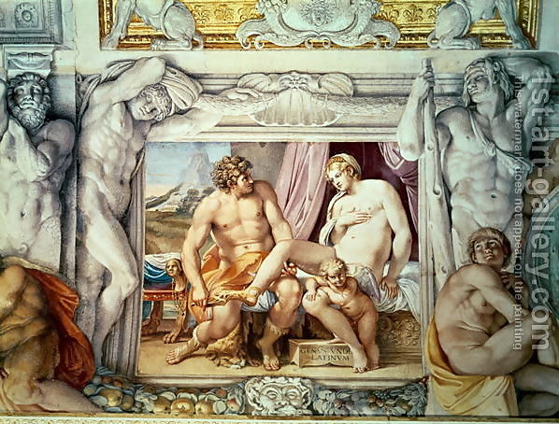
Venus and Anchises
Annibale Carracci
(1560-1609)

Slide 8
Vergil’s Aeneid
Book I: Aeneas Arrives in Carthage (in medias res)
Book II: Flashback to Fall of Troy (flashback)
Book III: Travels of Aeneas (Odyssey)
Book IV: Aeneas and Dido
Book V: Journey to Italy
Book VI: Journey to Underworld (catabasis)
Books VII-XII: War in Italy (Iliad)
More detailed outlines: http://www.uky.edu/AS/Classics/aeneidout.html
http://www.unbsj.ca/arts/classics/courses/clas1502/aenout.html

Slide 9
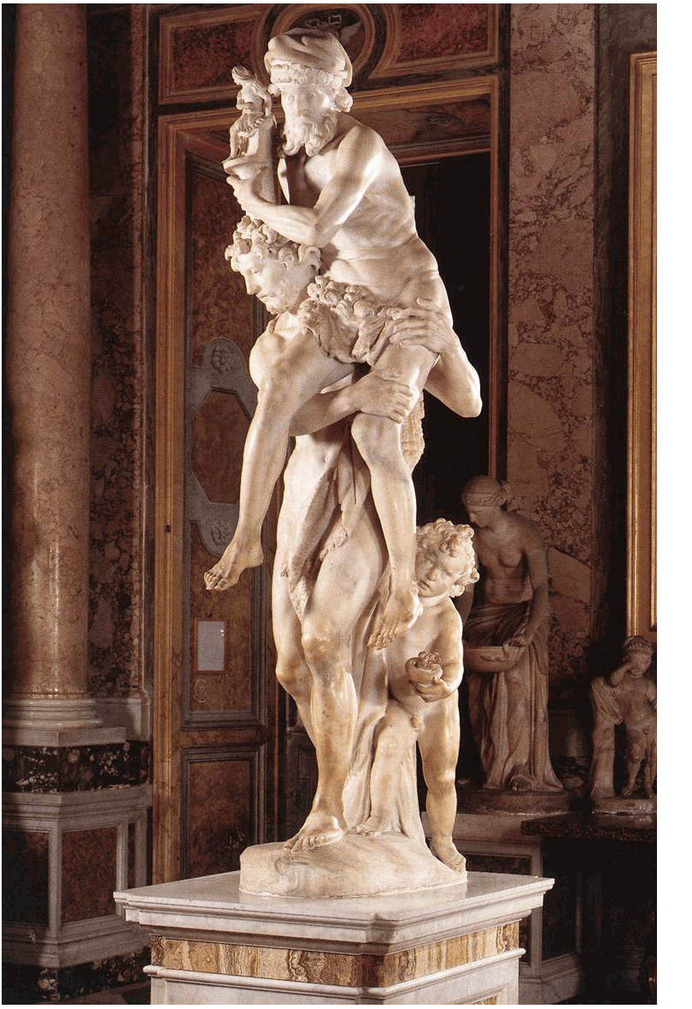
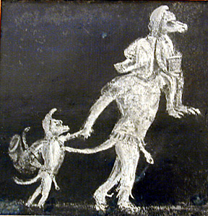
Pietas
Bernini, Gianlorenze Aeneas, Anchises, and Ascanius (1618-19) White marble, height 86 5/8" (220 cm) Galleria Borghese, Rome

Slide 10
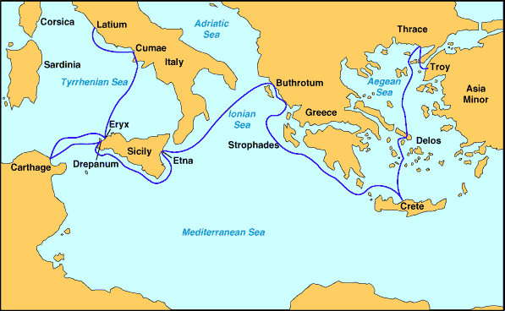
Travels of Aeneas

Slide 11
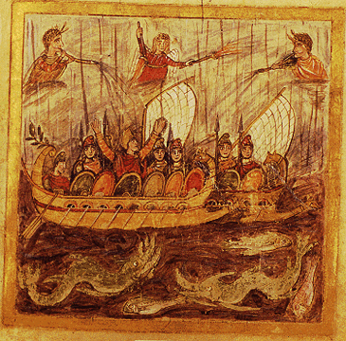
Aeneid I

Slide 12
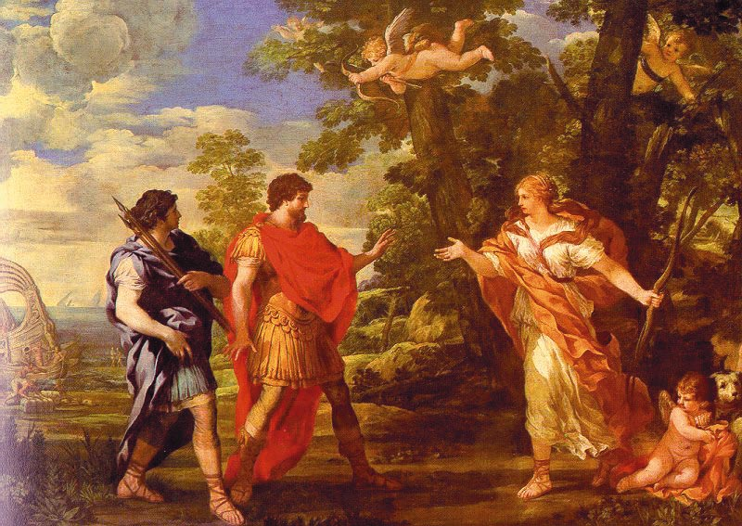
Aeneid I
PIETRO DA CORTONA (1596-1669) Venus as Huntress Appears to Aeneas

Slide 13
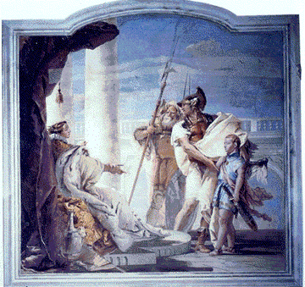
Aeneid I
Artist: G. B. Tiepolo
Date: 1757
Title: Aeneas and Venus
Artist: G. B. Tiepolo
Date: 1757
Title: Aeneas Presents Cupid in the Form of Ascanius to Dido

Slide 14
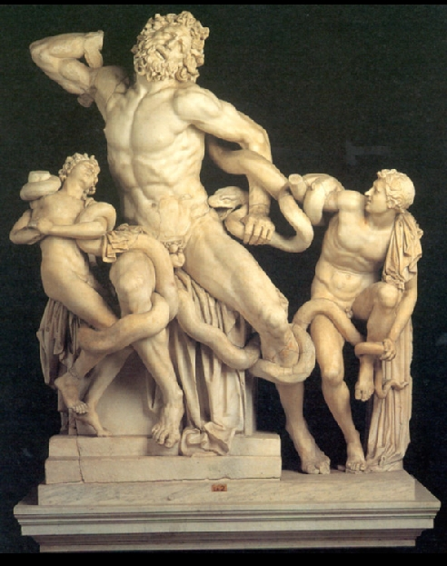
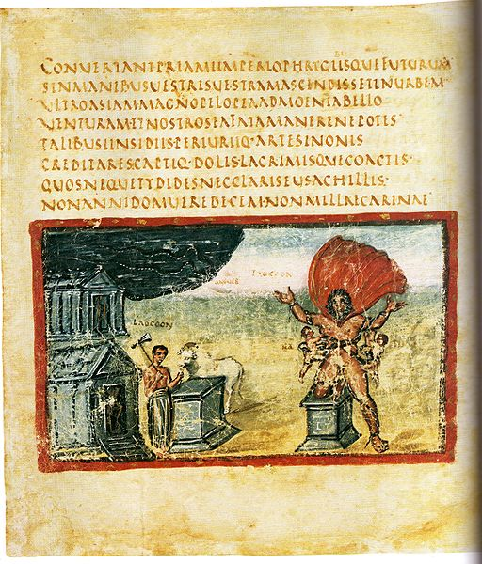
Death of Laocoon
Laocoon and His Sons, Hellenistic Greek, early 1st century, in Vatican Museums, Rome, by Athanadoros, Hagesandros, and Polydoros of Rhodes

Slide 15
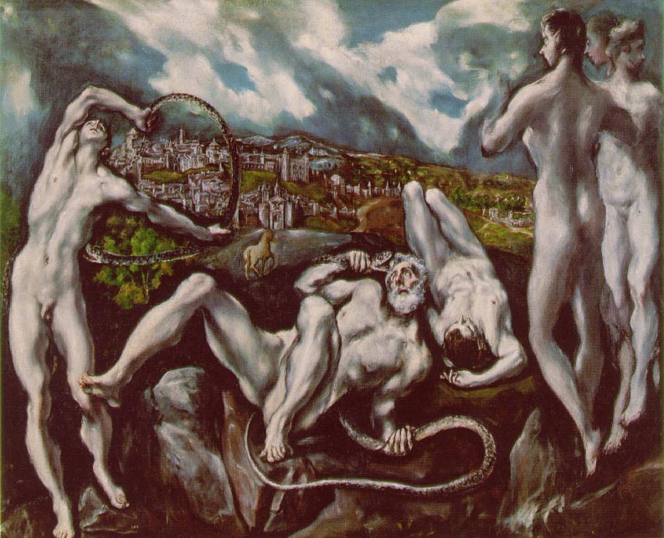
El Greco / Laocoon

Slide 16
Aeneid IV
Artist: J. M. W. Turner
Title: Dido and Aeneas Leaving Carthage on the Morning of the Chase
Date: 1814

Slide 17
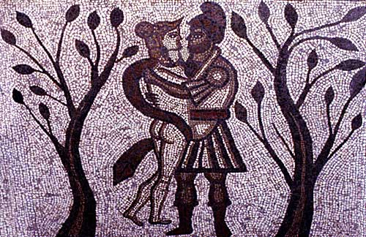
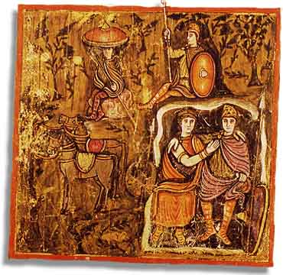
Aeneid IV
Dido and Aeneas take refuge from a storm in the cave. The scene is taken from a fourth century AD mosaic from Low Ham Roman villa, Somerset, which depicts several episodes from Virgil's Aeneid
The Vergilius Romanus: the first British book? Vergil MS Vat. lat. 3867= Romanus

Slide 18
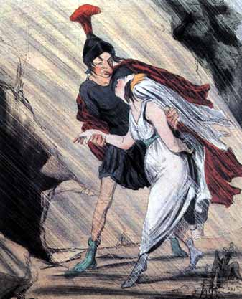
Honoré Daumier

Slide 19
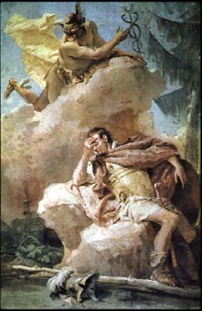
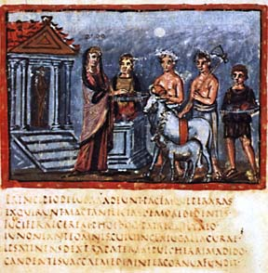
Artist: G. B. Tiepolo
Title: Mercury Appearing to Aeneas
Date: 1757

Slide 20
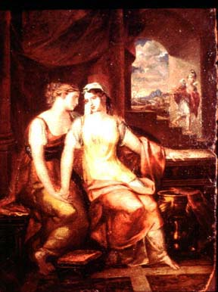
Artist: Washington Allston
Title: Dido and Anna
Date: 1813

Slide 21
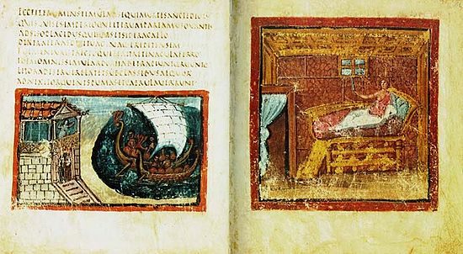

Slide 22
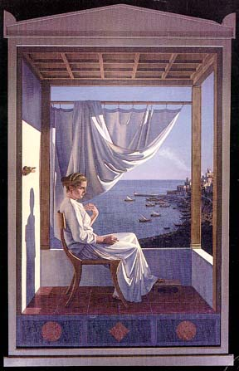
Artist: Ligare, David
Title: Dido Resolved

Slide 23
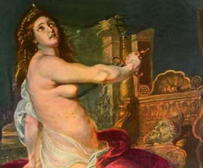
Artist: Peter Paul Rubens
Title: The Death of Dido
Date: 1635

Slide 24
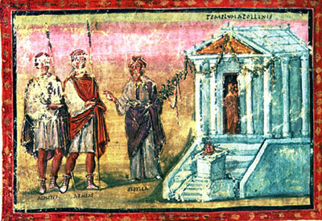
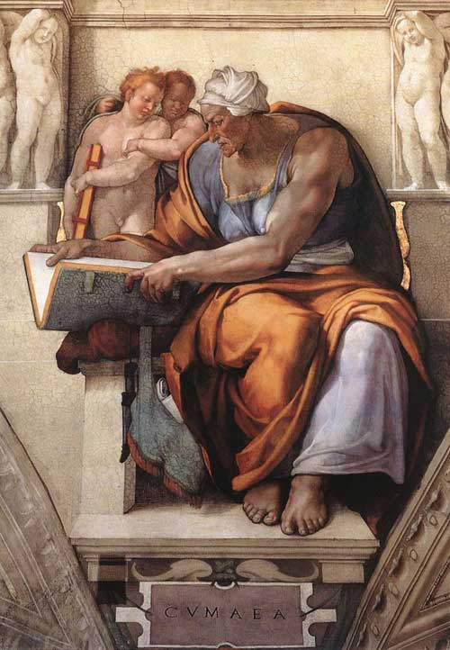
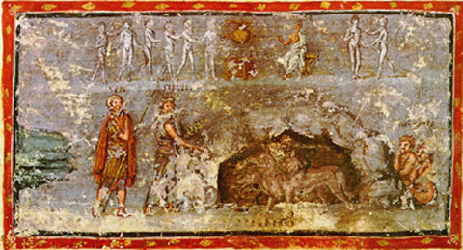
This fifth century manuscript illumination shows Aeneas and his guide, the Sibyl.
A manuscript illumination of the Sibyl putting Cerberus to sleep to lead Aeneas to the different groups of the dead.
Cumaean Sibyl Michelangelo. Sistine Chapel

Slide 25
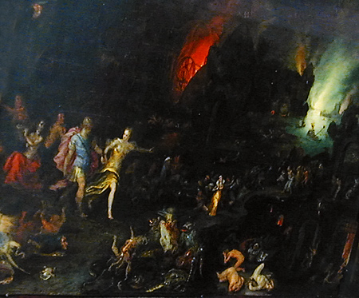
Jan Breughel II (1601-1678)
Sibyl leading Aeneas through the Underworld,
http://www.vroma.org/~bmcmanus/thesaurusimages.html

Slide 26
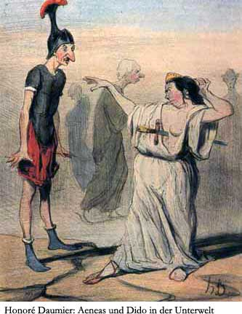

Slide 27
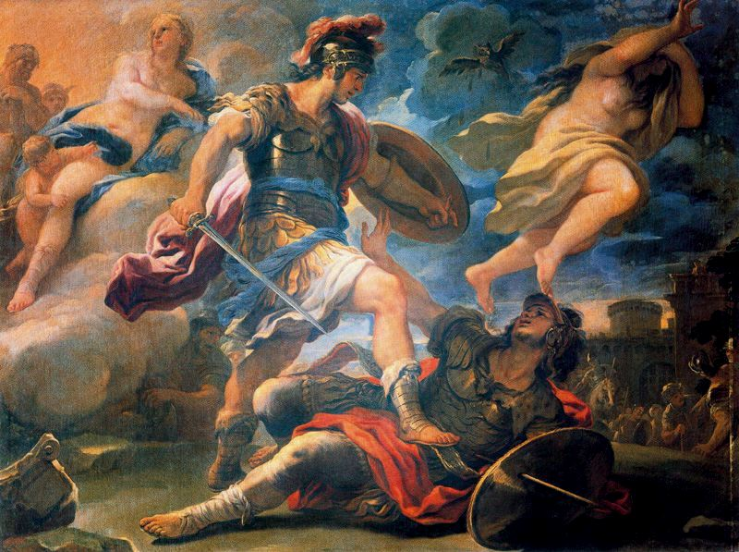
Luca Giordano (1634(1634)–1705(1705))
Death of Turnus

