Slide 1
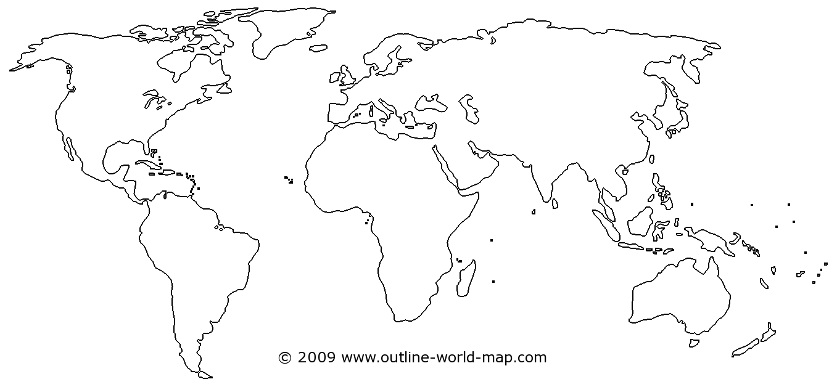

Slide 2
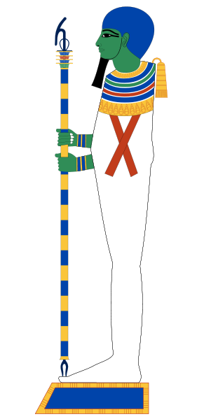
Where was this god worshipped?
5
Greece
Rome
Egypt
North America
10
0
Mean =

Slide 4
Who is this Egyptian god?
30
Ptah
Osiris
Horus
Ra
10
0
Mean =

Slide 5
Ptah is the Egyptian god of the:
5
sun
moon
sky
primordial mound
10
0
Mean =

Slide 6
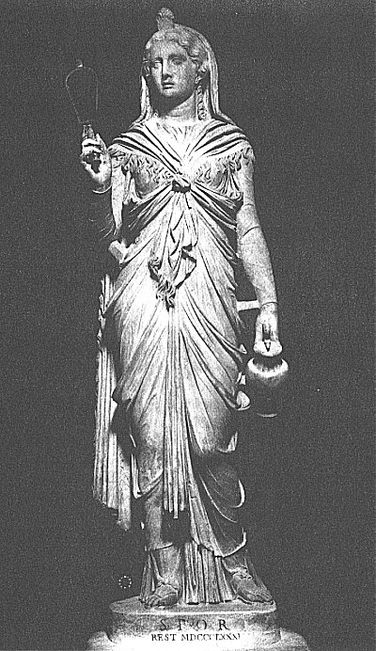
Who is this goddess?
30
Nun
Osiris
Isis
Nephthys
10
0
Mean =

Slide 7
Which of these cities was not a regligious cult center in ancient Egypt?
30
MEMPHIS
HELIOPOLIS
ALEXANDRIA
HERMOPOLIS
THEBES
10
0
Mean =

Slide 8
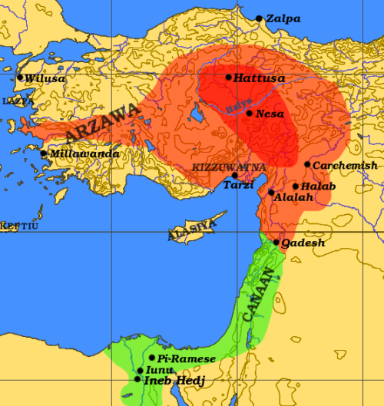
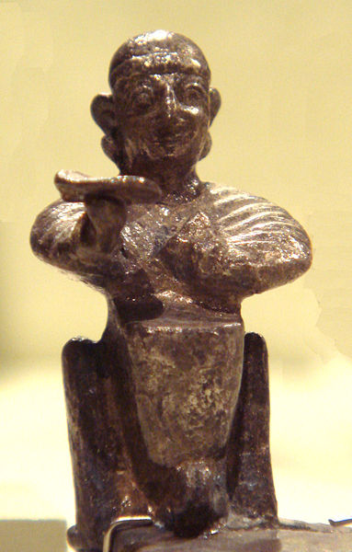
Hittites
Seated Hittite Deity
13th Cent. B.C
MET NYC
Telepinu

Slide 9
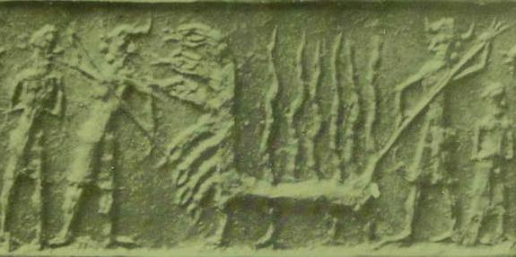
Babylonian Creation Stories
anthropomorphic gods
Babylon
Mesopotamia
polytheism
Enuma Elish
Apsu
Tiamat
Marduk
Ishtar

Slide 10
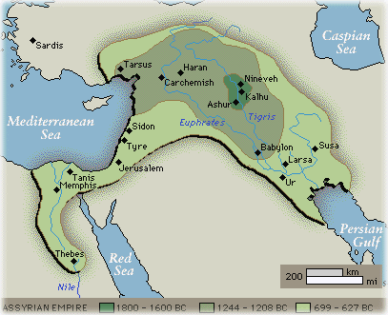
Babylon
Babylonian refers to any of the peoples who occupied Mesopotamia from the days of the early Sumerians and Akkadians, right through to 539 BC, when Babylon fell to the Persian leader Cyrus. Mesopotamia refers to the land around the Tigris and Euphrates rivers which is now part of modern Iraq
Source: http://home.no.net/torawo/skole/samfunnsfag/mesopotamia.htm

Slide 11
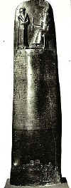
Babylonians
had an advanced and prosperous civilization
lived in cities
wrote in cuneiform: business records as well as literature and law
were ruled by Hammurabi: 1760 BCE
http://ragz-international.com/babylonia.htm

Slide 12
Science of the Babylonians
had considerable engineering knowledge and skill which they used in the preparation of maps, surveys, and plans involved the use of leveling instruments and measuring rods
observed the heavens in a detailed and accurate manner over many centuries.

Slide 13
Science of the Babylonians (2)
had a base-60 place value system
used fractions for calculations in base sixty
they used a year of 12 months and a week of 7 days, and also originated the division of the day into hours, minutes, and seconds
developed an extensive algebra which allowed them to solve quadratic equations as well as both third and fourth order equations, and als and simultaneous equations in several unknowns. They had an effective algorithm for computing square roots, and generated a remarkable approximation to √2. Using their version of log tables they solved problems in compound interest using linear interpolation.

Slide 14
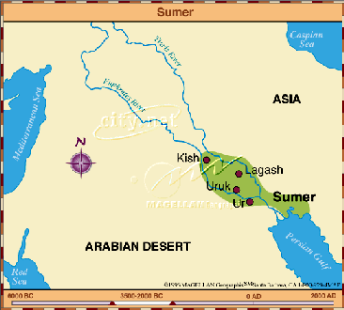
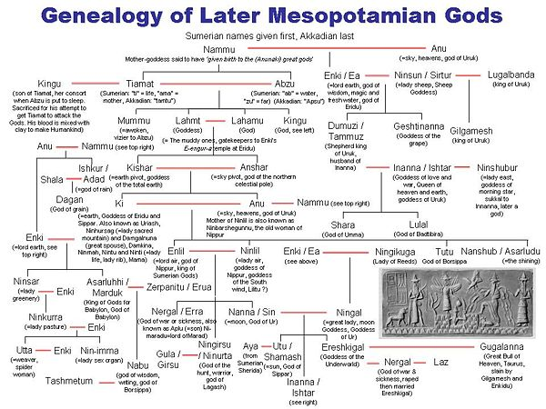
Mesopotamian gods slay a fiery seven-headed dragon. The image is from a cylinder seal (cf. fig.16.Alexander Heidel. The Babylonian Genesis, The Story of Creation. 1942, 1951. University of Chicago Press. Reprint 1993)

Slide 15
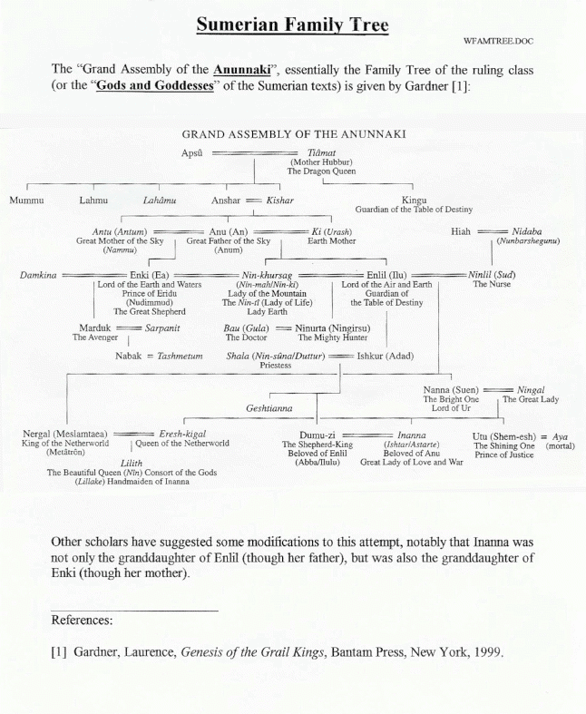

Slide 16
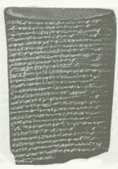
Enuma Elish
The Babylonian creation story is found in an epic poem from the second millennium BCE titled the
Enuma Elish (=“when in the height”)
http://www.sacred-texts.com/ane/enuma.htm

Slide 17
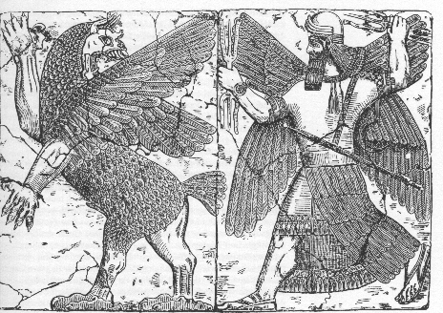
Cosmology of the Babylonians
creation takes place in a watery waste
mingling of Apsu (sweet water) and Tiamat (salt water)
The god Marduk makes the earth from the body of Tiamat, a monster he kills
The heavens are formed from her upper part and the waters are the liquids which flowed from her veins
http://www.goetter-und-mythen.de/marduk.htm

Slide 18
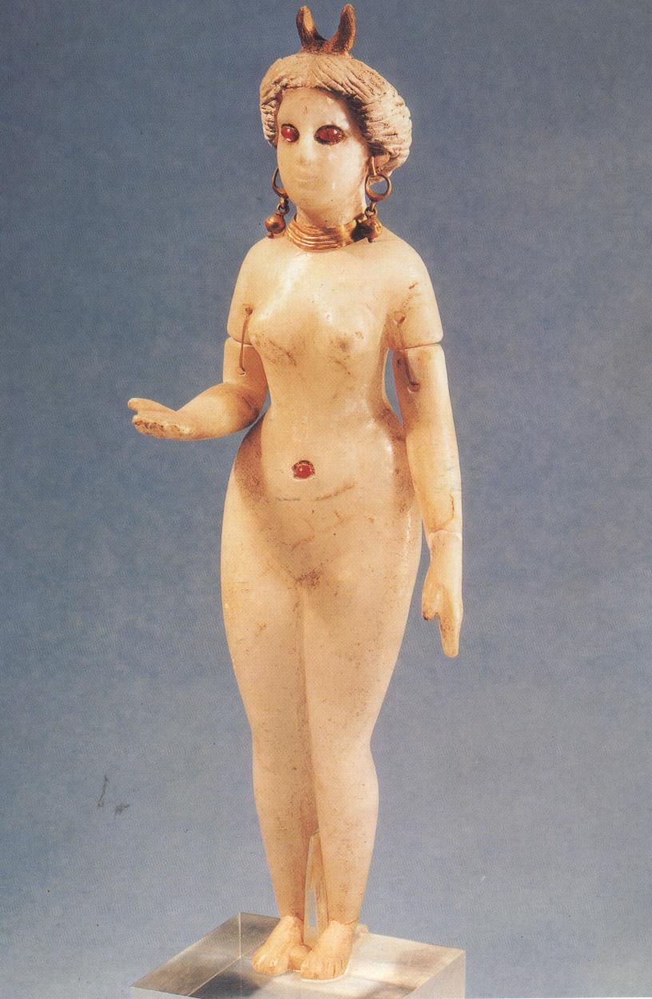
Babylonian Ishtar
Goddess of animal and human fertility
Her influence was felt throughout the world
Worshipped by sex with temple prostitutes
http://www.astroconsulting.com/FAQs/goddesses.htm

