Slide 1
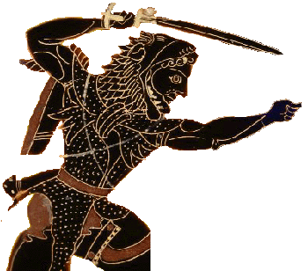
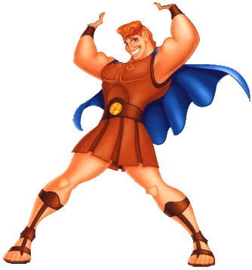
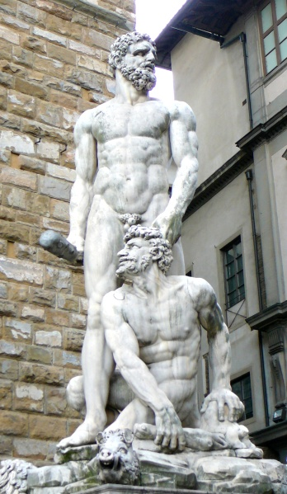
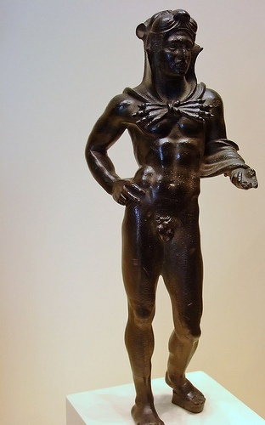
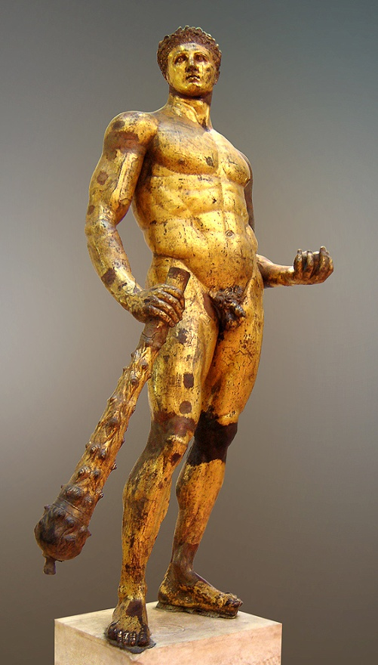
Herakles (Heracles) Hercle Hercules
American
Greek
Roman
Etruscan
Italian Renaissance

Slide 2
Assignment: Use the images in this Powerpoint and the course readings to compare and contrast different cultural representations of the hero Hercules.
Paper is due (via e-mail) on Tuesday, March 16.
EXTRA CREDIT: Use this paper to respond to the archaeology lecture (attendance required) on Wednesday, March 17

Slide 3
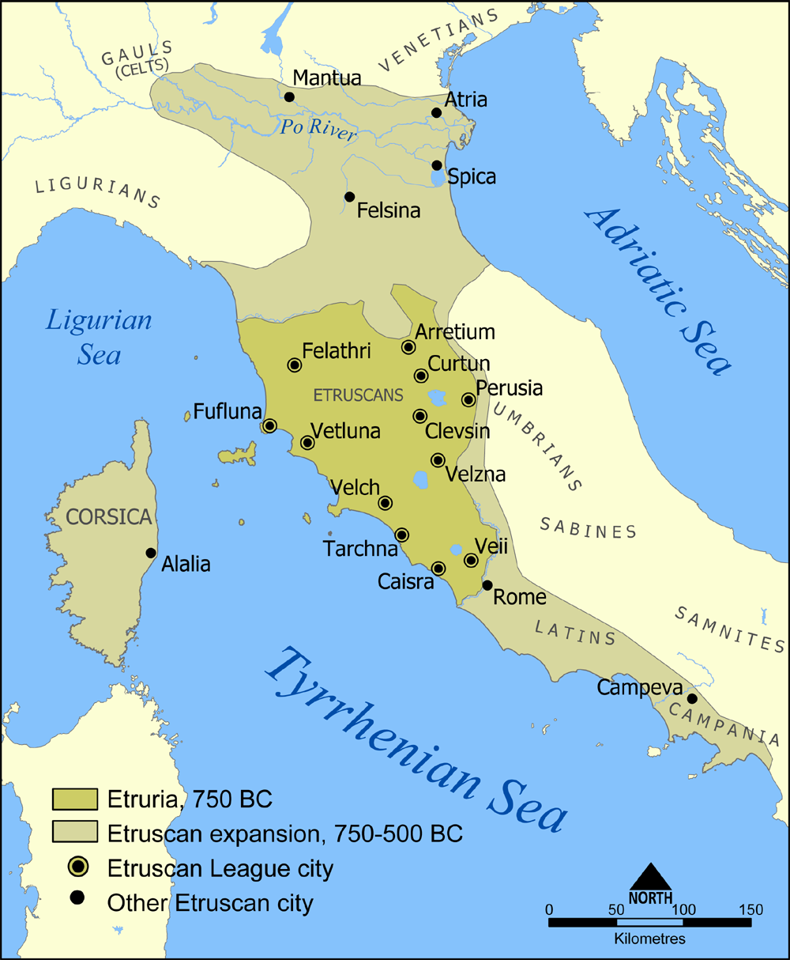
Etruria

Slide 4
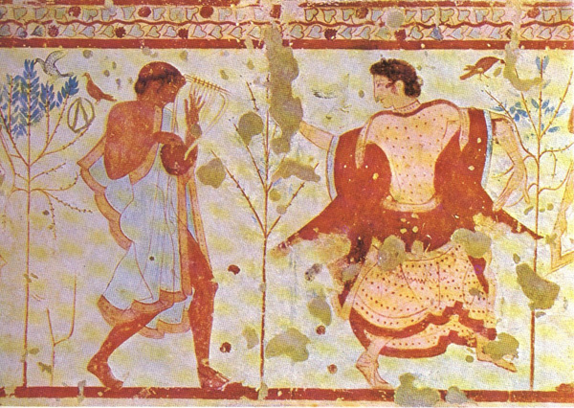
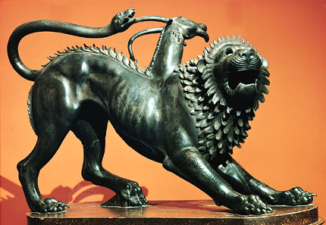
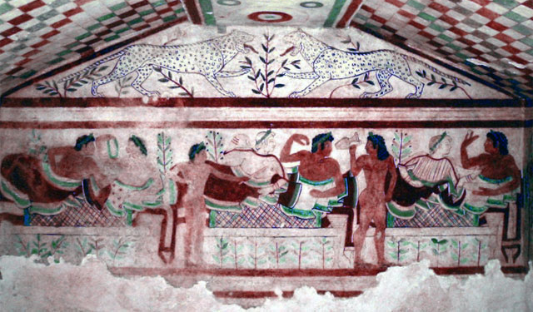
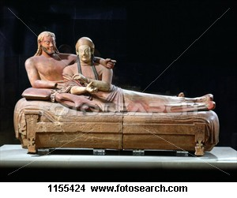
Etruria (modern Tuscany)

Slide 5
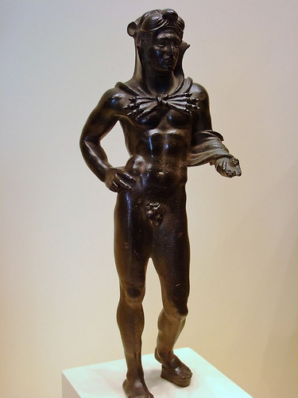
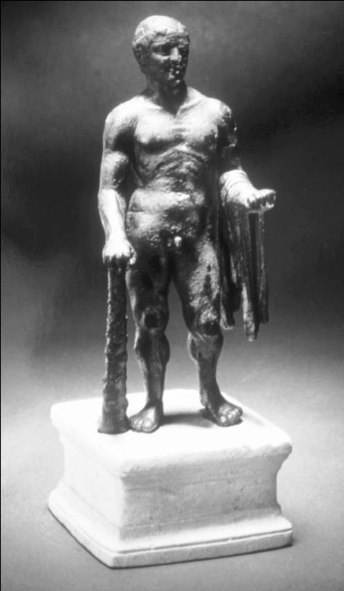
Etruscan Hercle and Greek Herakles
Bronze Statue of Heracles Statue of Hercules from the gym of Ai Khanoum, Afganistan, Sold in a bazaar of Pakistan in 2002 http://www.americanchronicle.com/articles/view/95856
Etruscan votive statue of Hercle (Herakles) 325-275 BCE Bronze Getty Villa Malibu

Slide 6
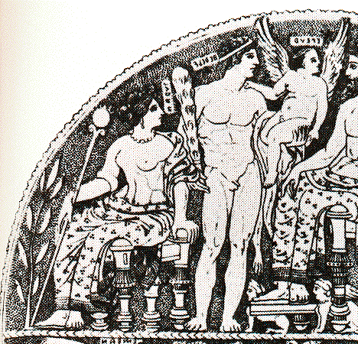
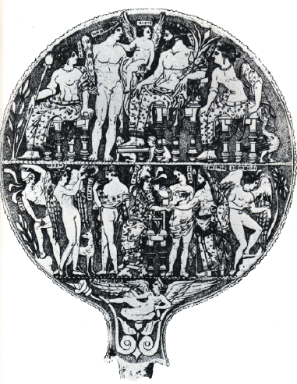
Mirror from Vulci which shows the story of Helen of Troy and the characters in the story with Etruscan names
http://www.maravot.com/Divine_Mirror.html

Slide 7
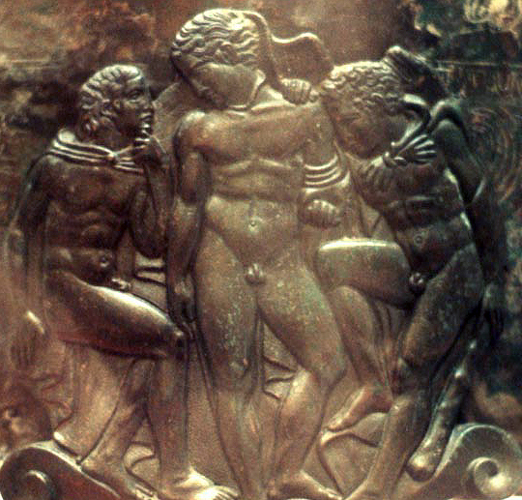
“Cista Ficoroni”, Etruscan bronze casting ritual vessel, 4th c. BCE. Villa Giulia, Rome.
Hercle at right, Eros in center, Iolaus at left

Slide 8
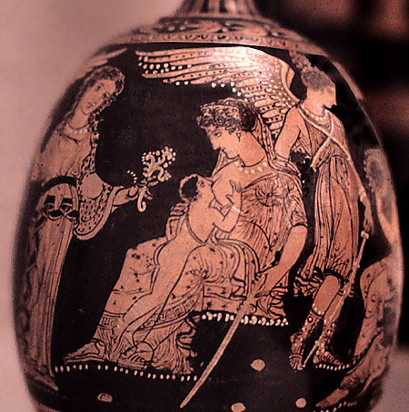
detail, red-figure lekythos:
Hera suckling Herakles while Aphrodite and Iris look on; Greek, c. 360-350 BCE London, British Museum. Credits: Barbara McManus, 1986

Slide 9
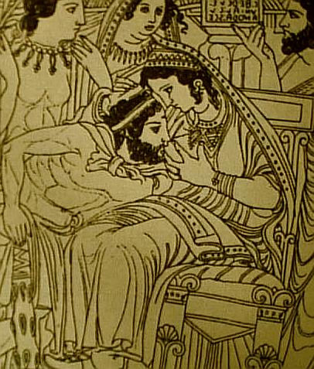
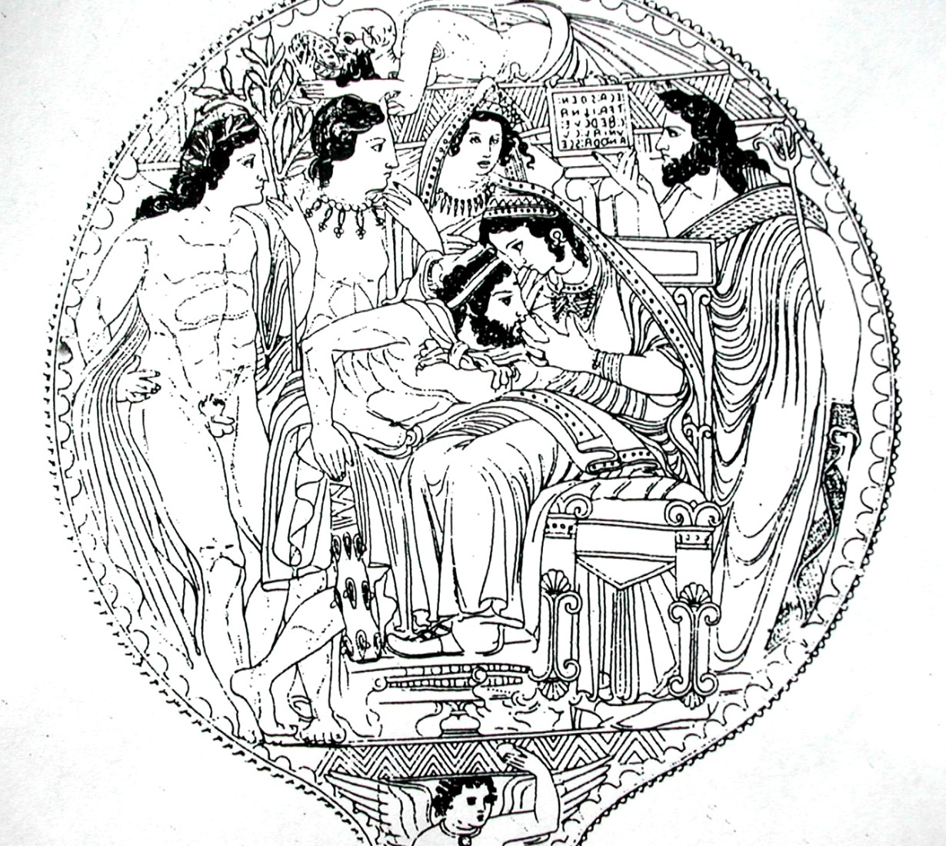
Apotheosis of Herakles (Ercole-Hercle), Herakles at Hera's breast in Olympus, Etruscan Mirror, Museo Archeologico, Firenze
Uni, the supreme goddess of the cosmos, wife of Tinia and mother of Hercle. Here depicted on a mirror from Volterra suckling Hercle.

Slide 10
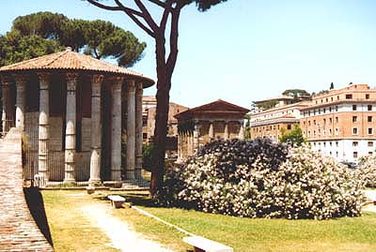
Forum Boarium
Gilded bronze "Hercules of the Forum Boarium", with the apple of the Hesperides, Roman 2nd century BCE; found in the Forum Boarium in the 15th century (Capitoline Museums)

Slide 11
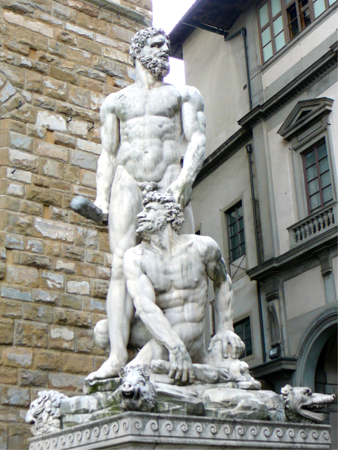
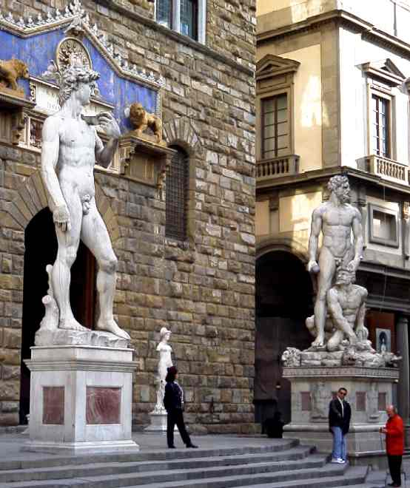
Hercules and Cacus
Florentine artist Baccio Bandinelli (1525-1534)

Slide 12
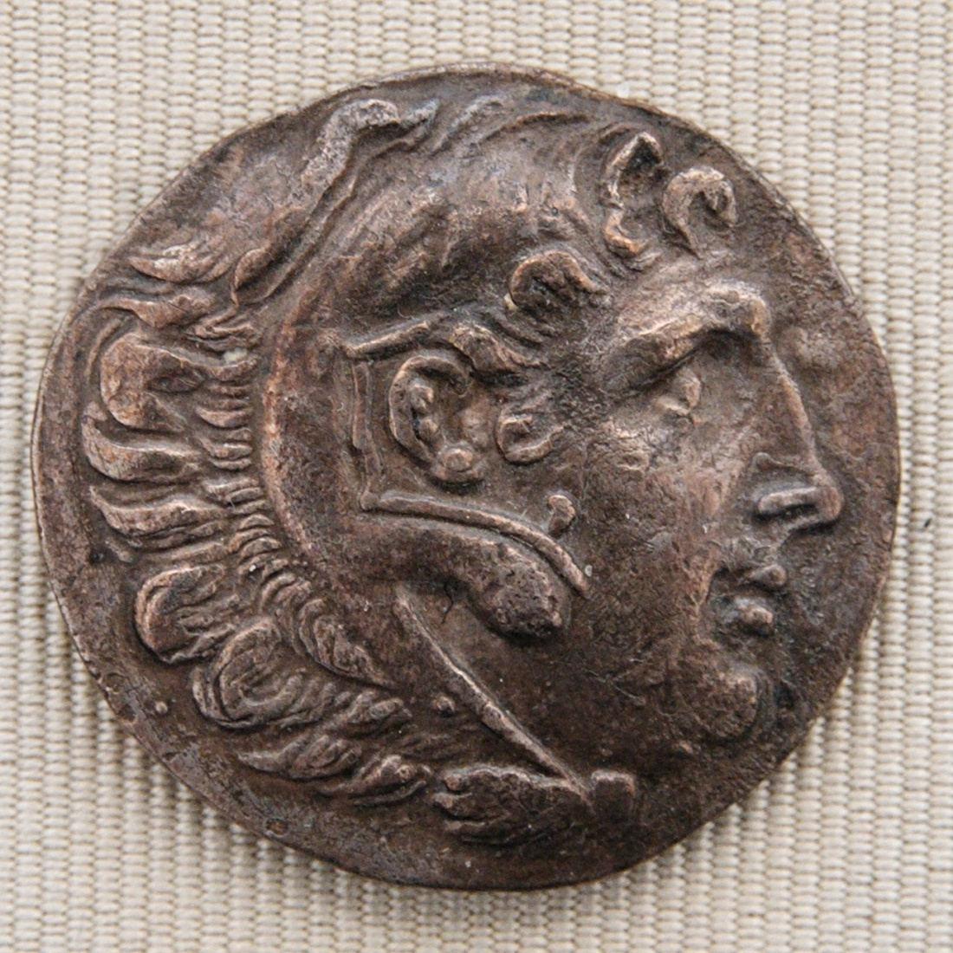
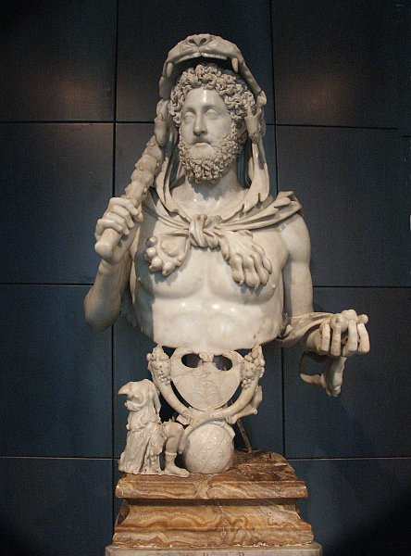
Silver tetradrachm issued by Erythrai ca. 200–180 BC, obverse: Alexander the Great as Herakles wearing the lion skin.
Marcus Aurelius Commodus Antoninus as Hercules
son of Marcus Aurelius
born 161; ruled 80 to 192

Slide 13
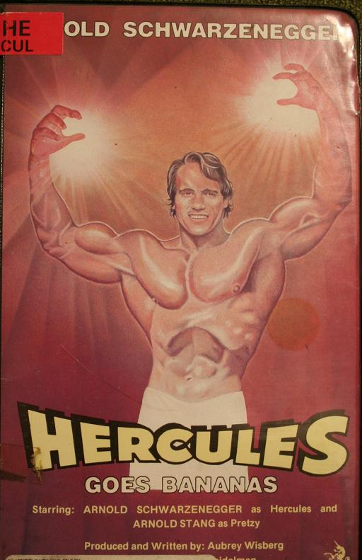
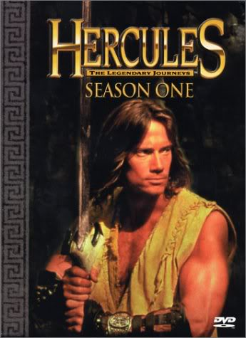
Kevin Sorbo
star of the "Hercules" television show

