Slide 1
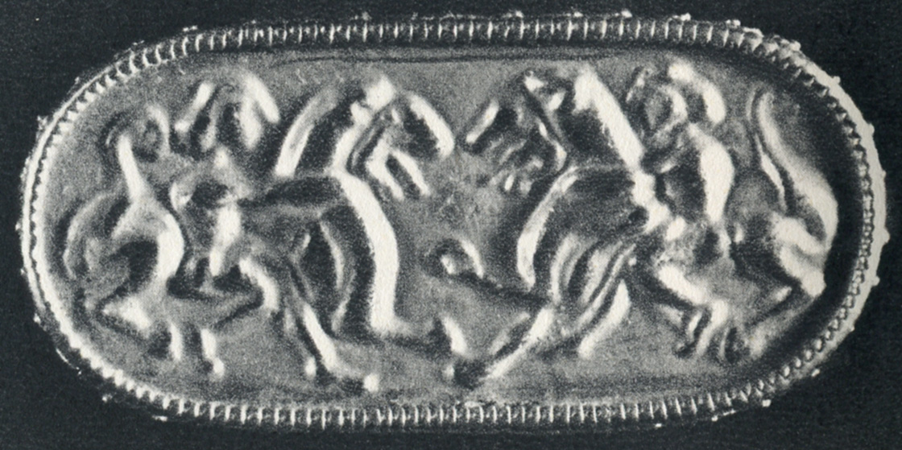
Gold brooch, with Herclé wrestling Nemean lion?, without provenience, ca. 600 BCE (after Coche de la Ferté 1956, pl. 30 no. 4).
Notes:
Gold brooch, with Herclé wrestling Nemean lion?, without provenience, ca. 600 BCE (after Coche de la Ferté 1956, pl. 30 no. 4).

Slide 2
Etrusco-Corinthian oinochoe fragments from tomb 18 at Satricum, ca. 620-610 BCE (after Colonna 1976, plate 95);
B) reconstruction drawing of incised decoration depicting Combat scene with lion-headed figure (Herclé?) (after Mengarelli 1898, 170).
Notes:
A) Etrusco-Corinthian oinochoe fragments from tomb 18 at Satricum, ca. 620-610 BCE (after Colonna 1976, plate 95); B) reconstruction drawing of incised decoration depicting Combat scene with lion-headed figure (Herclé?) (after Mengarelli 1898, 170).

Slide 3
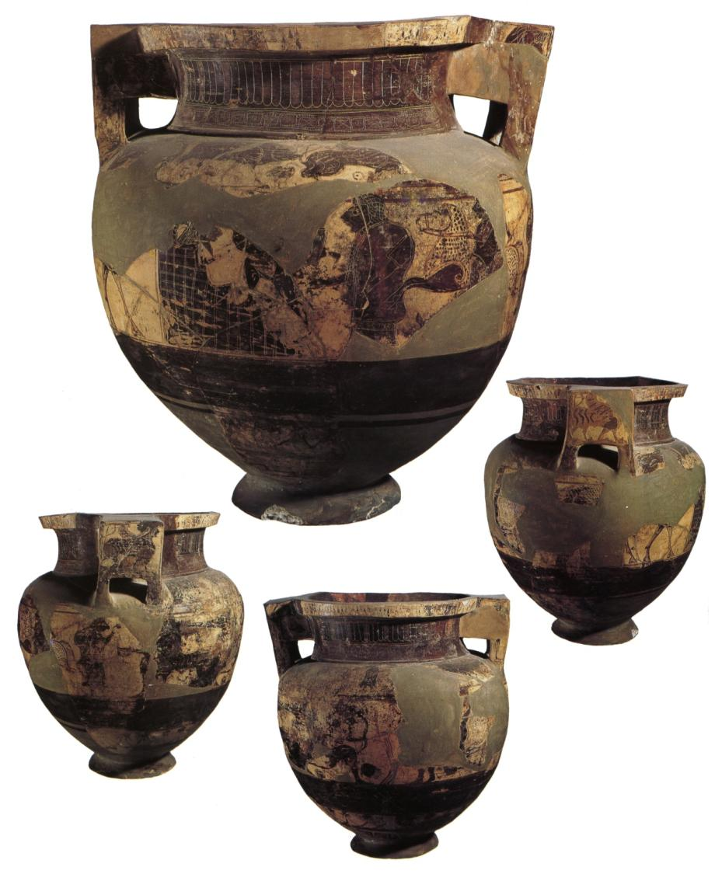
Etrusco-Corinthian column krater, from tomb 1, Tumulus1, Banditaccia Necropolis, Cerveteri, ca. 590-570 BCE (after Ceramica degli Etruschi, 132 no. 85).
Notes:
Etrusco-Corinthian column krater, from tomb 1, Tumulus1, Banditaccia Necropolis, Cerveteri, ca. 590-570 BCE (after Ceramica degli Etruschi, 132 no. 85).

Slide 4
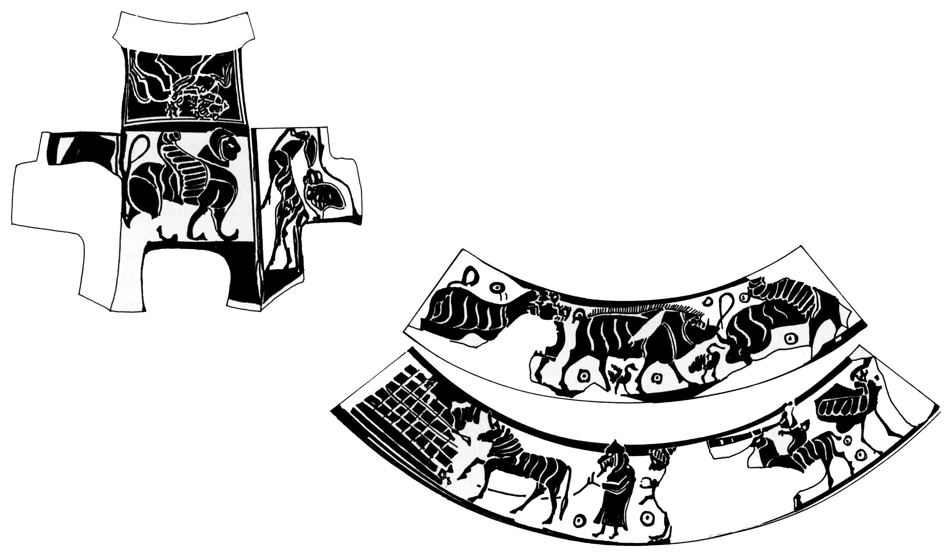
A) Drawing of lower body of krater with Herclé battling Geryon and Centaur Pholos ; and B) scenes from handle and upper body of krater (after Ceramica degli Etruschi, 290-291).
Notes:
A) Drawing of lower body of krater with Herclé battling Geryon and Centaur Pholos ; and B) scenes from handle and upper body of krater (after Ceramica degli Etruschi, 290-291).

Slide 5
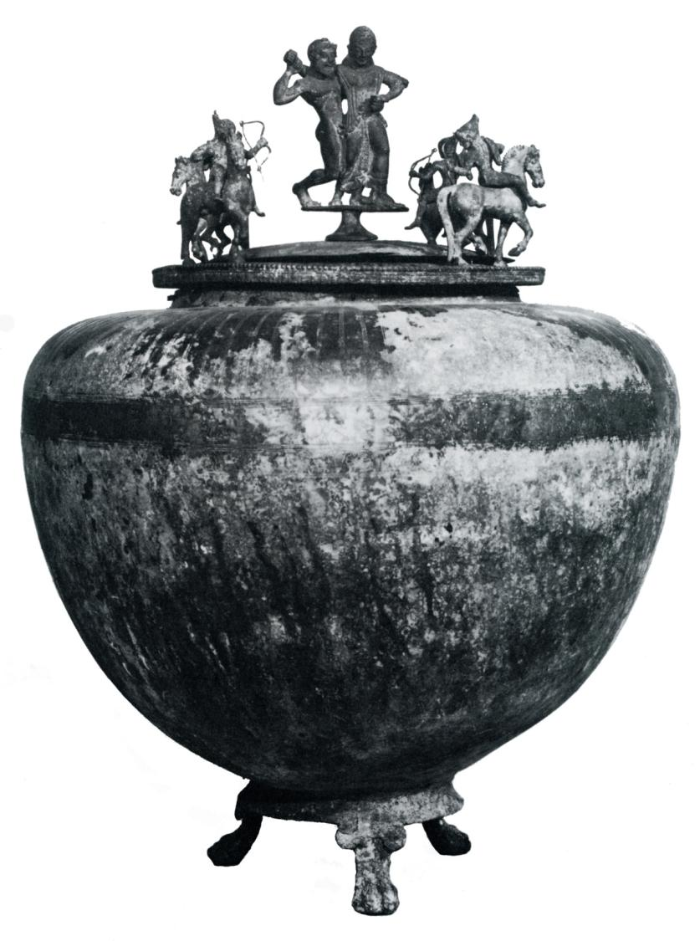
Bronze lebes used as a funerary urn with figures of Amazons circling a satyr and maenad on lid, from tomb at Capella dei Lupi, Santa Maria Capua Veteres, end of the 6th century BCE (after Haynes 1985, 162 no. 64).
Notes:
Bronze lebes used as a funerary urn with figures of Amazons circling a satyr and maenad on lid, from tomb at Capella dei Lupi, Santa Maria Capua Veteres, end of the 6th century BCE (after Haynes 1985, 162 no. 64).

Slide 6
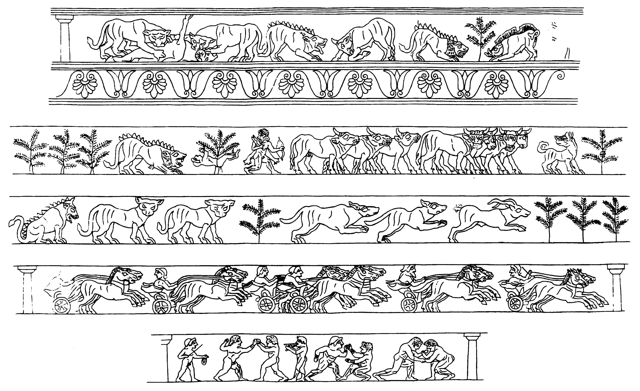
Reconstruction drawing of incised frieze (after Benassai 1997, 56 Fig. 3).
Cacus? Episode in row 2
Notes:
Reconstruction drawing of incised frieze (after Benassai 1997, 56 Fig. 3).
Cacus? Episode in row 2

Slide 7
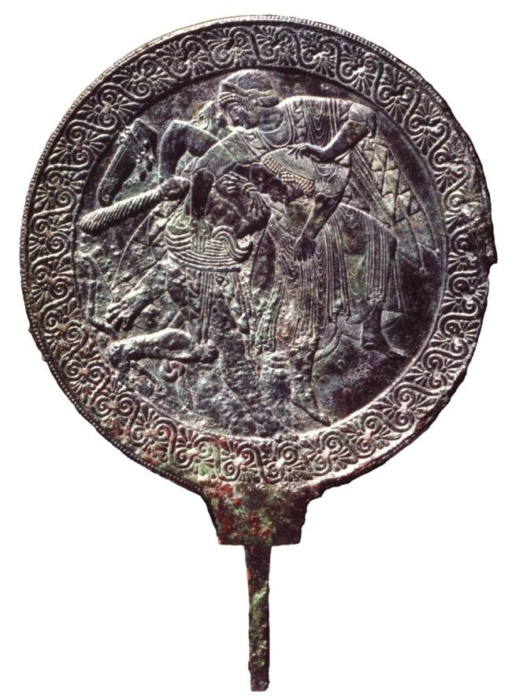
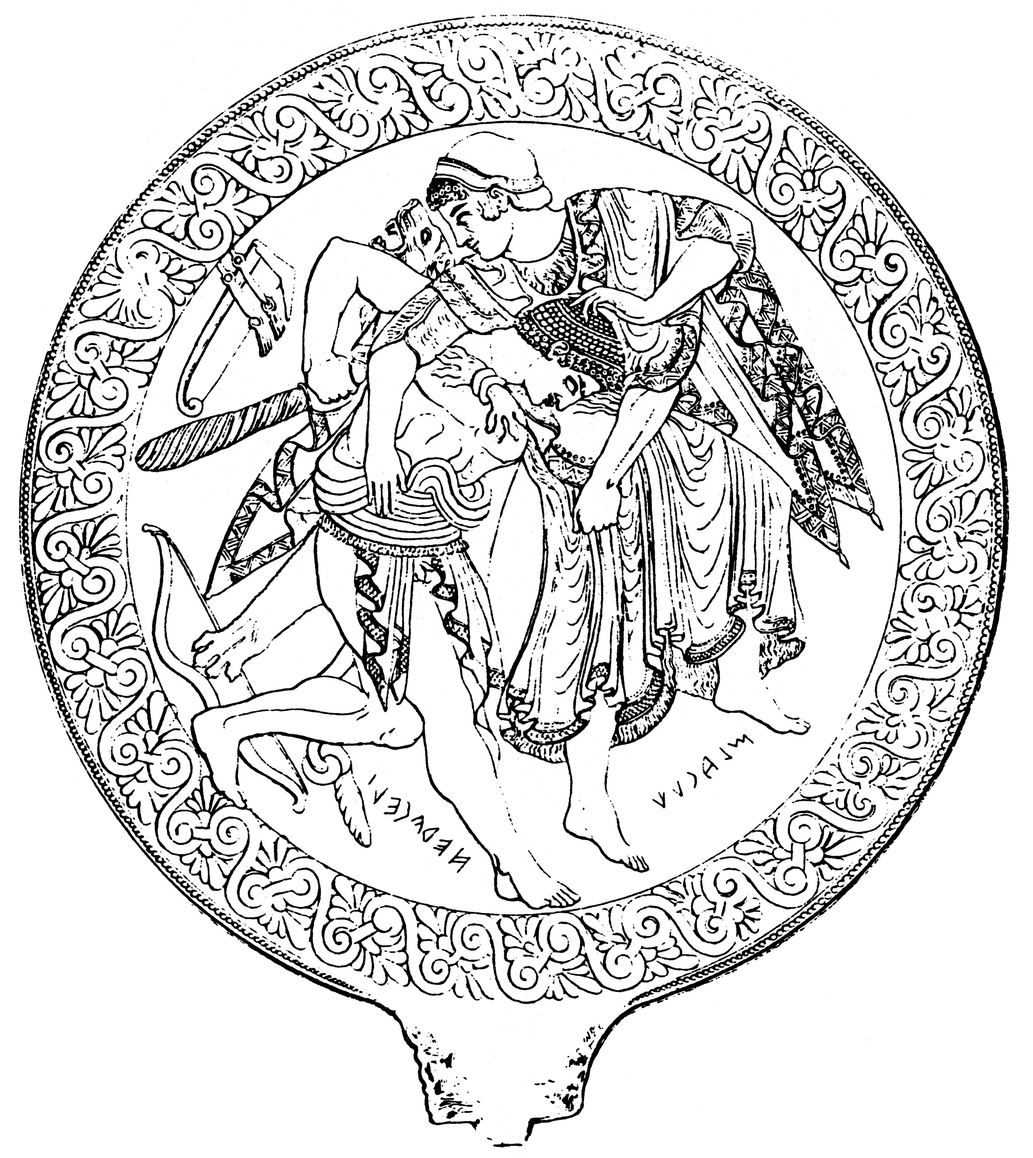
A) Bronze mirror, from Atri, ca. 500-475 BCE; B) drawing showing relief on back of mirror (after Carpino 2003, pls. 1 and 3, respectively).
Notes:
A) Bronze mirror, from Atri, ca. 500-475 BCE; B) drawing showing relief on back of mirror (after Carpino 2003, pls. 1 and 3, respectively).

Slide 8
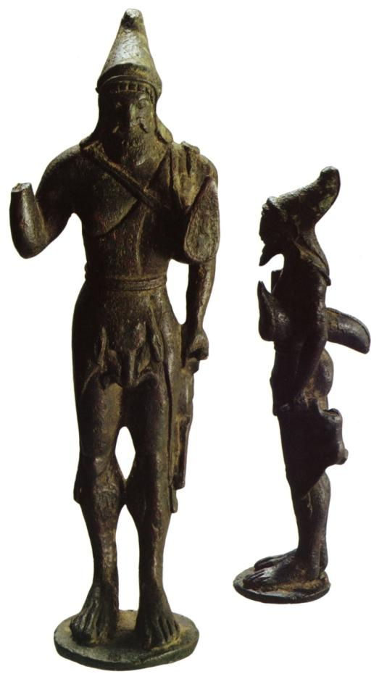
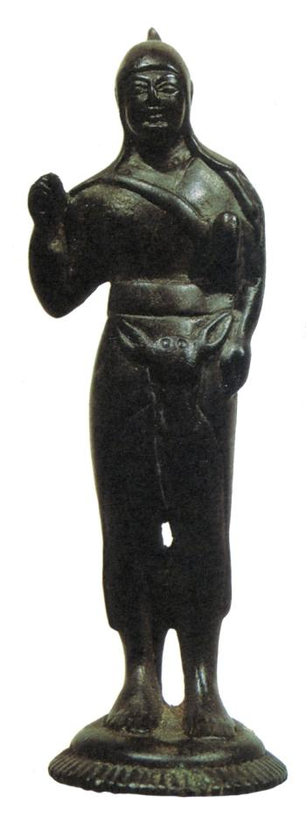
L: Bronze statuette of Herclé Promachos, from La Contarina (prov. of Rovigo), ca. 500-480 BCE (after Bronzi degli Etruschi, 200 no. 95).
Notes:
L: Bronze statuette of Herclé Promachos, from La Contarina (prov. of Rovigo), ca. 500-480 BCE (after Bronzi degli Etruschi, 200 no. 95).
R: statuette of Hybrid Herclé Promachos wearing deerskin, from Adria, ca. 500 BCE (after Mastrocinque 1993, Fig. 2).

Slide 9
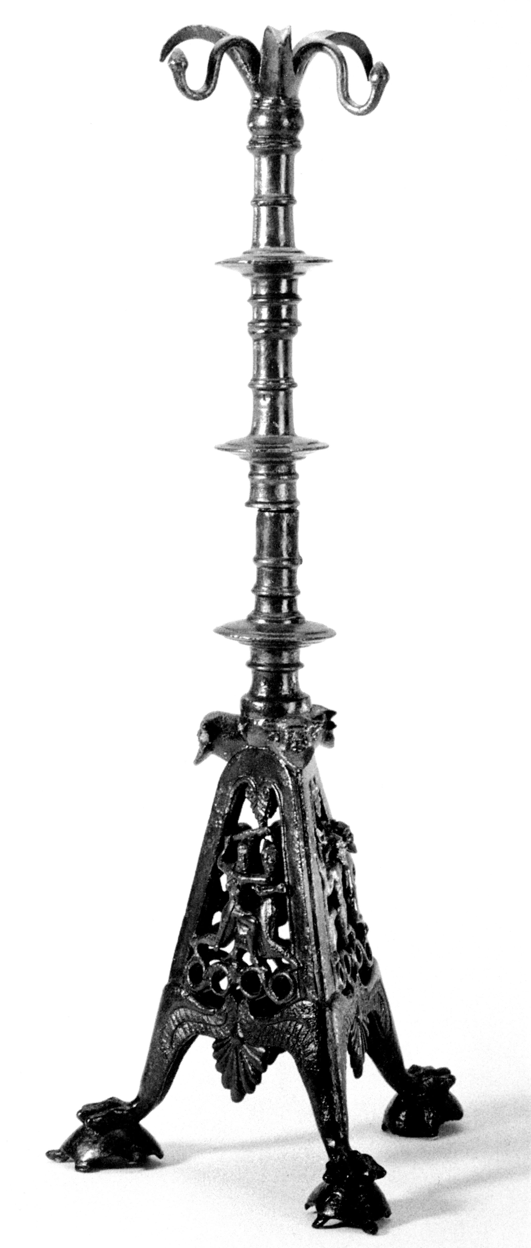
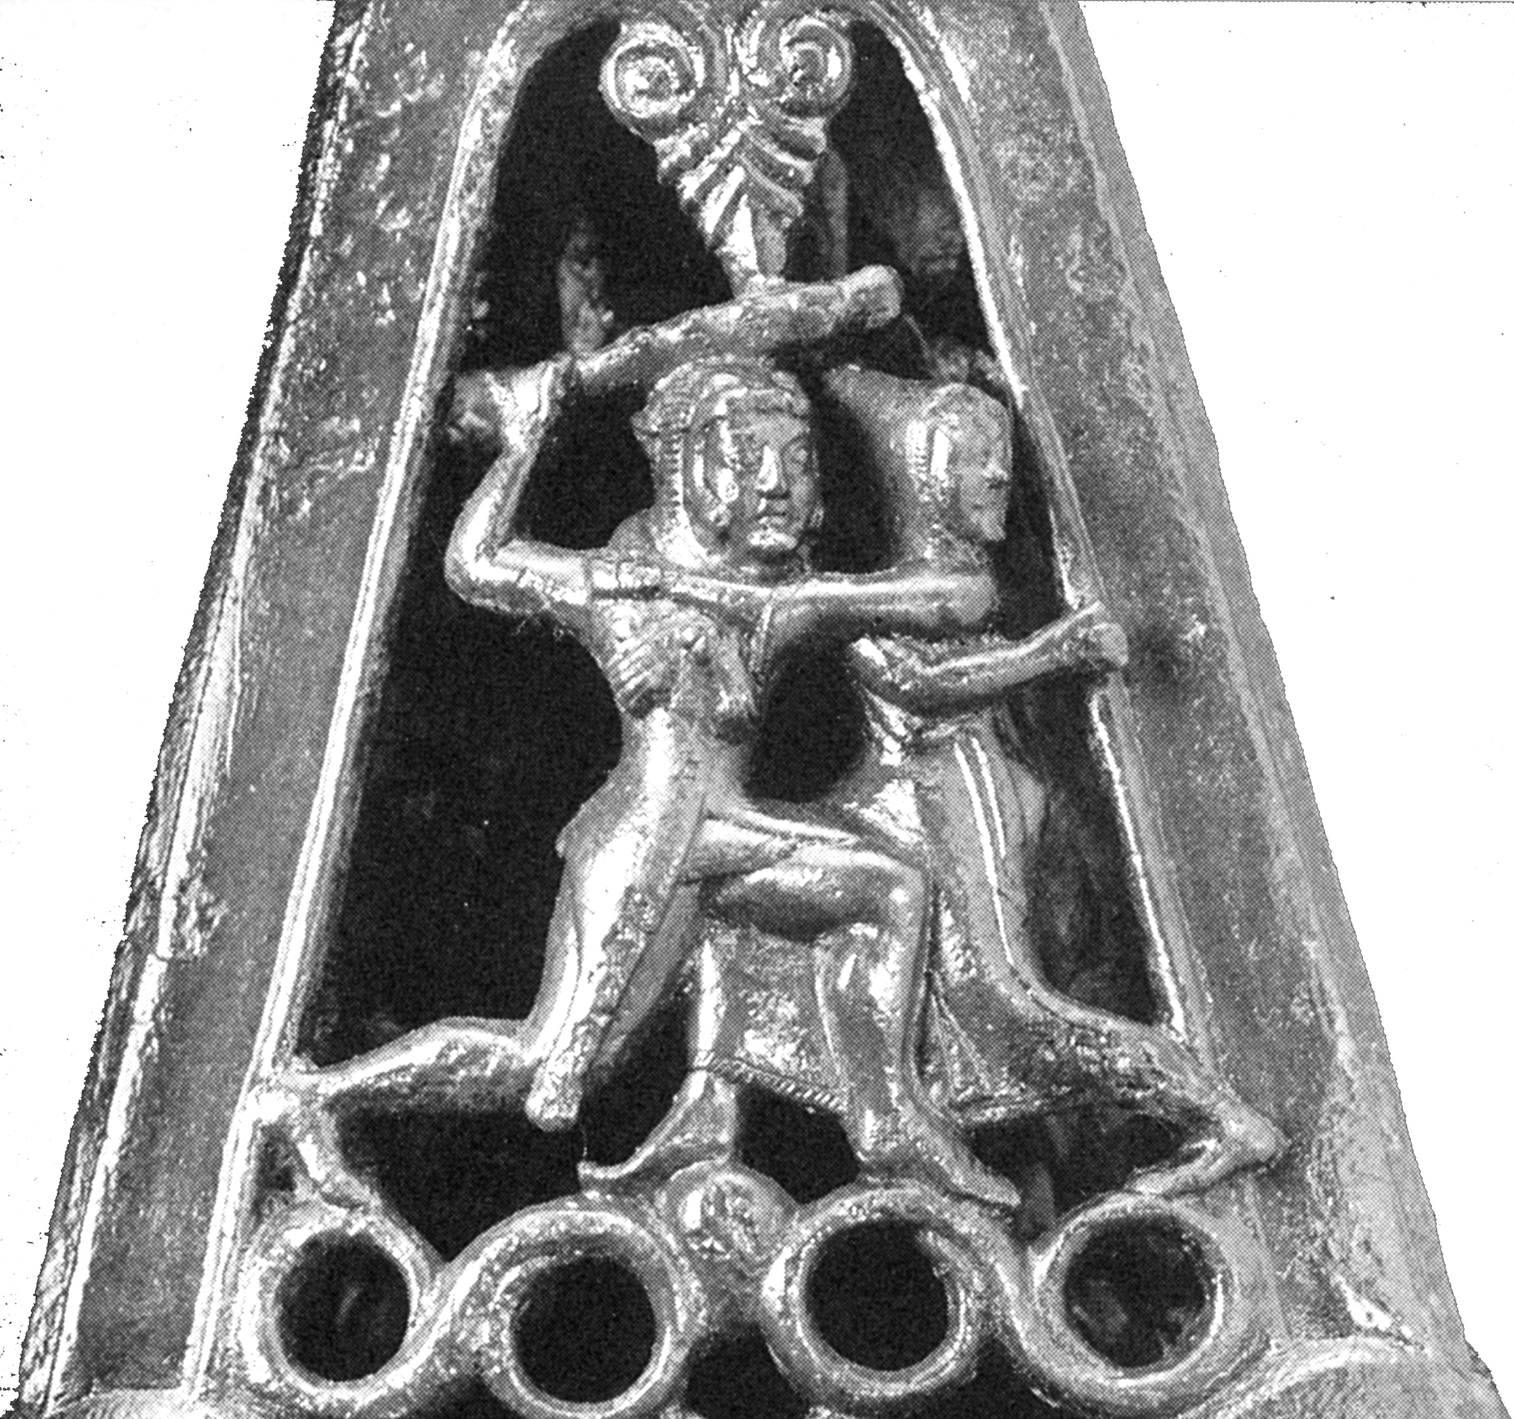
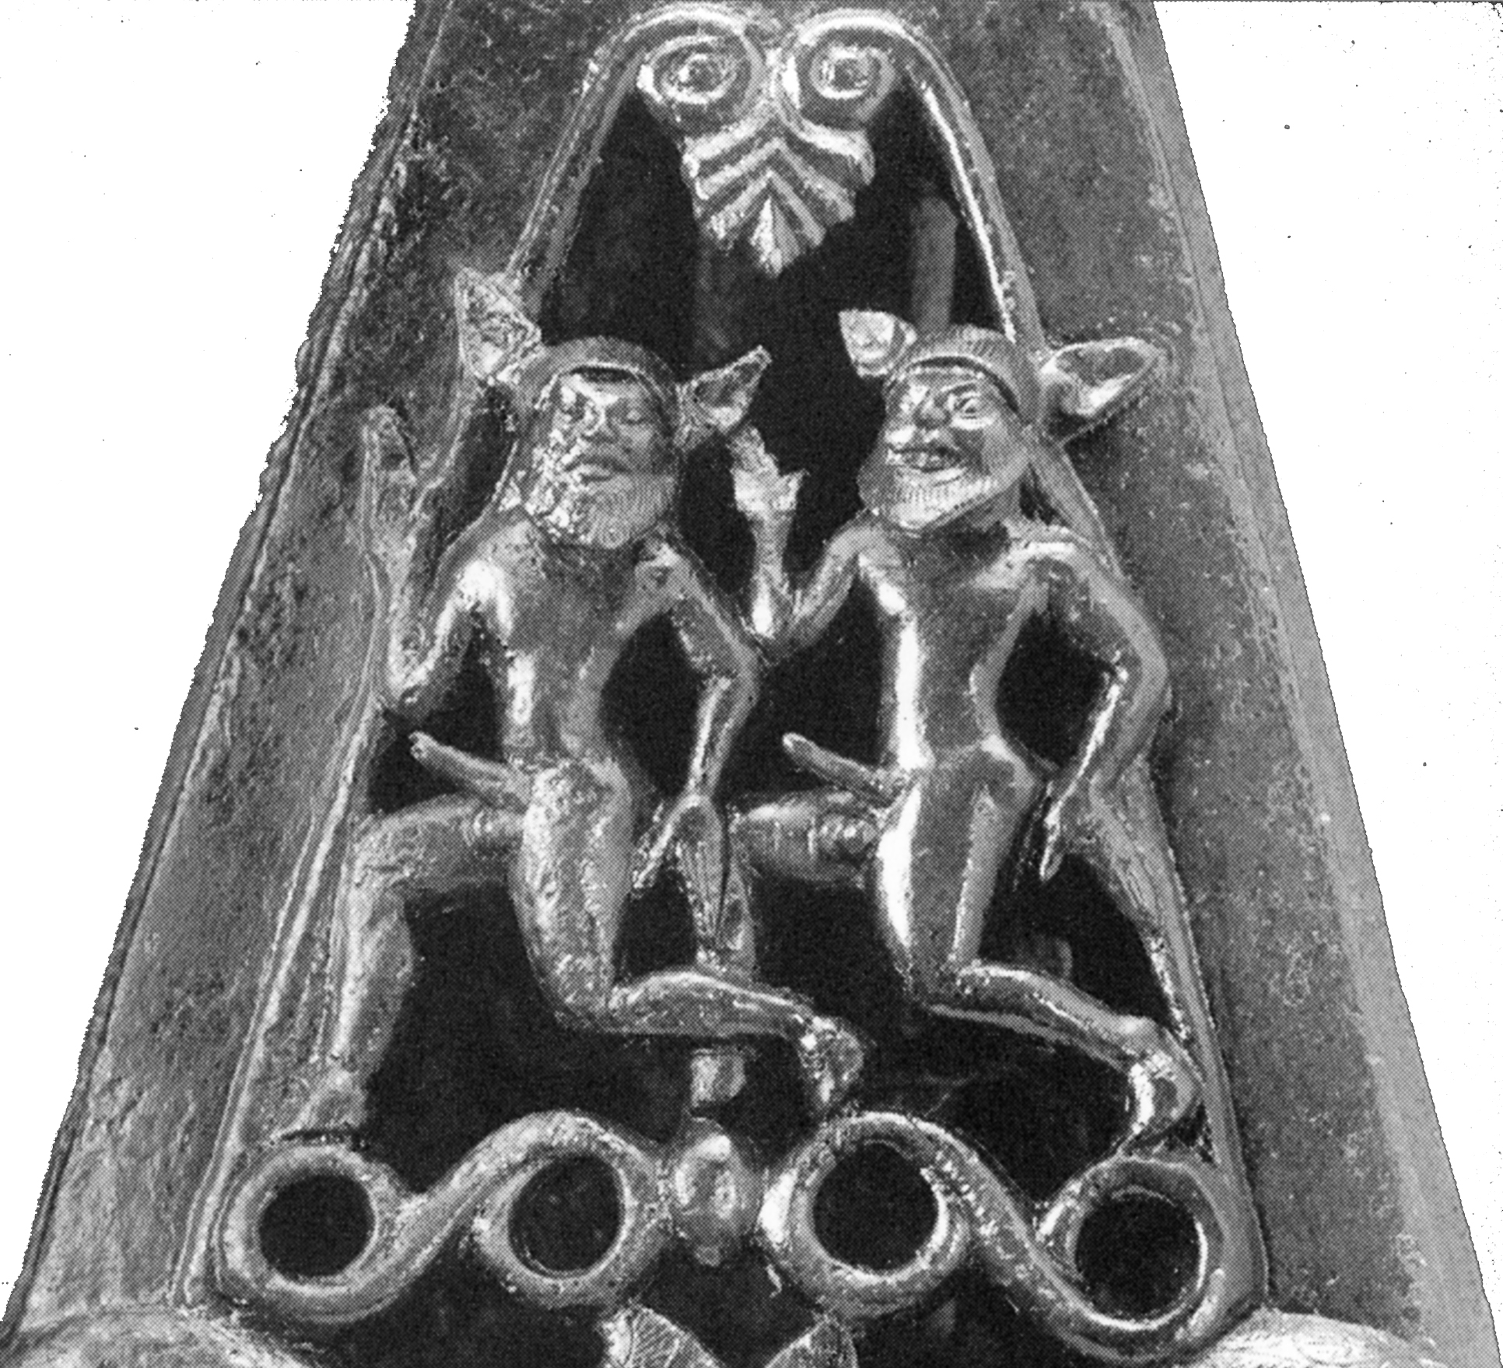
A) Bronze candelabrum without provenience, early 5th century BCE:
B) detail, Herclé and Uni;
C) detail, pair of ithyphallic satyrs (after Naso 2003, pls. 4 and 52 [details]).
Notes:
A) Bronze candelabrum without provenience, early 5th century BCE: B) detail, Herclé and Uni; C) detail, pair of ithyphallic satyrs (after Naso 2003, pls. 4 and 52 [details]).

Slide 10
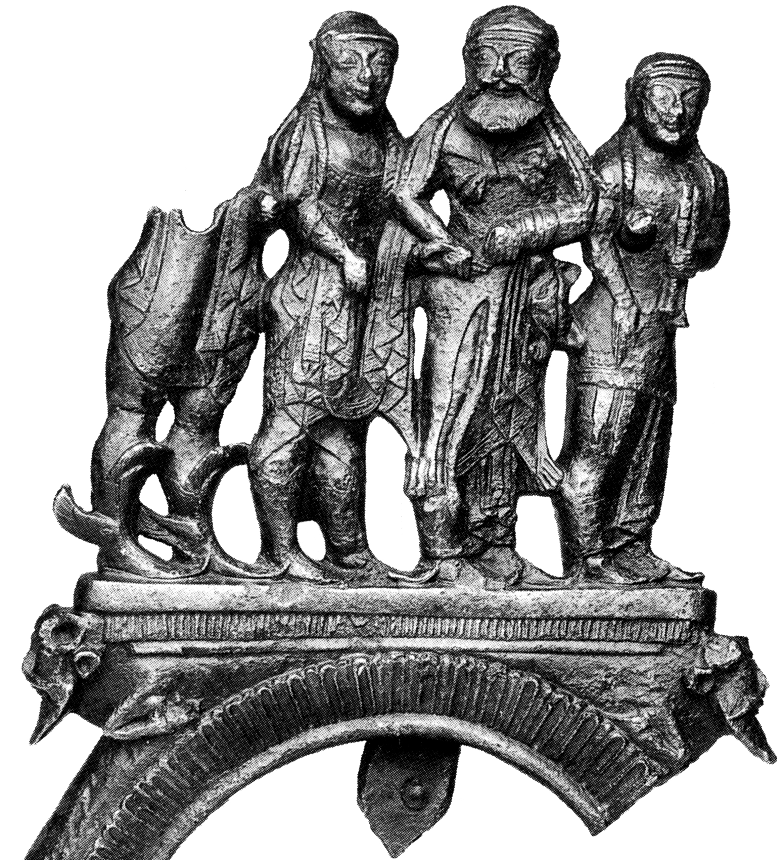
Bronze tripod fragment (no. 523) with Herclé in an Encounter with divinities (Apotheosis of Herclé?), from Athenian Acropolis, ca. 500 BCE (after Riis 1998, 64 fig. 60a).
Notes:
Bronze tripod fragment (no. 523) with Herclé in an Encounter with divinities (Apotheosis of Herclé?), from Athenian Acropolis, ca. 500 BCE (after Riis 1998, 64 fig. 60a).

Slide 11
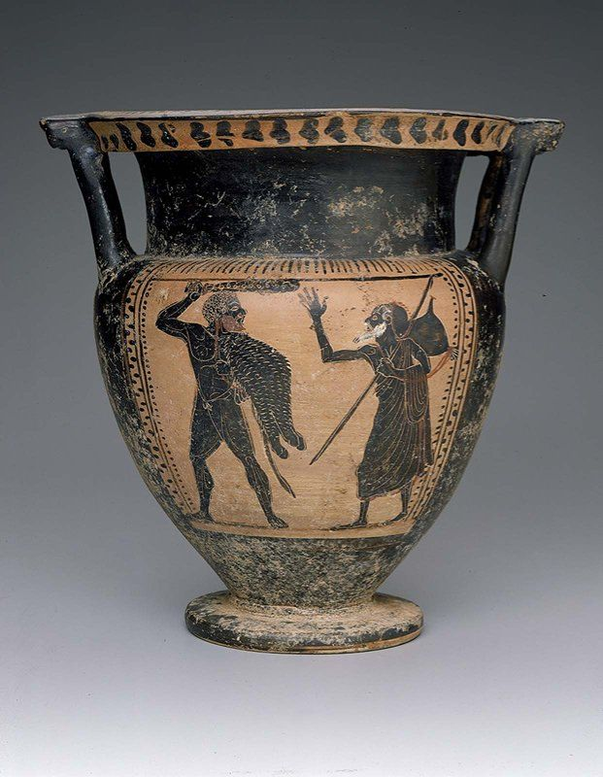
Etruscan black-figure column-krater with Herclé confronting Gēras, without provenience, ca. 480-470 BCE (http://www.mfa.org/collections/search_art.asp?recview=true&id= 310955&coll_keywords=&coll_package=26122&coll_start=1
[accessed 8/11/2009]).
Notes:
Etruscan black-figure column-krater with Herclé confronting Gēras, without provenience, ca. 480-470 BCE (http://www.mfa.org/collections/search_art.asp?recview=true&id= 310955&coll_keywords=&coll_package=26122&coll_start=1 [accessed 8/11/2009]).

