Slide 1
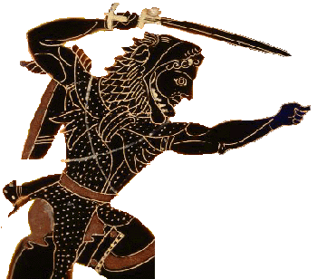
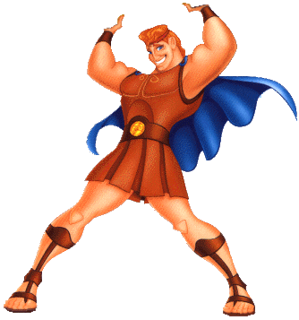
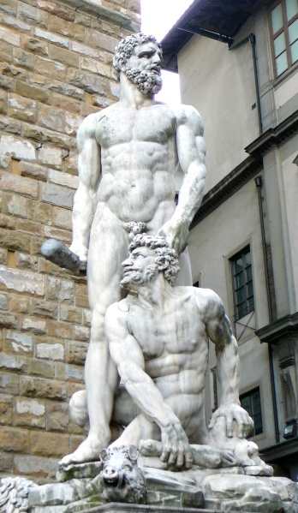
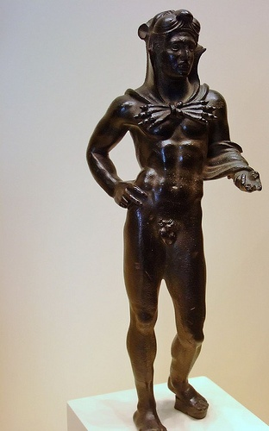
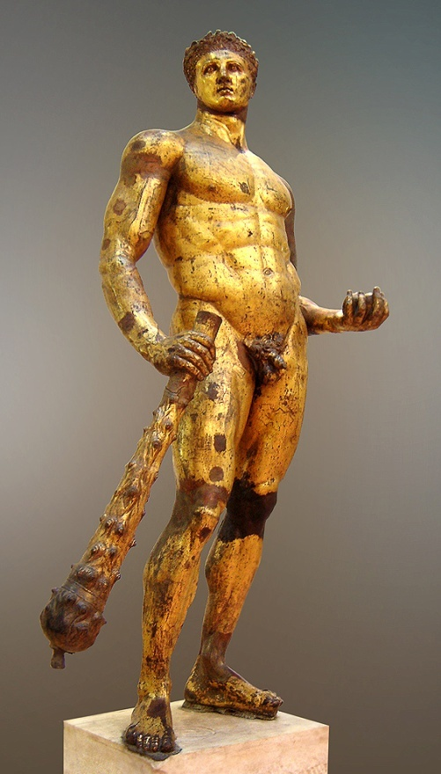
Hercules
American
Greek
Roman
Etruscan
Italian Renaissance

Slide 2
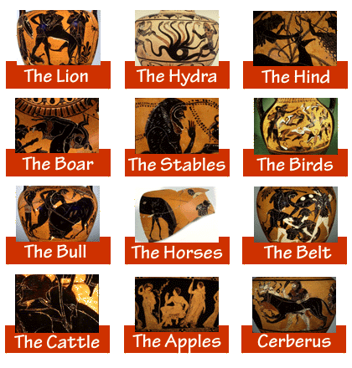
The Twelve Labors of Hercules

Slide 3
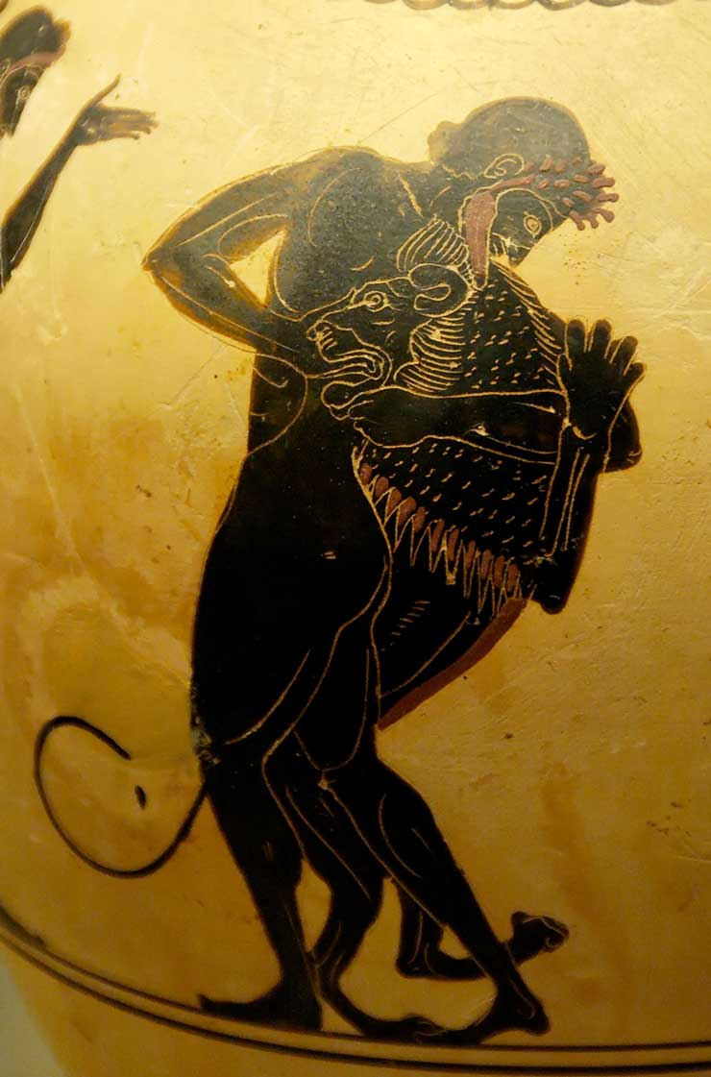
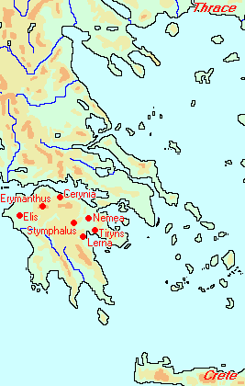
1. Nemean Lion
The British Museum, London, United Kingdom
Artist/Maker Painter of London 620
Heracles and the Nemean Lion. Attic white-ground black-figured oinochoe, ca. 520/500 BC. From Vulci.
Accession number GR 1836.2-24.92 (Cat. Vases E 621)
Peloponesian labors

Slide 4
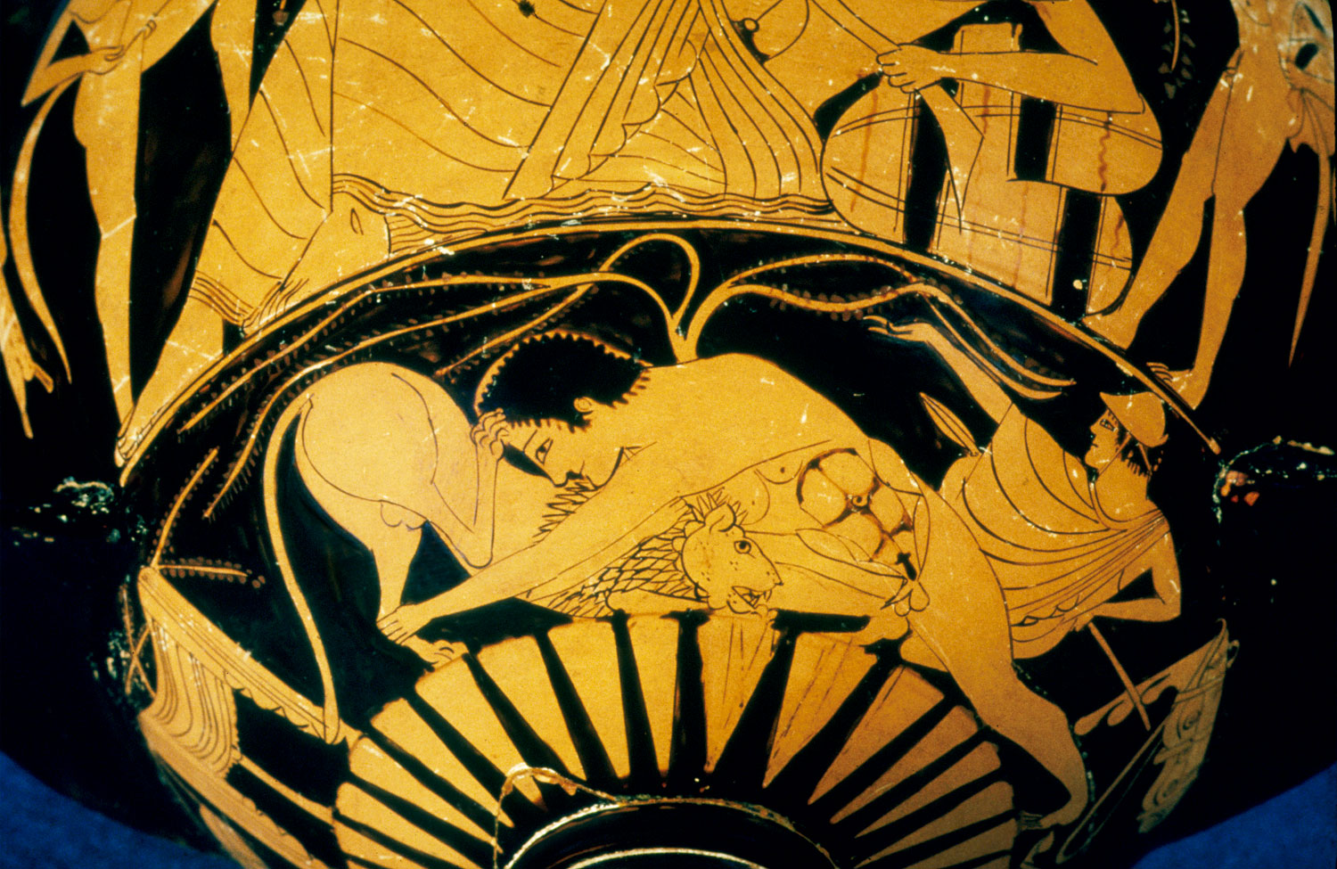

Slide 5
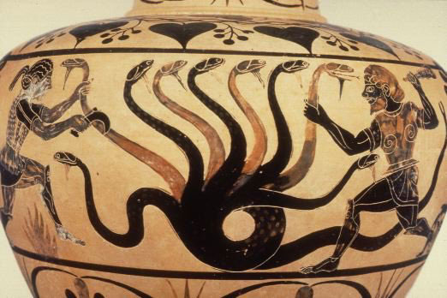
2. Hercules and the Lernean Hydra

Slide 6
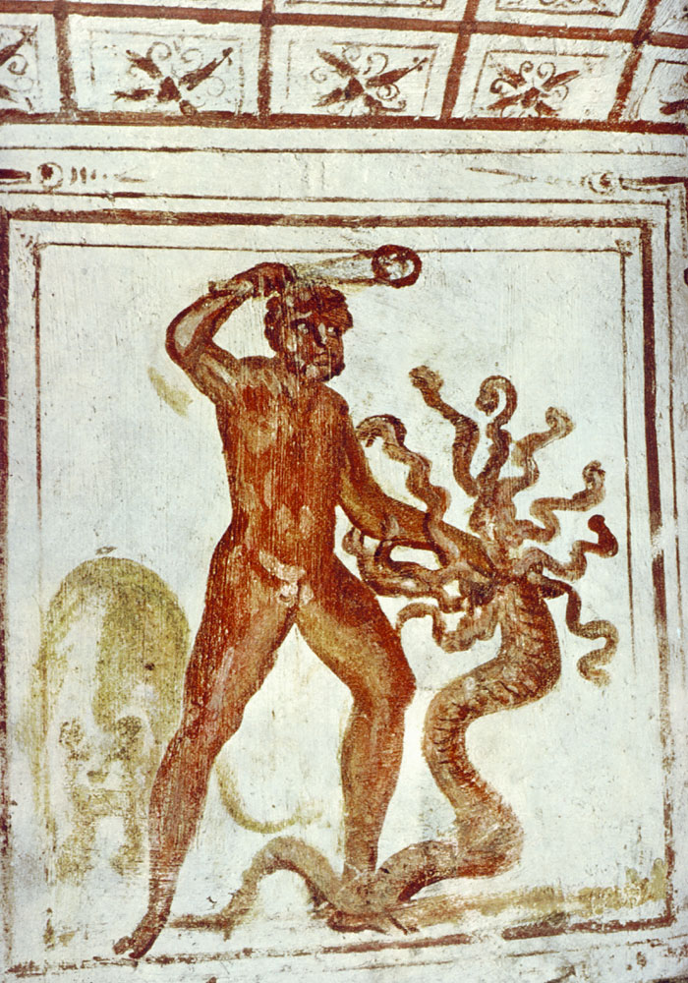

Slide 7
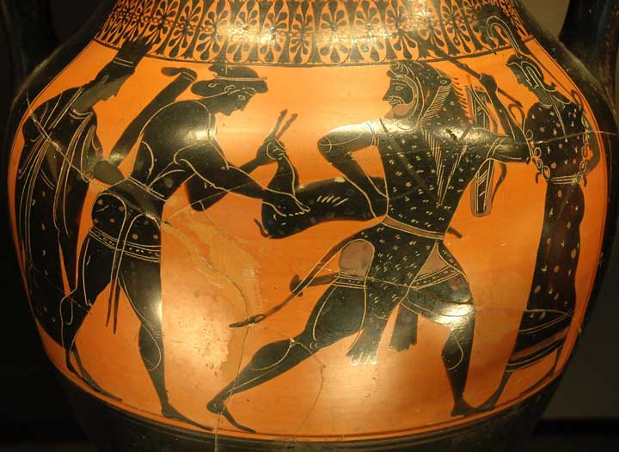
3. Cerynian Stag
Heracles and the Ceryneian Hind, Louvre F 234bis

Slide 8
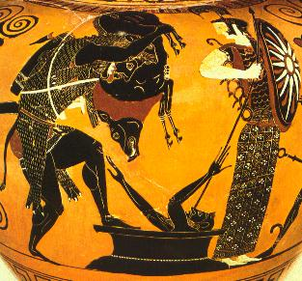
4. Erymanthian Boar
Hercules and the Erymanthian Boar
Paris, Louvre

Slide 9
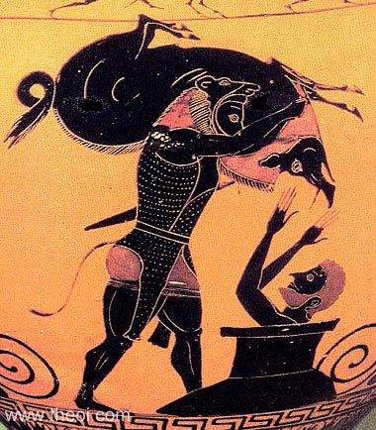
HERAKLES & THE ERYMANTHIAN BOAR
Museum Collection: British Museum, London, UK
Catalogue Number: London B213
Beazley Archive Number: 310380
Ware: Attic Black Figure
Shape: Amphora, neck
Painter: Attributed to the Near Group E
Date: --
Period: Archaic

Slide 10
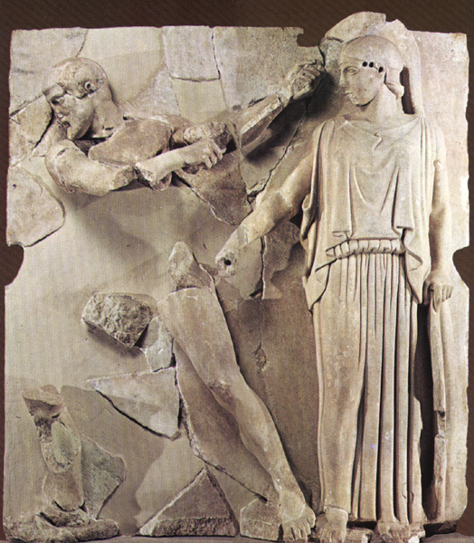
5. Augean Stables

Slide 11
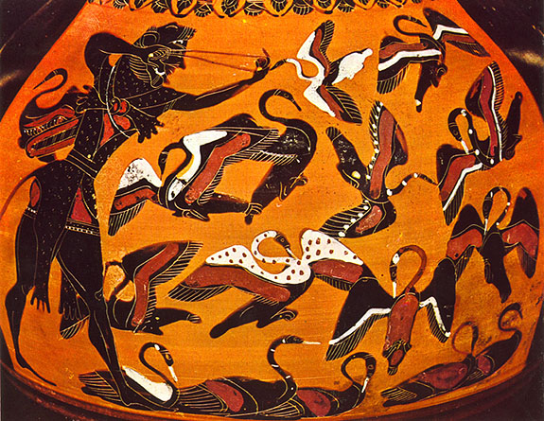
6. Stymphalian Birds
Detail from an Athenian black-figure clay vase, about 540 BC. London, British Museum

Slide 12
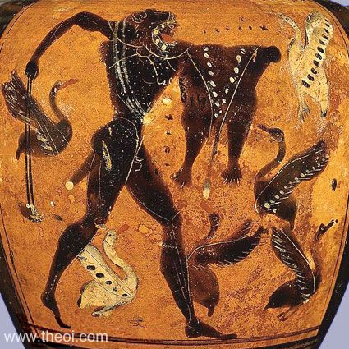
HERAKLES & THE
STYMPHALIAN BIRDS
Museum Collection: Musée du Louvre, Paris, France
Catalogue No.: Paris F387
Beazley Archive No.: 7590
Ware: Attic Black Figure
Shape: Neck Amphora
Painter: Attributed to Diosphos Painter
Date: C6th BC
Period: Archaic

Slide 13
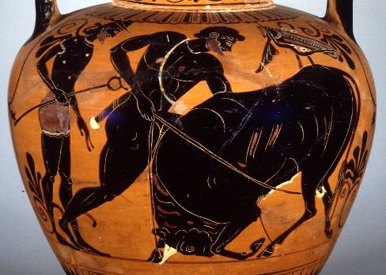
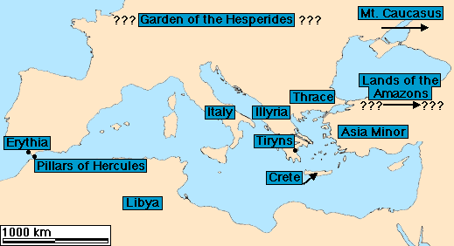
7. Cretan Bull
Hercules ropes the Cretan Bull
Mississippi 1977.3.61a and b, Attic black figure neck amphora, ca. 530-520 B.C.

Slide 14
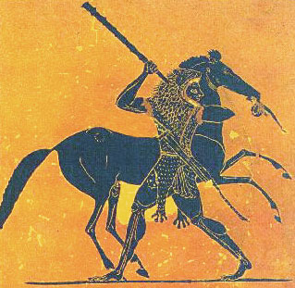
8. Horses of Diomedes (Thrace)
The Horses of Diomedes, cylix 510 BC

Slide 15
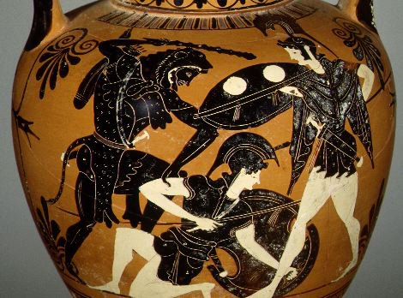
9. Girdle of Hippolyta

Slide 16
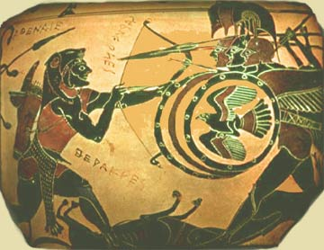
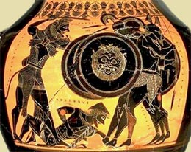
10. Cattle of Geryon
amphora 540 BC
amphora 550 BC
Exekias, Louvre.

Slide 17
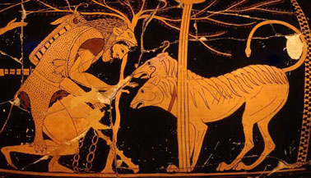
11. Cerberus

Slide 18
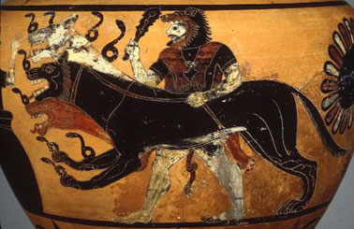
Hydria found in Cairéa, 530-525 BC
Musée du Louvre, Paris

Slide 19
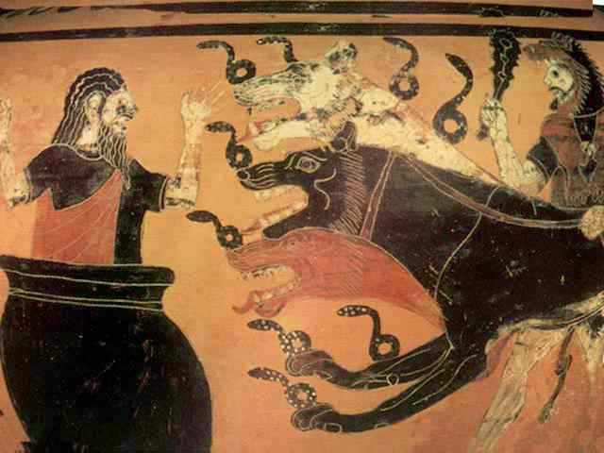

Slide 20
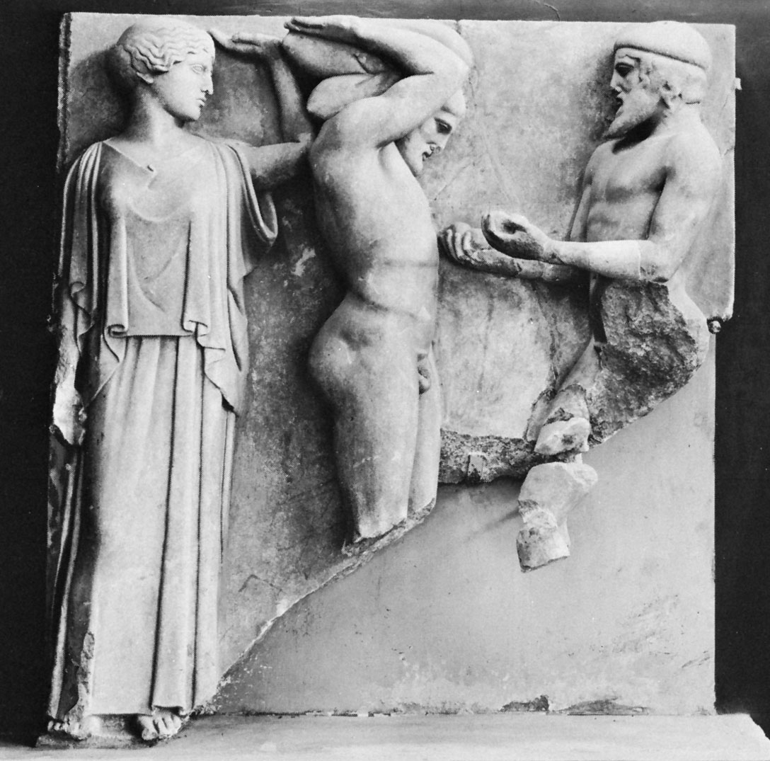
Apples of the Hesperides

Slide 21
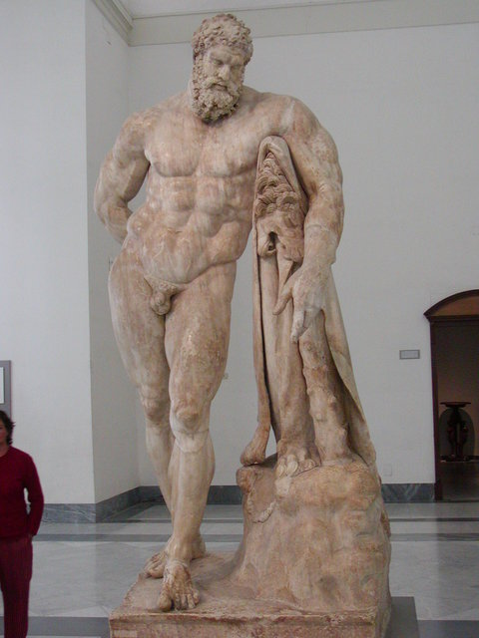

Slide 22
