Slide 1
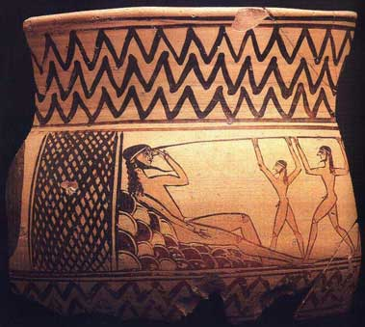
Odysseus and the Cyclops (Polyphemus)

Slide 2
Plot
Odysseus and his men arrive at cave
Make themselves at home
Arrival of Cyclops (Xenia: Guest vs. Host)
Cyclops Eats Some of Odysseus’ Men
Odysseus Makes Cyclops Drunk (No Man)
Odysseus Blinds the Cyclops
Tricky Escape
Cyclops’ Curse

Slide 3
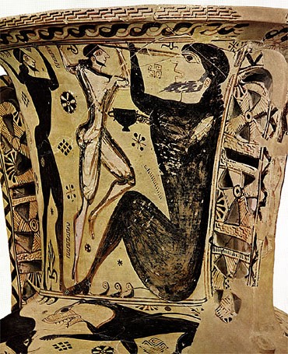
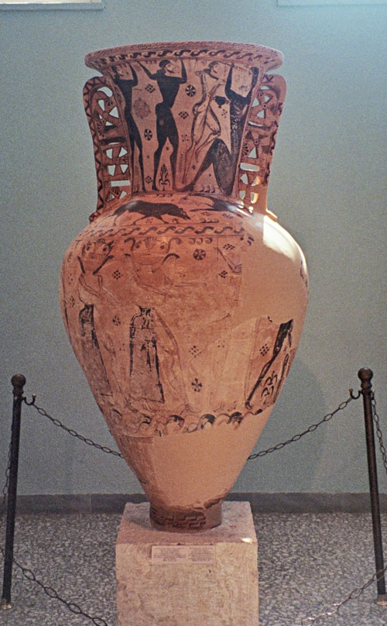
Eleusis amphora", a proto-attic work, c. 650 BC, museum of Eleusis, Inv. 2630

Slide 4
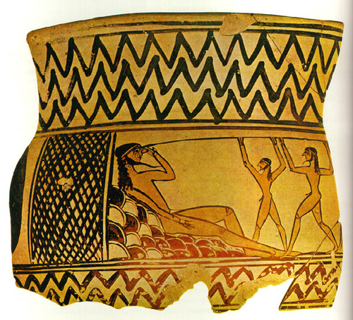
Fragment of Argive Bowl, From Argos. Mid 7th century B.C. Blinding of Polyphemus: 11cm, Museum Argos.

Slide 5
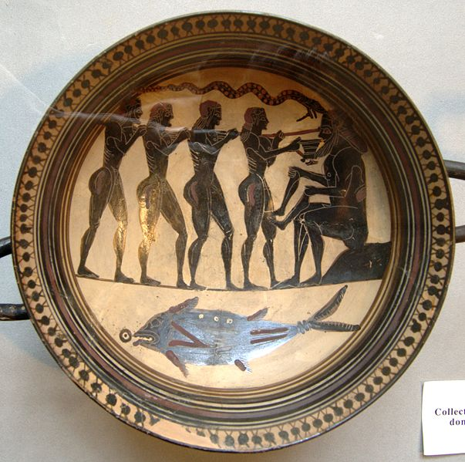
Laconian black-figure cup, 565-560 B.C.

Slide 6
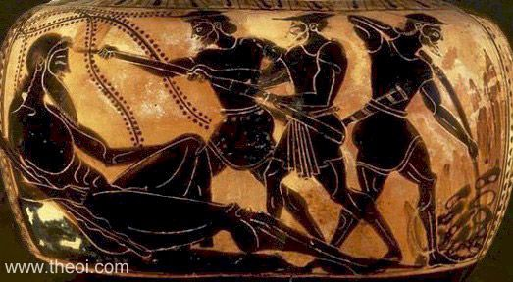
Musée du Louvre, Paris, France Catalogue Number: Louvre F342 Beazley Archive Number: 303347 Ware: Attic Black Figure Shape: Oinochoe Painter: Attributed to the Theseus Painter Date: ca 510 - 490 BC Period: Late Archaic

Slide 7
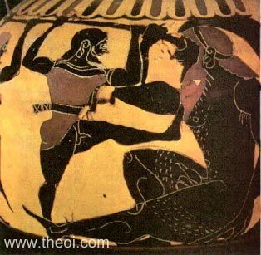

Slide 8
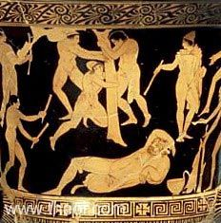
Museum Collection: British Museum, London, UK Catalogue Number: London 1947.7-14.18 Beazley Archive Number: N/A Ware: Lucanian Red Figure Shape: Calyx krater Painter: Name vase of the Cyclops Painter Date: ca 410 - 400 BC Period: Classical

Slide 9
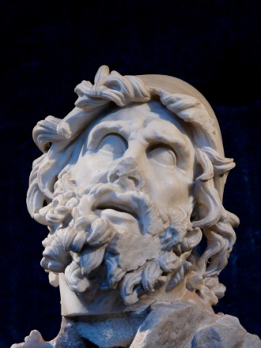
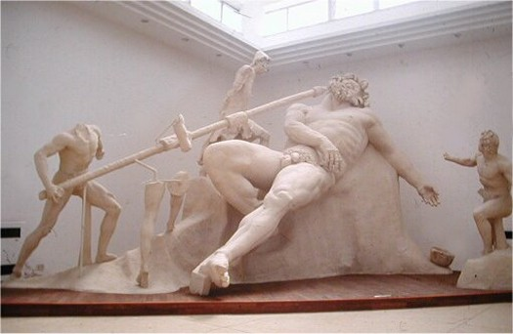
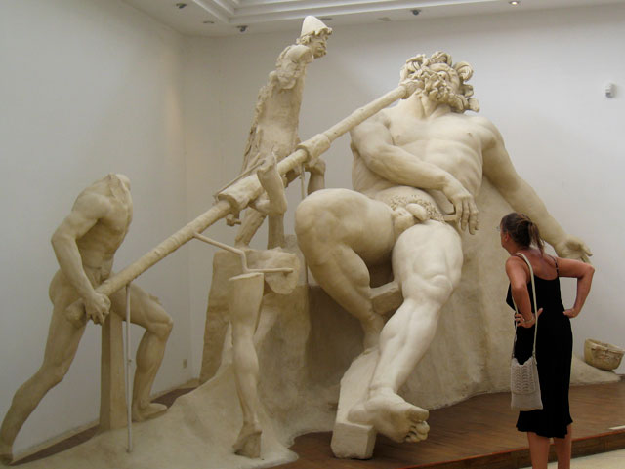
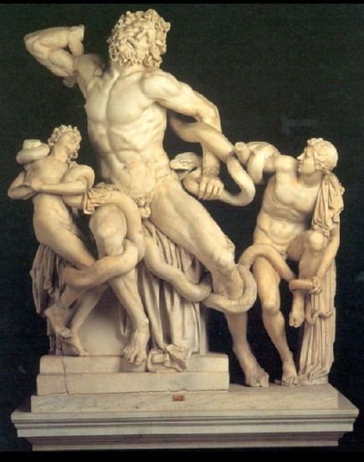
Tiberius’ Villa at Sperlonga. Sculpture based on lost bronze group by the Rhodian sculptors Hagesander , Athenadorus , and Polydorus, active between 50 bc and ad 25 . Pliny names these same artists as the sculptors of the Laocoön.
http://www.mlahanas.de/Greeks/Arts/Polyphemos.htm

Slide 10
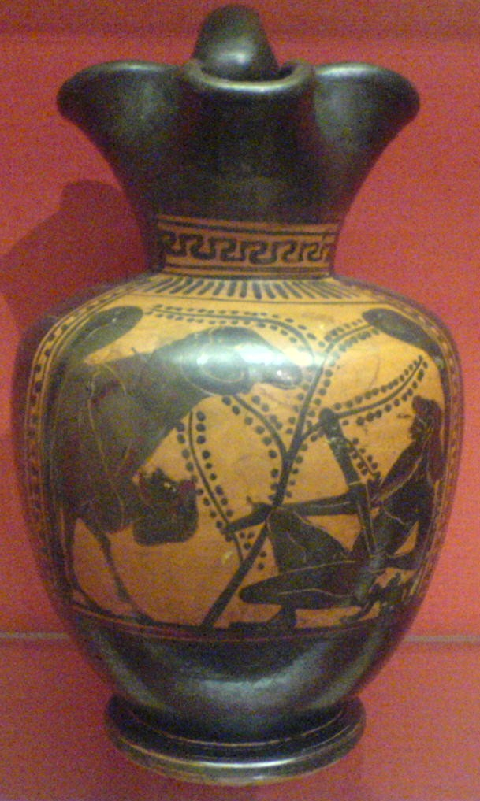
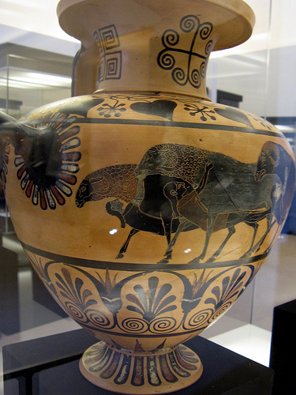
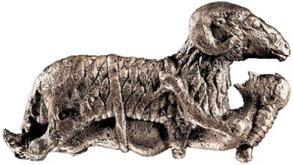

Slide 11
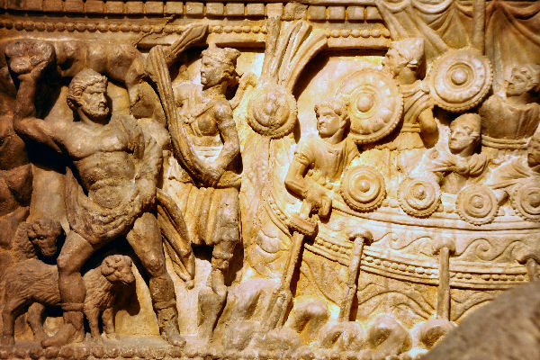
Etruscan sarcophagus from the Rijksmuseum van oudheden, Leiden

