Slide 1
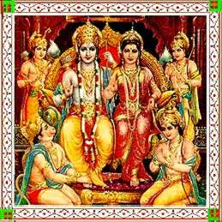
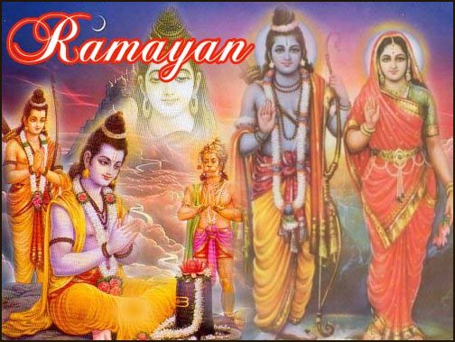
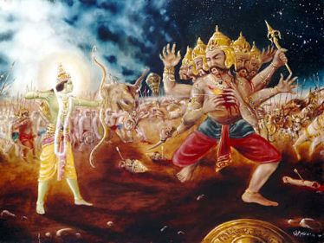
Ramayana
Rama’s Journey

Slide 2
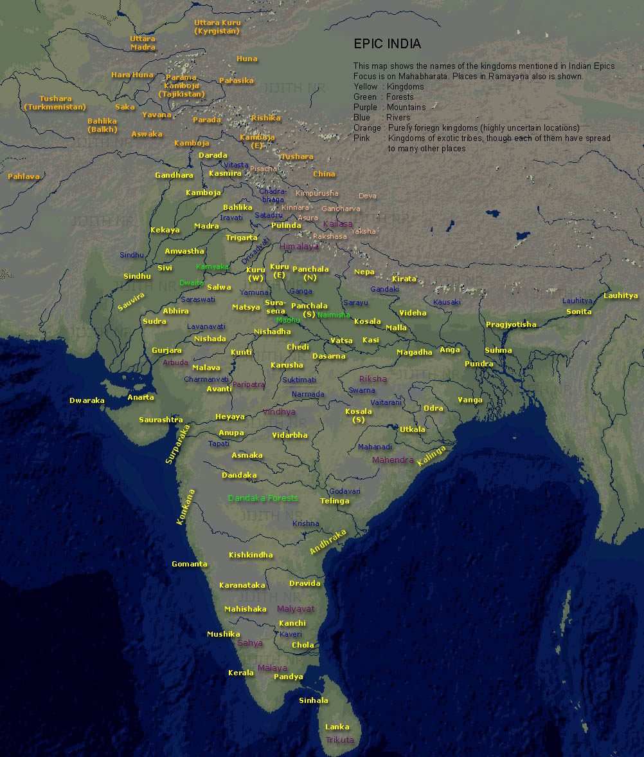
Ramayama
24000 verses
anuṣṭubh: ancient Vedic meter and a metrical unit, a quatrain of four verses.
Sloka: epic verse of two hemistich (half-verse) of 16 syllables
7 books (kandas)
500 cantos (sargas)

Slide 3
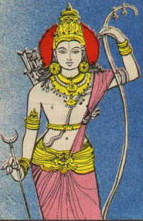
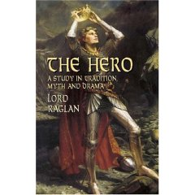
Aeneas as Hero
Some Definitions of "Hero"
Lord Raglan's Hero Pattern
The Hero Pattern applied to Women in Myth, History, and Literature
The Hero Quest
Stages in the Heroic Quest
Variations on the Theme of the Heroic Quest
Other Hero Patterns

Slide 4
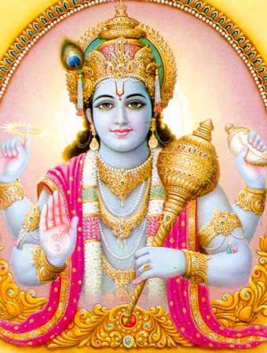
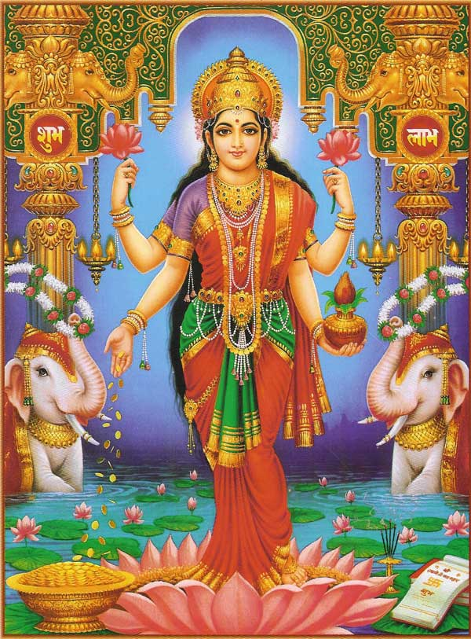
Vishnu and Lakshmi
Hindu goddess of beauty wealth, prosperity, light
Hindu god, the preserver of the universe

Slide 5
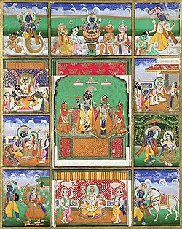
Avatar
a= descent or incarnation
Ten avatars of Vishnu
(clockwise, from upper left):
Matsya
Kurma
Varaha
Vamana
Krishna
Kalki
Buddha
Parshurama
Rama
Narasimha
Krishna (centre)

Slide 6
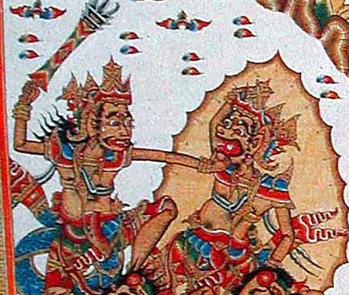
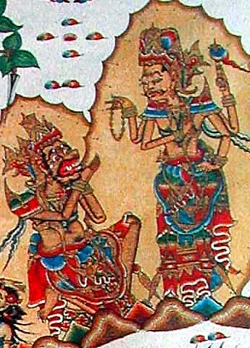
Ravana fighting Yama (lord of the dead)
Story cloth
Bali, Indonesia

Slide 7
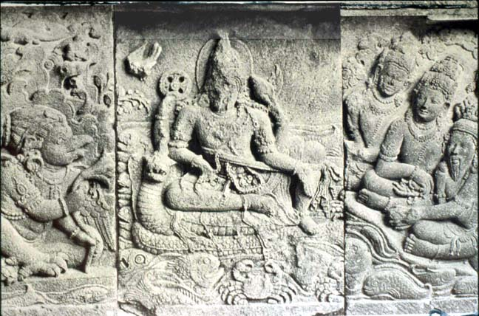
The god Vishnu) sits in heaven on a giant snake throne.
On his left kneels a garuda, on his right five gods ask Vishnu's help in defeating Rawana (Ravana) who is ravaging heaven and earth.
Temple relief
Prambanan, Java, Indonesia

Slide 8
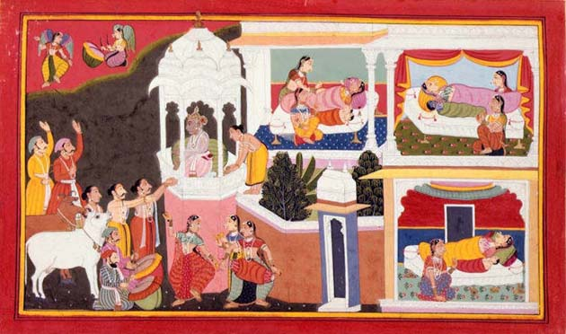
Birth of Four Sons of Dasa-ratha
Rama is born to Kausalya
Bharata is born to Kaikeyi
Sumitra gives birth to twins named Lakshmana and Shatrughna

Slide 9
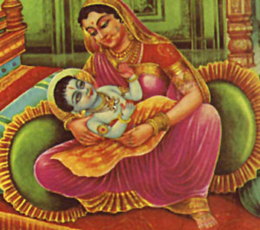
Kaushalya, Mother of Rama

Slide 10
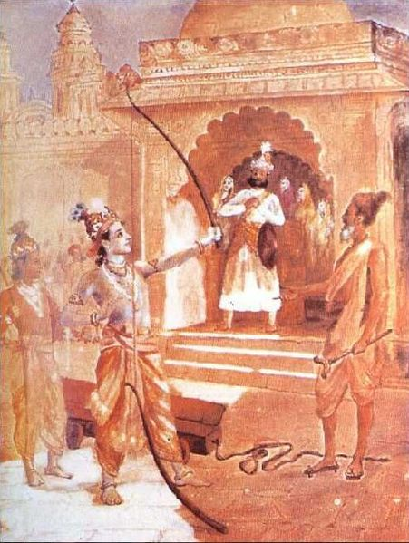
Rama breaks King Janaka’s Mighty Bow

Slide 11
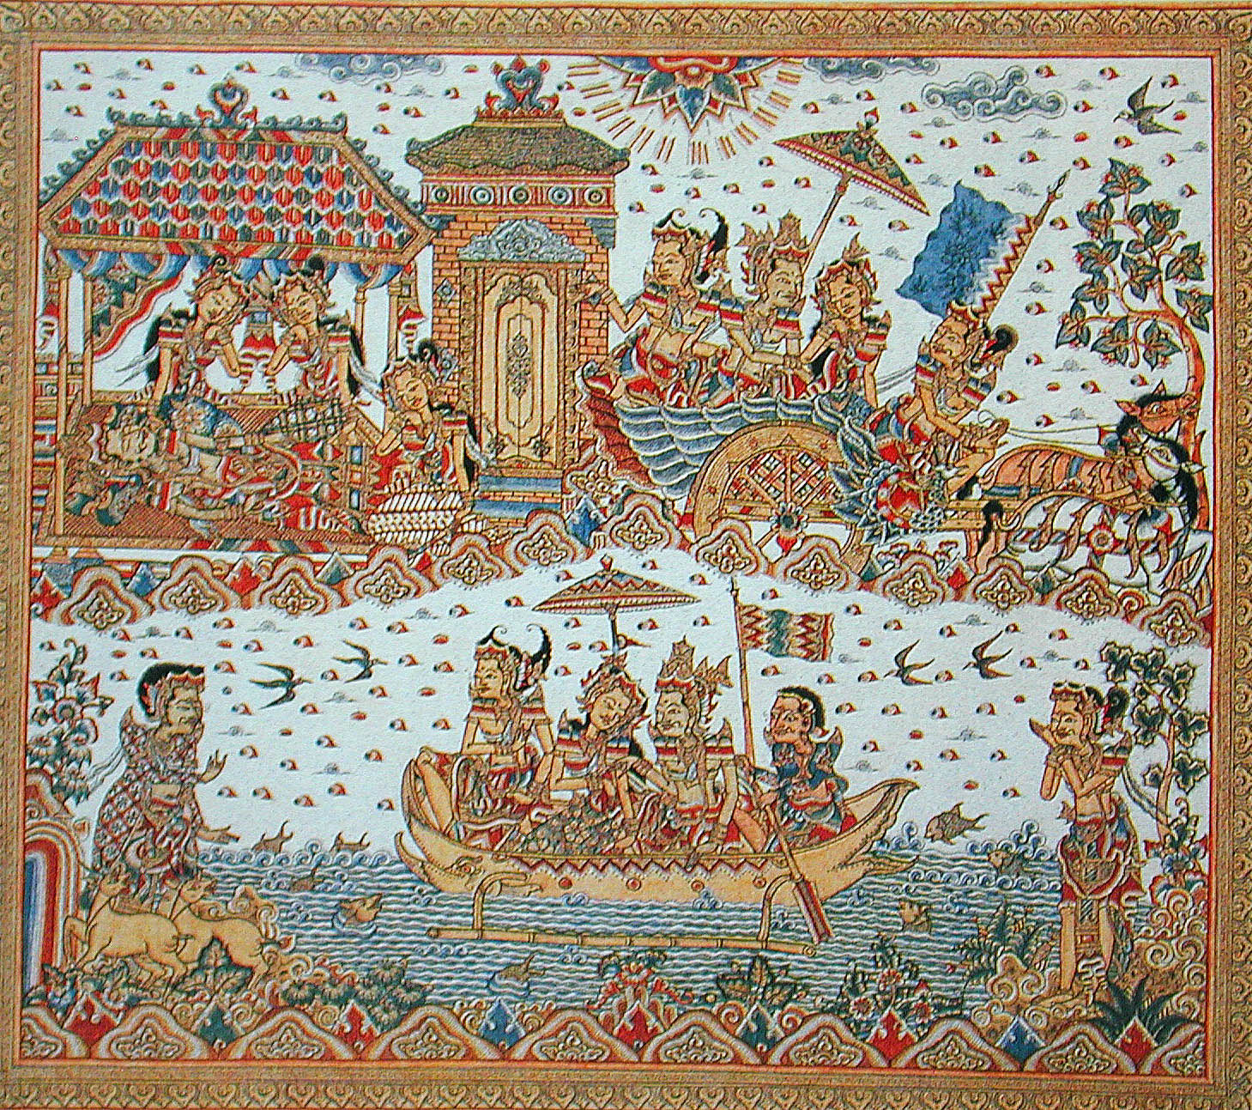
Story cloth
Bali, Indonesia

Slide 12
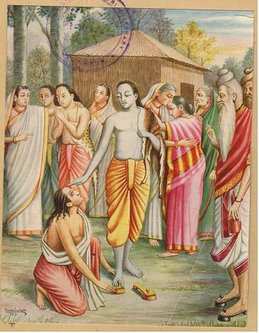
Bharata Asks for Rama's Footwear (Padukas)
Painting by Balasaheb Pandit Pant Pratinidhi
1916

Slide 13
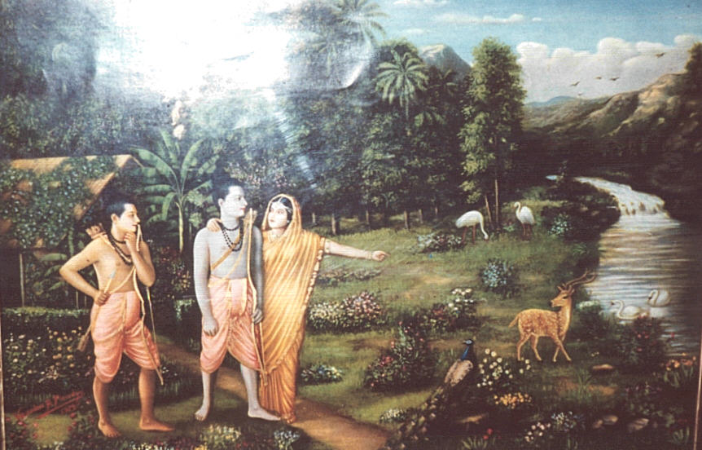

Slide 14
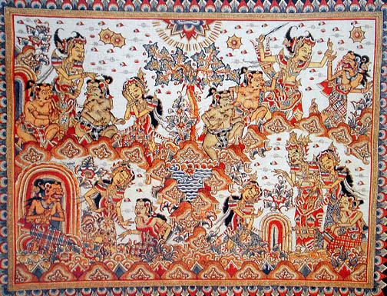
Ravana's ogress sister, Shurpanakha, disguises herself as a beautiful maiden, surprising a servant in the lower left corner.
Shurpanakha entices Rama as Sita and a servant listen. (Lower right)
Lakshmana cuts Shurpanakha's nose and she changes back into an ogress and flees. (Upper right.)
Story Cloth
Bali, Indonesia.

Slide 15
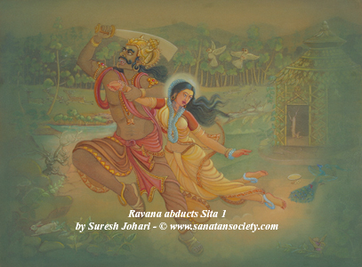

Slide 16
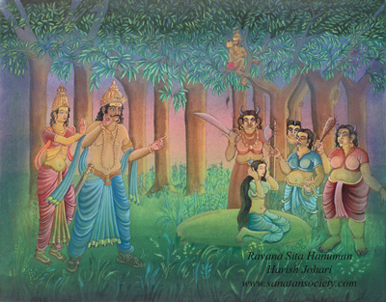

Slide 17
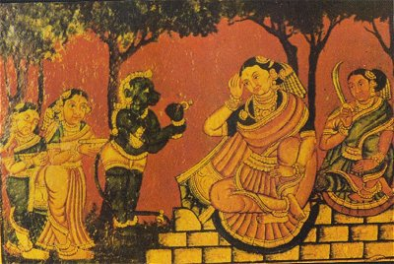

Slide 18
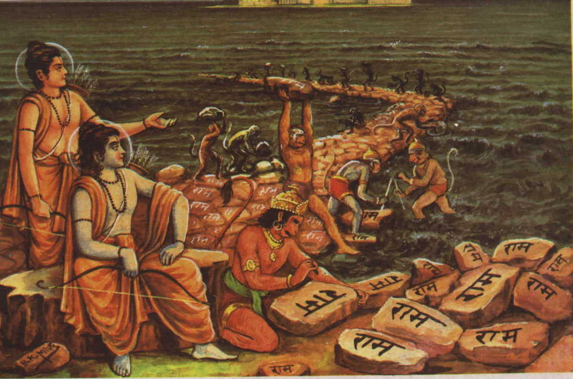

Slide 19
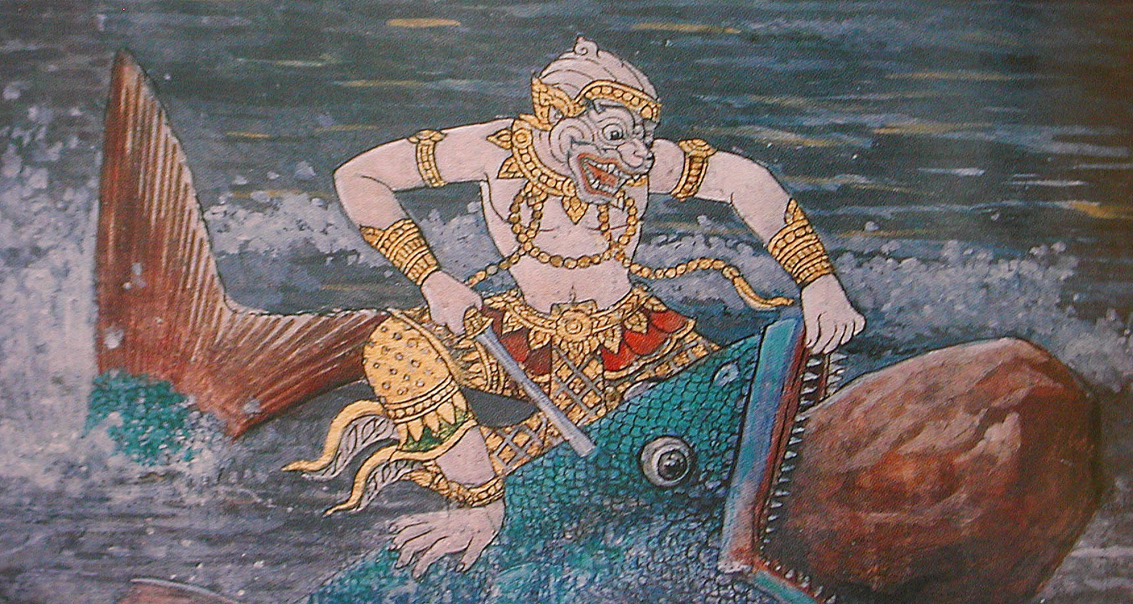

Slide 20
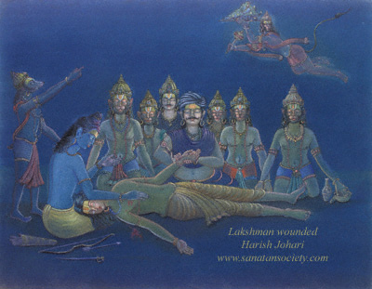

Slide 22
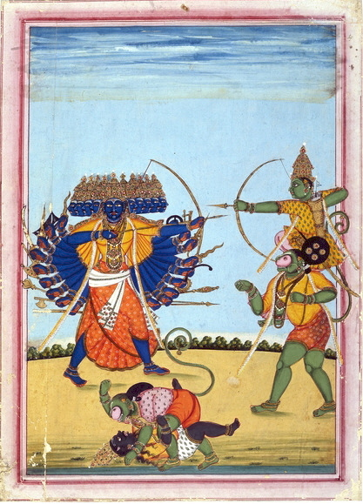
Rama and Hanuman fighting Ravana
c.1820
Tanjore or Trichinopoly, Tamil Nadu, India,

Slide 23
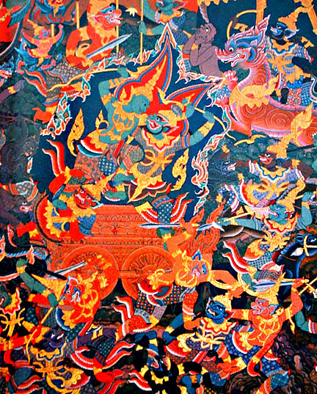

Slide 24
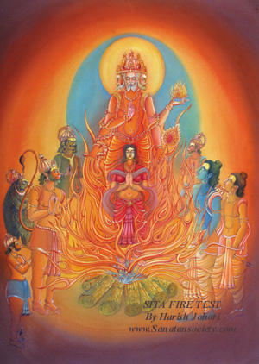

Slide 25
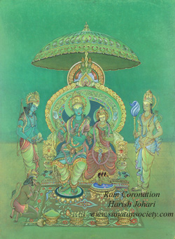

Slide 26
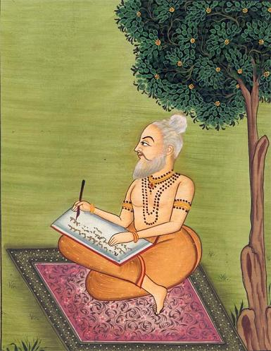
Valmiki
author of the Ramayama
c.400 B.C.
father of Sanskrit literature
Adi Kavi (the first poet)

Slide 27
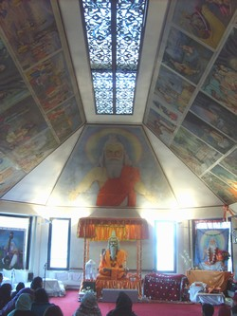
Valmikism (Balmikisim)
Monotheism: There is only one God, who incarnated on Earth as Maharishi Valmiki.
Sacred Text: The Ramayana as sacred scripture .
Important Premises:
  Dharma - the path of duty or right action and the fulfillment of one’s domestic responsibilities attached to one’s role in life; only if this is carried out mindfully and with dedication can it be effective.
  Karma - the theory that there are equal and opposite reactions for every action or that as you sow, so shall you reap
  Evil, as illustrated in the form of Ravana, can have no power over those who are dutiful, faithful and obedient.
Balmiki ashram (temple)

Slide 28
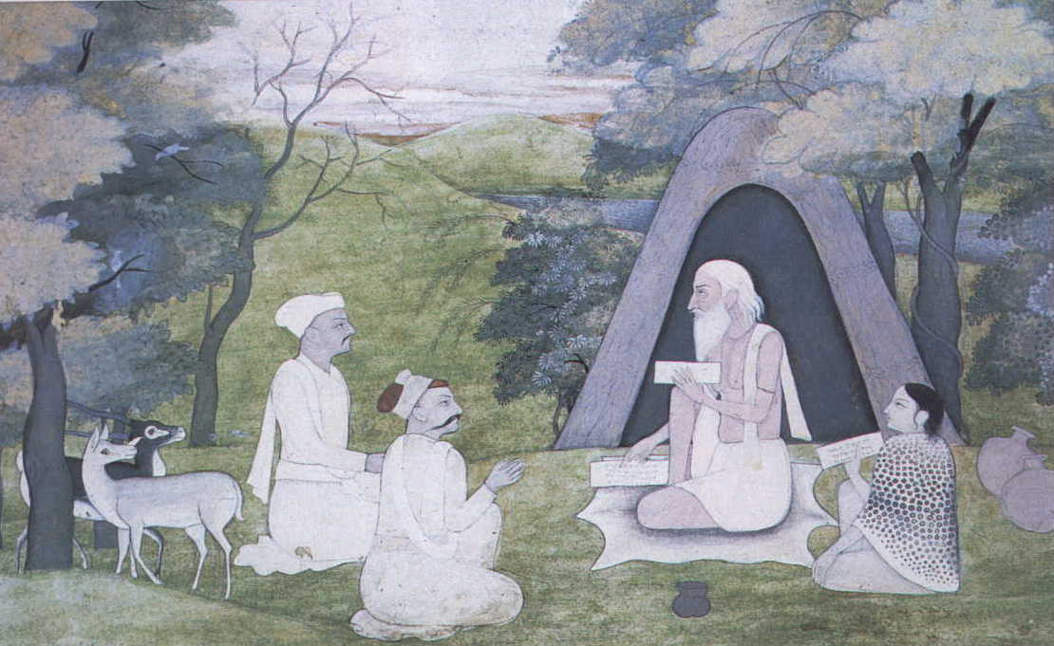
Valmiki Maharishi

Slide 29
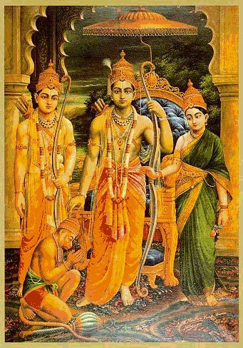
Charter Myth in Ramayana
Charter Myth: The centrality of the Ramayana, which is not just a story but illustrates several ideals of human behavior.
  Rama: the ideal King. Duty to the people before his responsibility to his family.
  Sita: the ideal wife, remaining faithful to her husband.
  Lakshmana: the ideal brother, supporting his brother without question, even at great loss to himself.
  Hanuman: the ideal devotee.
  Respect for the animal kingdom is as important as respect for one’s fellow human-being. The Ramayana taught the importance of man’s kinship with the animal Kingdom as characterized by Hanuman a warrior from the monkey tribe.

