Slide 1
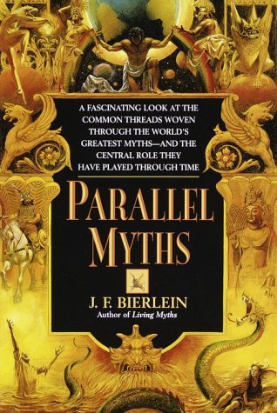
Bierlein: What is Myth?
Language and Myth
Time and Myth
Sacred Time vs. Profane Time
History and Myth
Civic Myth
Morality and Myth

Slide 2
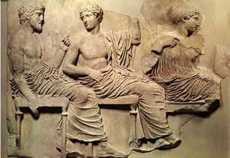
the projection of human features or qualities on the divine
32
28
theriomorphism
personification
anthropomorphism
aetiology
10
Mean = 2.8214

Slide 3
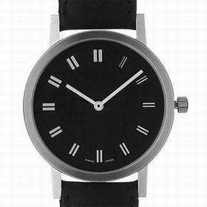
A separate time for a separate reality that transcends everyday routine
32
29
sacred
profane
mealtime
0
Mean = 1.069

Slide 4
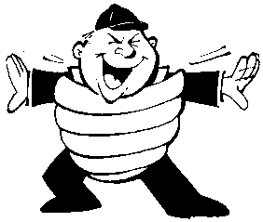
Which of the following is not an example of sacred time?
32
29
Christian Eucharist
a wristwatch
the Jewish Sabbath
a football game
10
Mean = 2.1379

Slide 5
Bierlein: What is Myth?
Language and Myth
Time and Myth
Sacred Time vs. Profane Time
History and Myth
Civic Myth
Morality and Myth

Slide 6
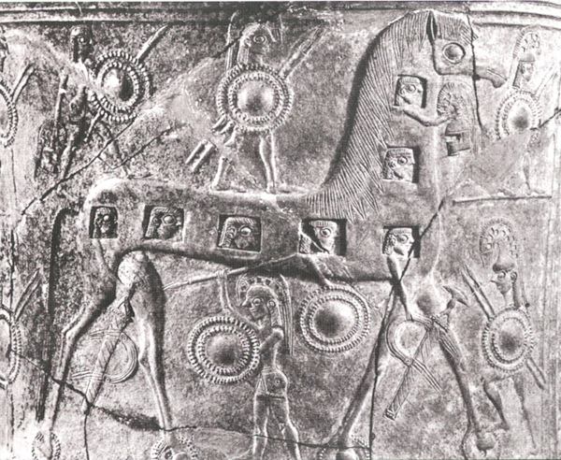
Myths, History and Material Culture
Was there a Troy?
Was there a Trojan War?
Was there a Trojan Horse?
Was there a labyrinth?
Was there a minotaur?
Was there a King Minos?

Slide 7
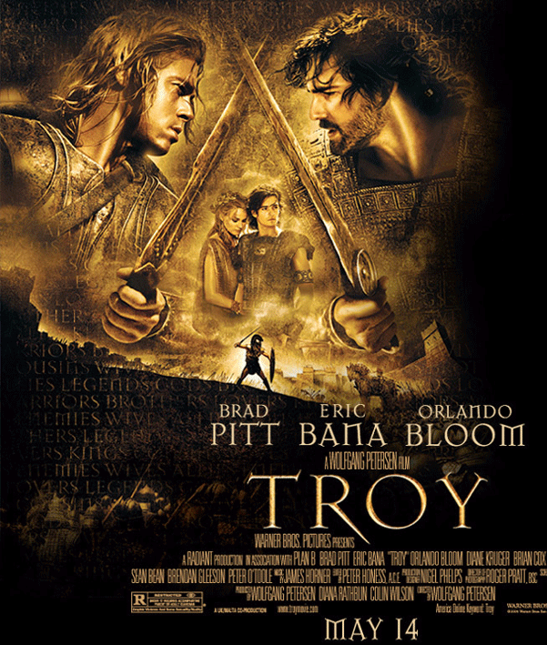
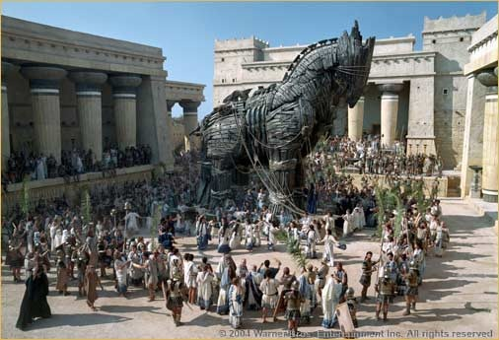
Troy (Ilium)
Iliad = the story of Ilium

Slide 8
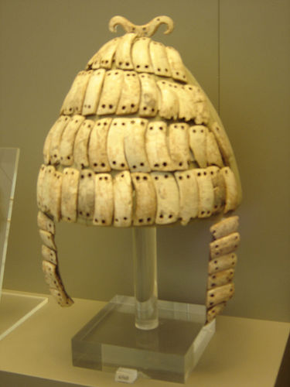
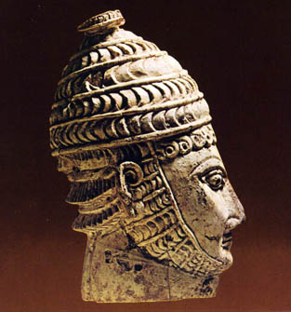
Odysseus’ Boar Tusk Helmet

Slide 9
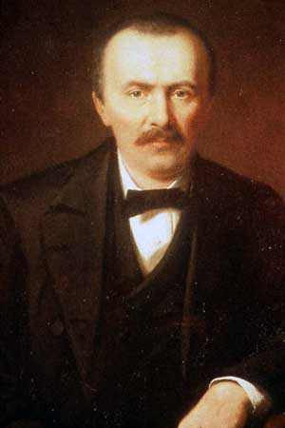
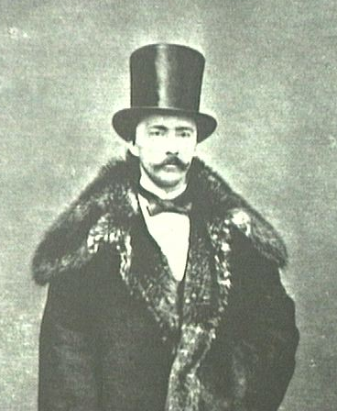
Heinrich Schliemann
Born: January 6, 1822 in Neu-Buckow / Mecklenburg, Germany
Died: December 26, 1890 in Naples / Italy

Slide 10
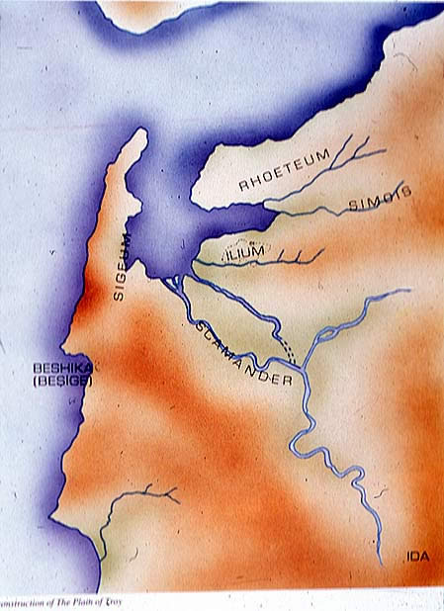
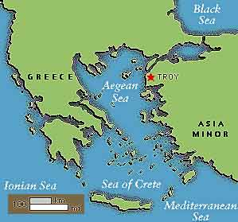

Slide 11
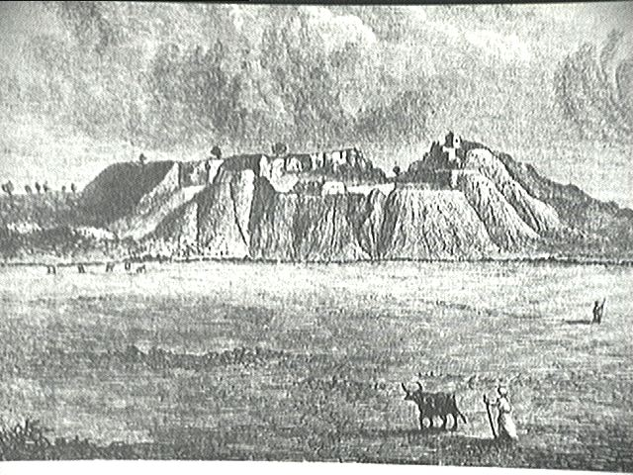
Hissarlik

Slide 12
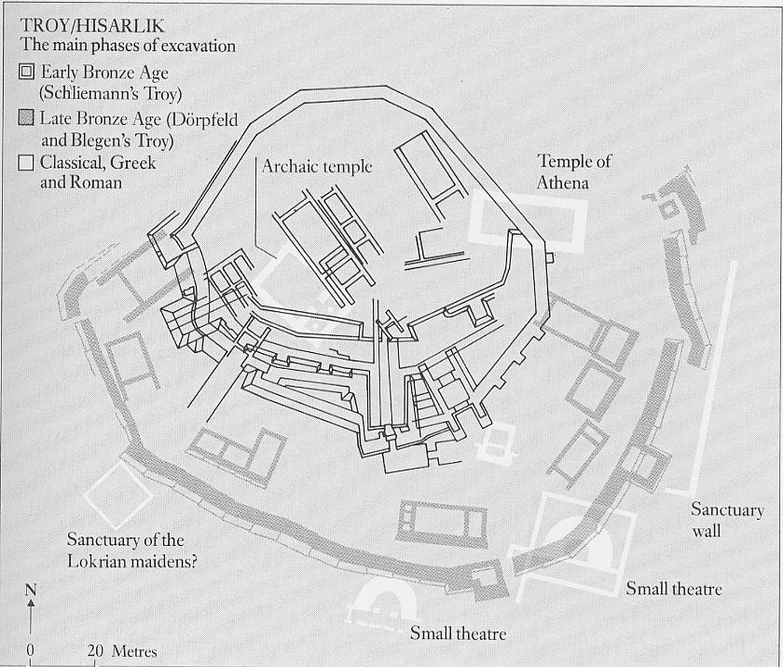

Slide 13
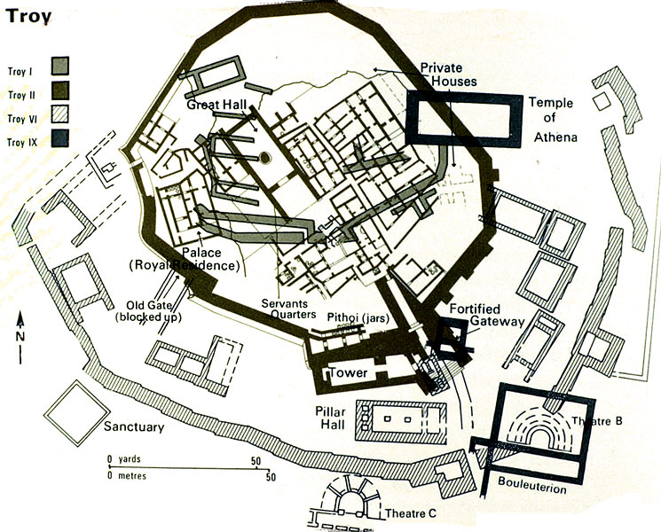

Slide 14
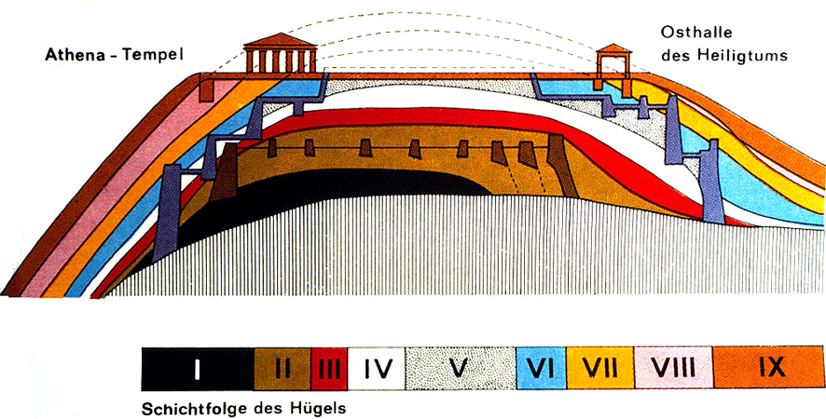

Slide 15
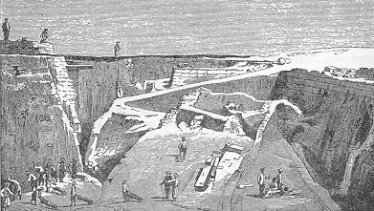

Slide 16
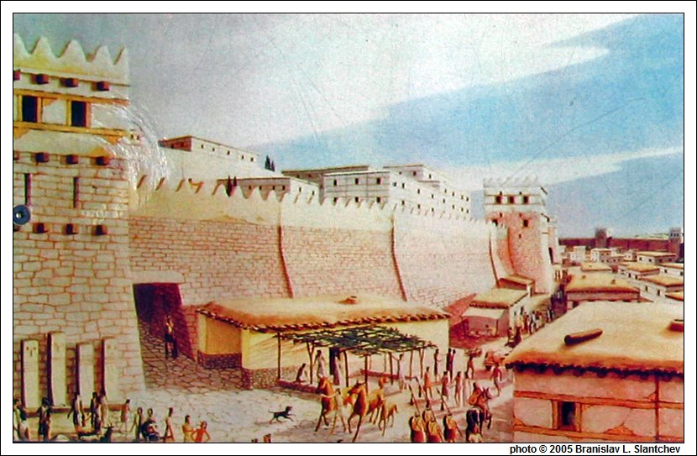

Slide 17
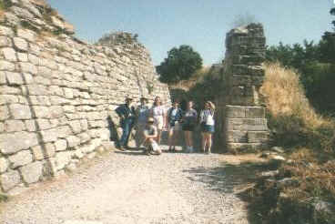
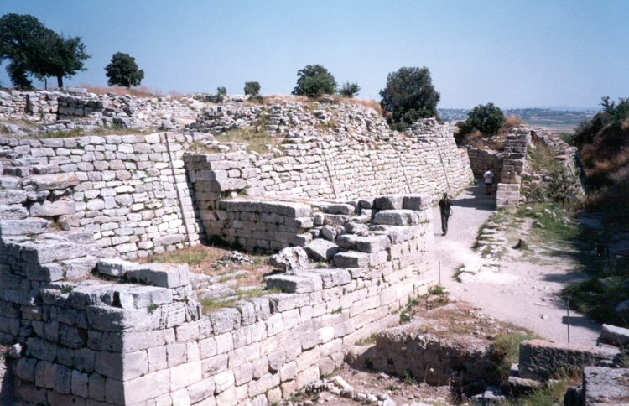
Troy Today

Slide 18
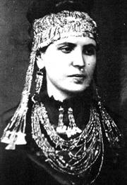
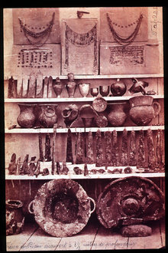
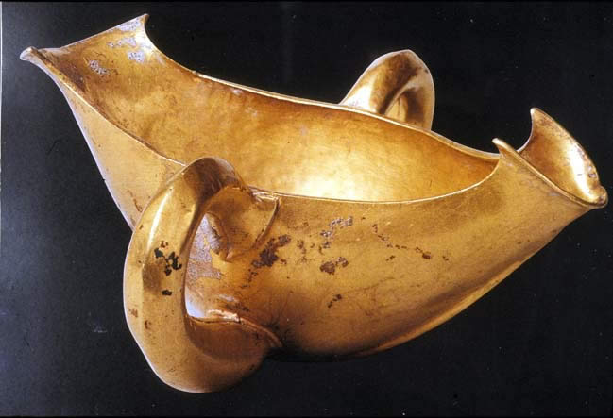
Priam’s Gold
Troy “Rich in Gold”

Slide 19
Important Dates
c.2000 B.C. Troy II (Priam’s Troy?)
c.1250 B.C. Troy VIIa destroyed by fire
1183 B.C. Traditional Date for the Fall of Troy
1871-1873 Schliemann excavates at Hissarlik
1945 Priam’s Treasure disappears in the ruins of Berlin
1993 Treasure reappears in Pushkin Museum in Moscow

Slide 20
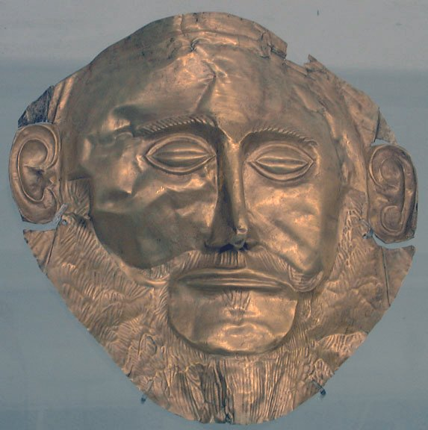
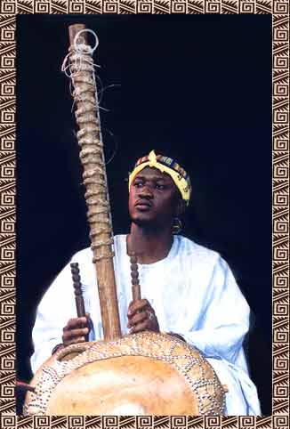
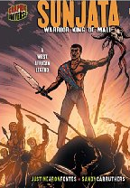
Myth and History
Odysseus’ Boar Tusk Helmet / Historical World behind the Trojan War; MC at Troy; Schliemann; Mycenae; Knossos / Plan of Knossos / Chronology / Timeline of Roman History / Timeline
West Africa: Sunjata
http://orias.berkeley.edu/hero/sunjata/interview.html

Slide 21
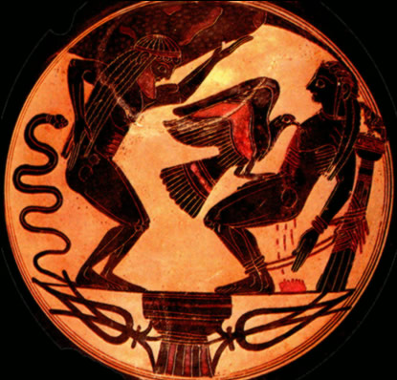
World Tricksters
Sisyphus
Hermes (Mercury)
Prometheus
Shaharazade
Anansi (Beirlein 159-165)
Maui (Bierlein 111-115)
Coyote
Brer Rabbit
Why are almost all tricksters MALE?

Slide 22
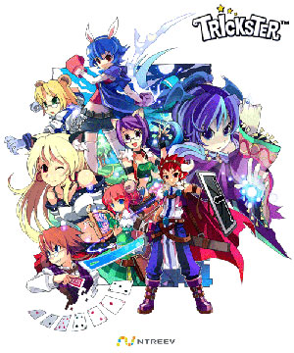
Tricksters
Trickster Tales / Native American Trickster Tales / Trickster & Coyote Links / Riddle of the Trickster / Transformations of the Trickster

Slide 23
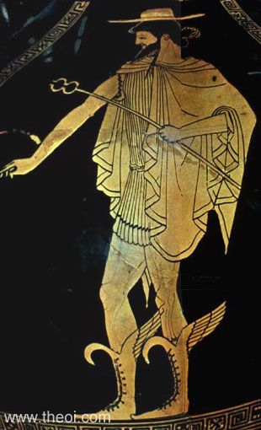
Trickster Characteristics
a mischievous or roguish figure
vulgar but sacred
makes up for physical weakness with cunning and subversive humor
alternates between cleverness and stupidity, kindness and cruelty, deceiver and deceived, breaker of taboos and creator of culture

