Slide 1
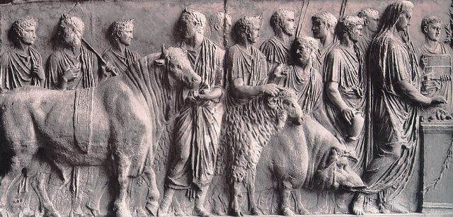
Roman Animal Sacrifice

Slide 2
Roman Sacrifice
1. Lustration (Purification)
  Circular procession around the victim, usually three times
2. Procession to the altar
3. Praefatio (Preface)
  Offerings of incense and wine on the altar
  The opening of ritual space
4. Immolatio
  Pouring of wine over victim’s head
  Sprinkling back with salted flour
  Passing sacrificial knife over victim’s spine
  Prayers transferring the victim from human to divine possession
5. Slaughtering
  Victim is felled and butchered.
  The corpse is opened up and the vital organs inspected. (If the vital organs look suspicious, the sacrifice needs to begin again with a different victim.)
6. Banquet
  Beheading of the victim
  Vital organs are set aside and prepared as offerings to the gods (either boiled or roasted)
  Then the meat of the victim was cooked and eaten in a sacrificial meal.

Slide 3
Suovetaurilia
The suovetaurilia or suovitaurilia : the sacrifice of a pig (sus), a sheep (ovis) and a bull (taurus) to the deity Mars to bless and purify land (lustratio).
http://en.wikipedia.org/wiki/Suovetaurilia

Slide 4
The ritual is preserved in Cato the Elder's De Agri Cultura, "On Agriculture".
The first step was to lead the three animals around the boundaries f the land to be blessed, pronouncing the following words:
Cum divis volentibus quodque bene eveniat, mando tibi, Mani, uti illace suovitaurilia fundum agrum terramque meam quota ex parte sive circumagi sive circumferenda censeas, uti cures lustrare.
"That with the good help of the gods success may crown our work, I bid thee, Manius, to take care to purify my farm, my land, my ground with this suovetaurilia, in whatever part thou
thinkest best for them to be driven or carried around."

Slide 5
Mars pater, te precor quaesoque uti sies volens propitius mihi domo familiaeque nostrae, quoius re ergo agrum terram fundumque meum suovitaurilia circumagi iussi, uti tu morbos visos invisosque, viduertatem vastitudinemque, calamitates intemperiasque prohibessis defendas averruncesque; utique tu fruges, frumenta, vineta virgultaque grandire beneque evenire siris, pastores pecuaque salva servassis duisque bonam salutem valetudinemque mihi domo familiaeque nostrae; harumce rerum ergo, fundi terrae agrique mei lustrandi lustrique faciendi ergo, sicuti dixi, macte hisce suovitaurilibus lactentibus inmolandis esto; Mars pater, eiusdem rei ergo macte hisce suovitaurilibus lactentibus esto
"Father Mars, I pray and beseech thee that thou be gracious and merciful to me, my house, and my household; to which intent I have bidden this suovetaurilia to be led around my land, my ground, my farm; that thou keep away, ward off, and remove sickness, seen and unseen, barrenness and destruction, ruin and unseasonable influence; and that thou permit my harvests, my grain, my vineyards, and my plantations to flourish and to come to good issue, preserve in health my shepherds and my flocks, and give good health and strength to me, my house, and my household. To this intent, to the intent of purifying my farm, my land, my ground, and of making an expiation, as I have said, deign to accept the offering of these suckling victims; Father Mars, to the same intent deign to accept the offering of these suckling offering."

Slide 6
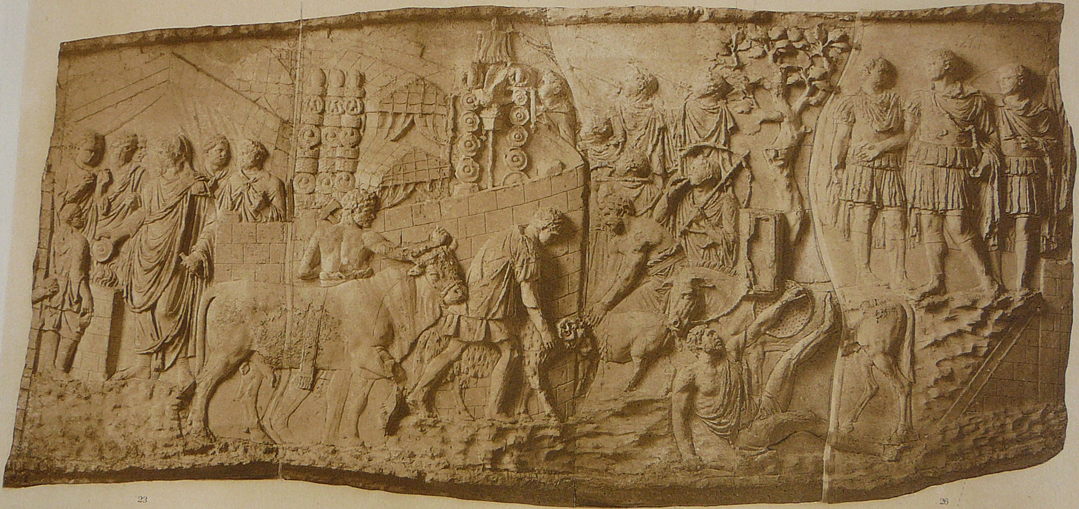

Slide 7
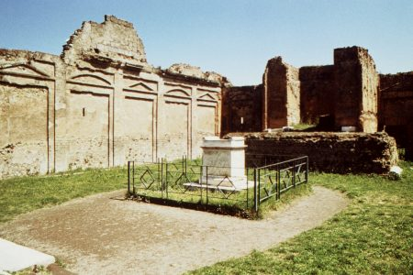
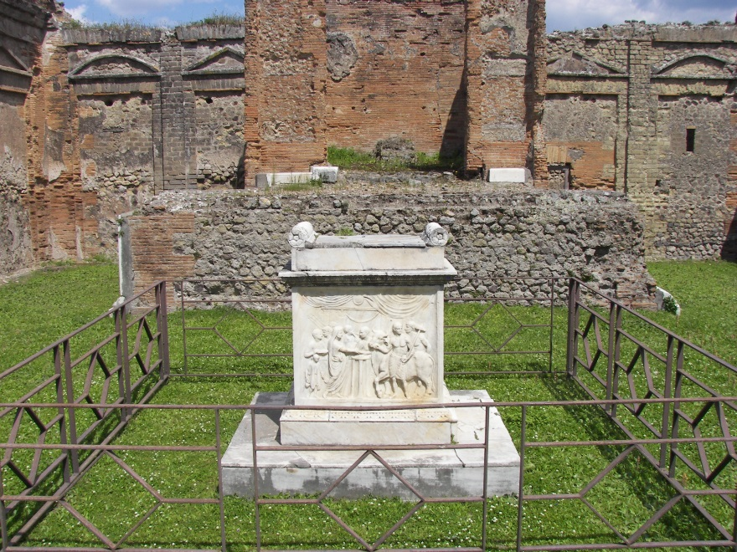
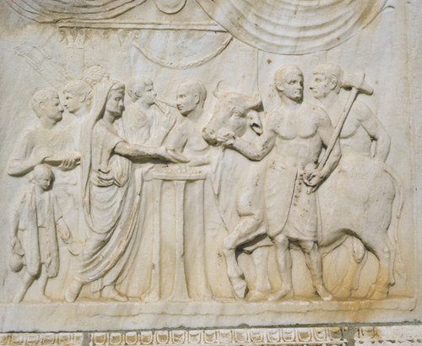
Sacrifice of a bull. (Temple of Vespasian, Pompeii)

Slide 8
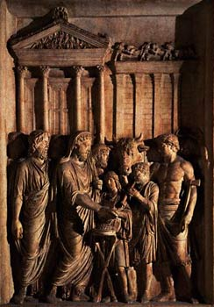
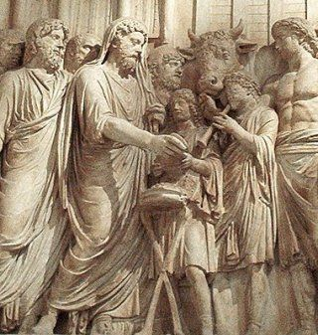
The emperor Marcus Aurelius sacrificing in front of the temple of Jupiter; the flute player stands opposite him. (VRoma: Capitoline Museums, Rome: Susan Bonvallet)

Slide 9
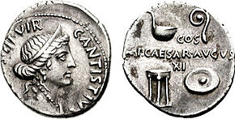
Roman Religious Practice:
Animal Sacrifice
Denarius issued under Augustus, with a bust of Venus on the obverse, and ritual implements on the reverse: clockwise from top right, the augur's staff (lituus), libation bowl (patera), tripod, and ladle (simpulum)

Slide 10
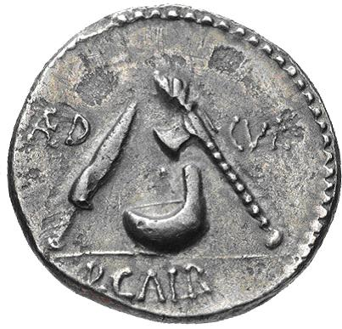
A denarius minted in Rome by P. Galba (69BC), shows the secespita (sacrificial knife), simplum (blood-catching vessel) and secures (axe) used in Roman sacrificial ritual.

Slide 11
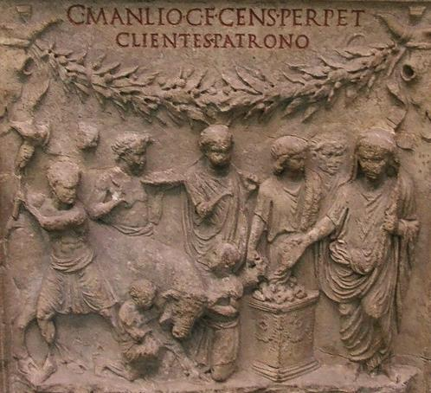
An Augustan-period altar from Cervetari dedicated to Gaius Manlius shows a male figure with his toga pulled over his head pouring wine onto an altar before which two kneeling victimarii hold the head of a bull while another prepares to swing the sacrificial axe. Behind the bull another victimarius holds the hammer used to stun the bull in his right hand and a plate with mola salsa in his left. In front of him stand a flute player and a camillus (boy sacrificial attendant). Vatican Museums, Rome

Slide 12
