Slide 1
Monmouth College 27 October 2013
The Karen Gould Collection

Slide 2
The Spencer Art Reference Library
The Nelson-Atkins Museum of Art

Slide 3
KGC 1
Bible, Old Testament, I & II Maccabees

Slide 4
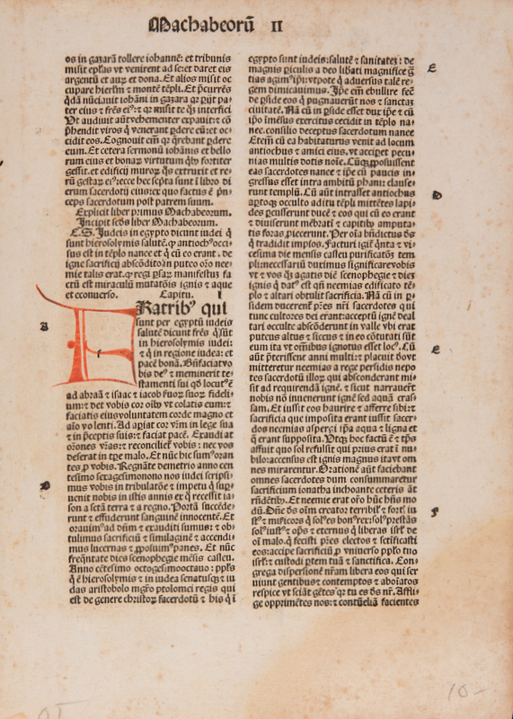
KGC 10
I & II Maccabees
Printed: Strasbourg, 1497
Material: Paper

Slide 5
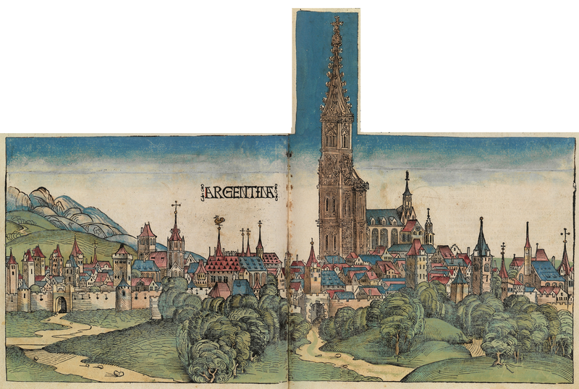
Notes:
The Nuremberg Chronicle is an illustrated biblical paraphrase and world history that follows the story of human history related in the Bible; it includes the histories of a number of important Western cities. Written in Latin by Hartmann Schedel, with a version in German, translation by Georg Alt, it appeared in 1493. It is one of the best-documented early printed books—an incunabulum —and one of the first to successfully integrate illustrations and text.

Slide 6
KGC 3
GLOSSA ORDINARIA

Slide 7
KGC 3 recto
Glossa ordinaria, Hebrews 2: 1-7a
Printed: Nuremberg, Anton Koberger, 1497
Material: Paper

Slide 8
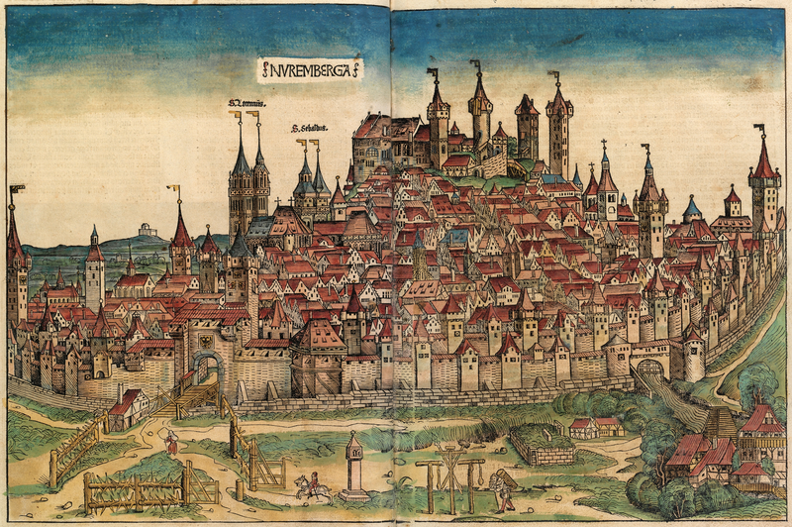

Slide 9
Notes:
Glossa ordinaria, Psalter (conclusion Psalm 36 & Psalm 37)
Format: Simple
Rebdorf, Germany
1st half 12th century

Slide 10
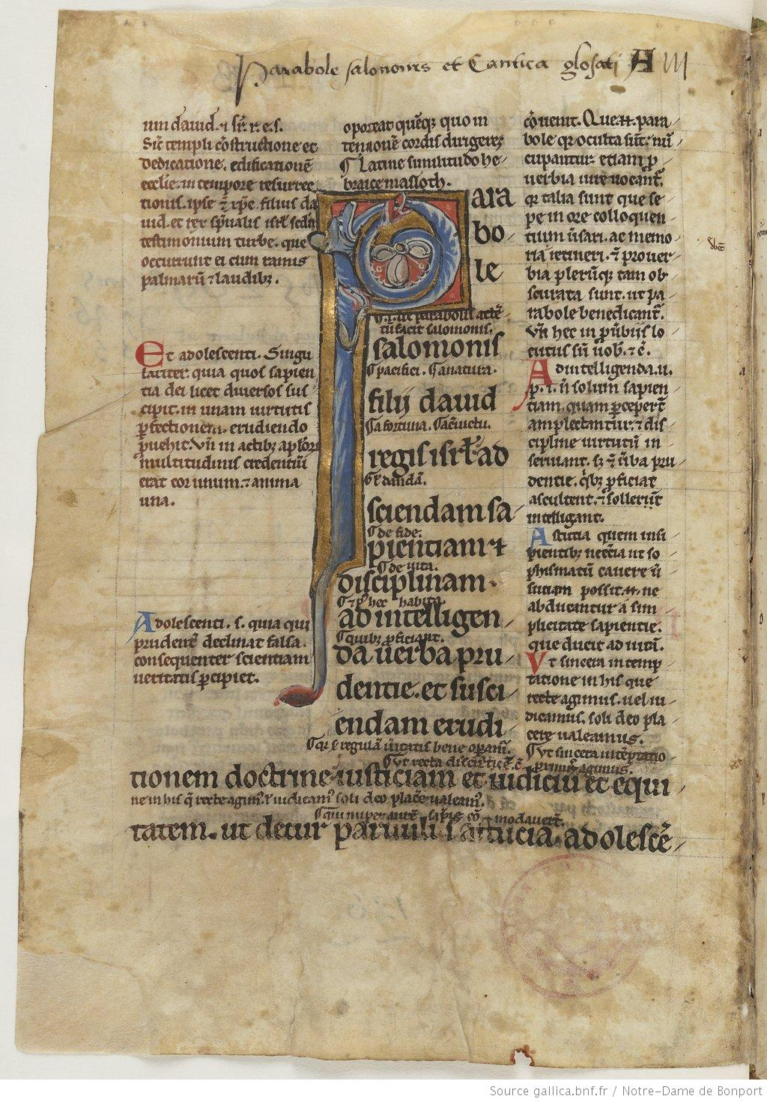
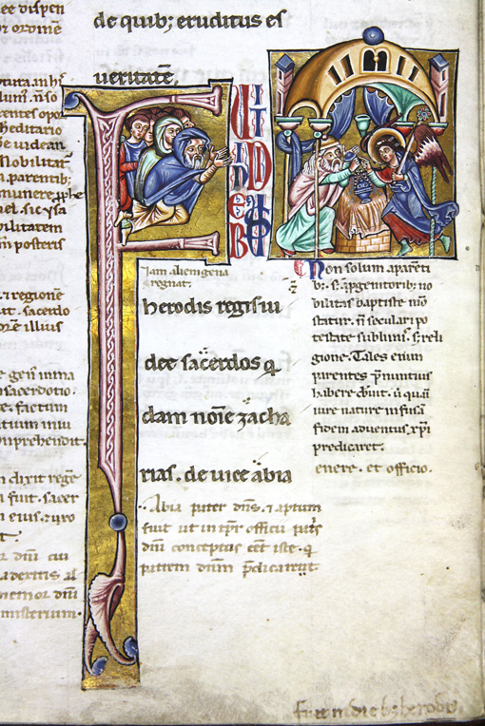
Notes:
Right: Glossa ordinaria, Proverbs 1: 1-4, France, early 13th cent. Format: Simple, Materials: Parchment
Dimensions: 9.4” x 6.3”; Left: Glossa ordinaria; Gospel of Luke 1: 4 & 5; Image: People of Jerusalem waiting for Zachary to return from the Holy of Holies; Format: Simple; Materials: Parchment.

Slide 11
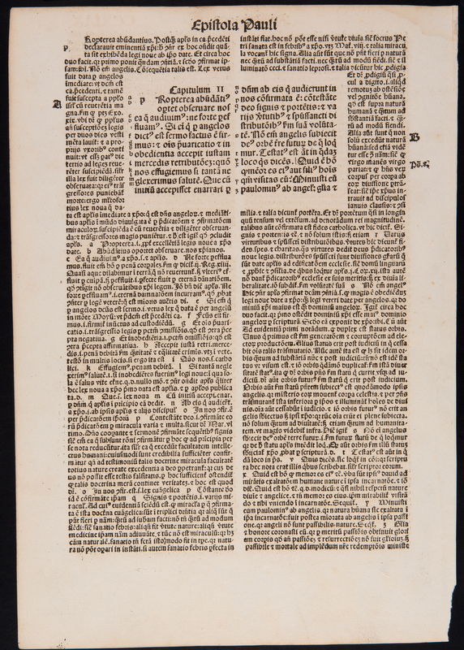
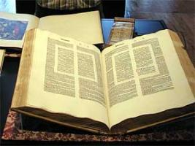

Slide 12
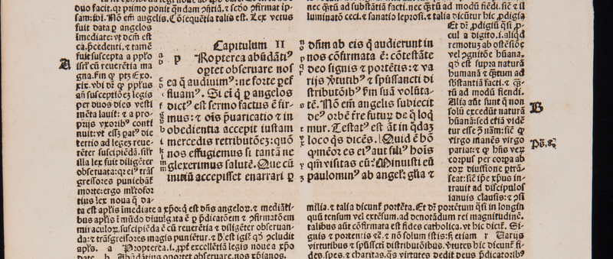

Slide 13
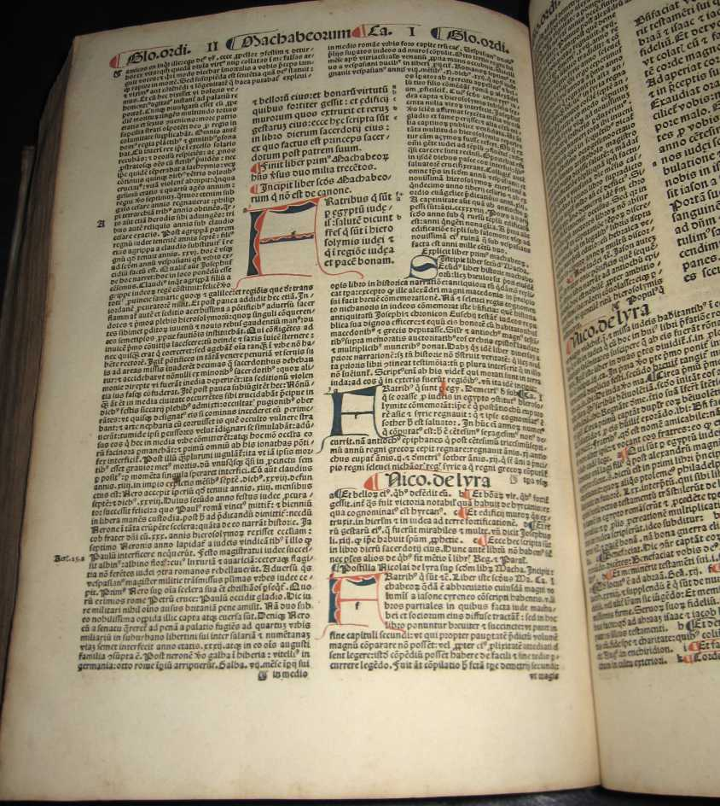
Notes:
Basel, 1498

Slide 14
KGC 7
Commentary on The Odes of Horace by Cristoforo Landino

Slide 15
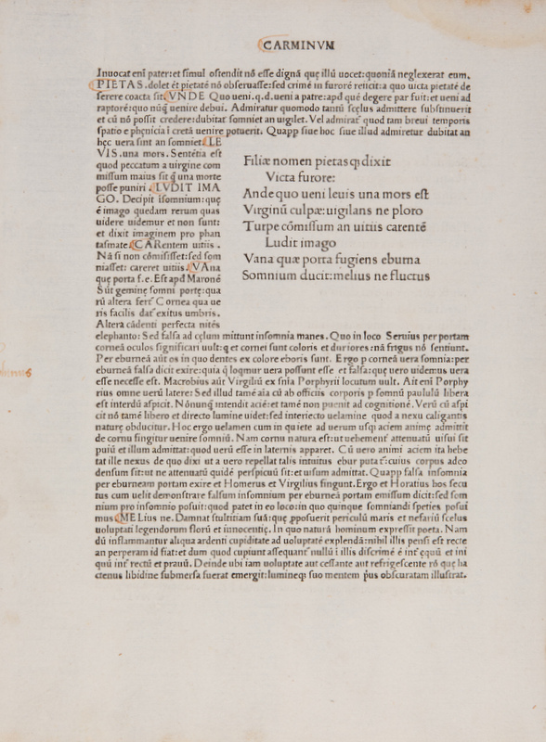
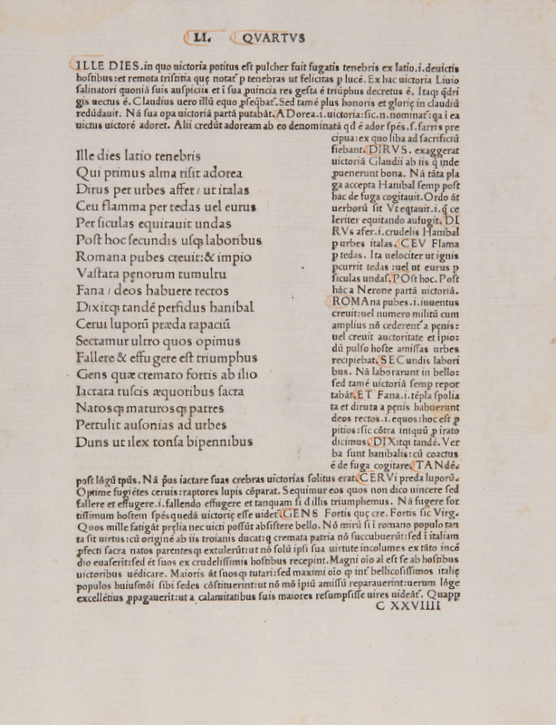
Notes:
Florence, 5 August 1482, Paper, running header, Commentary of Cristoforo Landino on the Opera of Horace

Slide 16
KGC 1
Peter Lombard, F0ur Books of Sentences

Slide 17
KGC 1 verso
Peter Lombard, Sentences
France, ca 1250
Material: Translucent parchment
Dimensions: 8.97” x 6.45”, text block 4.3” x 3”
Script: Informal textura

Slide 18
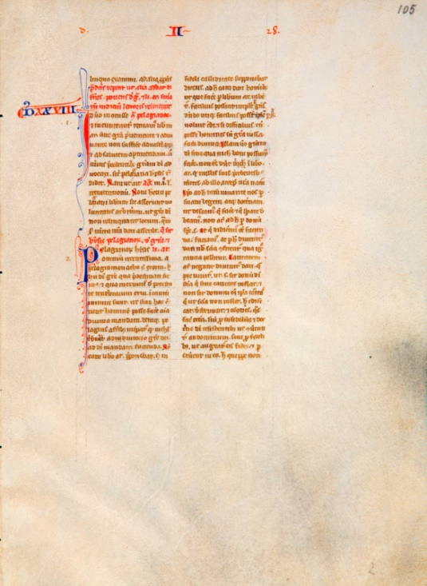
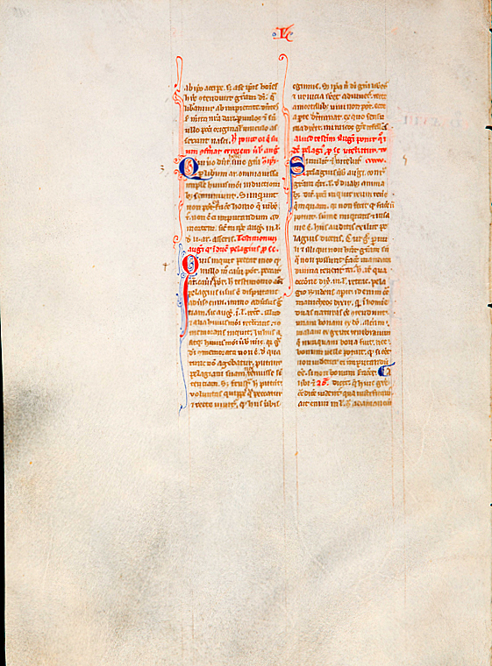

Slide 19
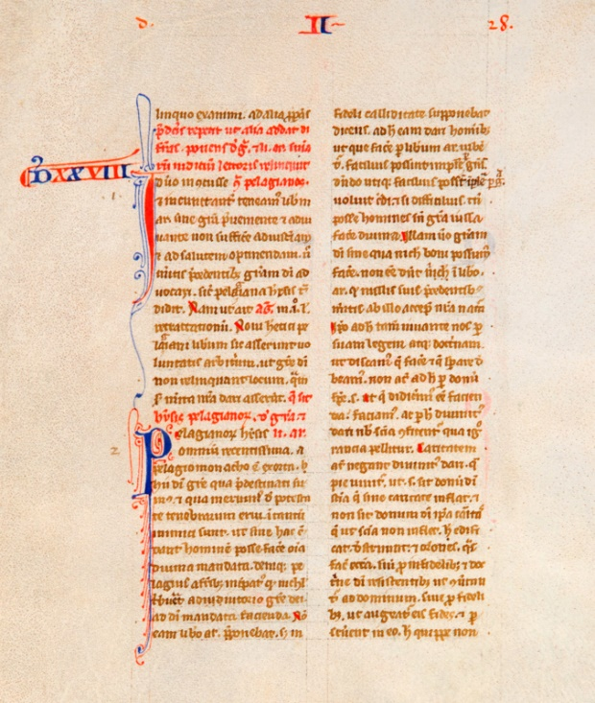

Slide 20
KGC 12
Thomas Aquinas, Commentary on the Lombard’s Sentences

Slide 21
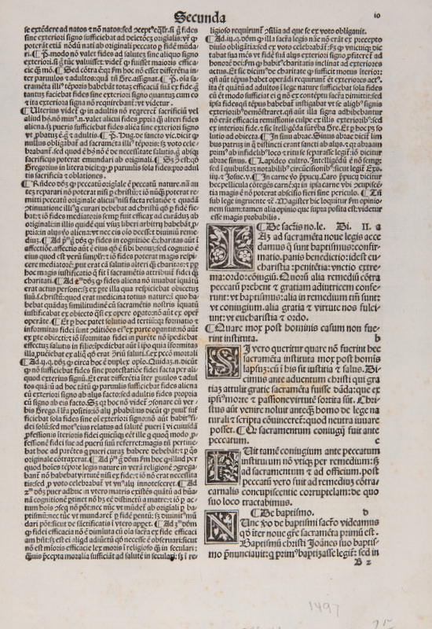
KGC 12
Thomas Aquinas, Scriptum super libros Sententiarum, Book 4, Distinctions 1 & 2
Venice, Bonetus Locatelli, 1497

Slide 22
KGC 27
Book of Hours, Calendar, May

Slide 23
KGC 27 recto
Book of Hours
France, 15th century
Calendar page for May
Material: Translucent parchment
Dimensions: 6.6” x 4.8”, text block 3.6” x 2.2”

Slide 24
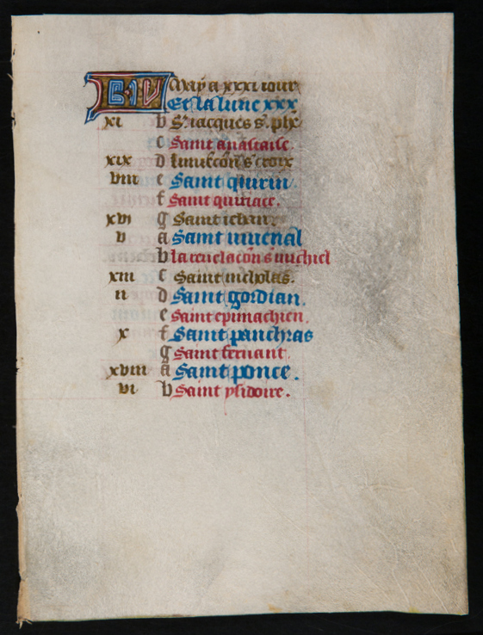
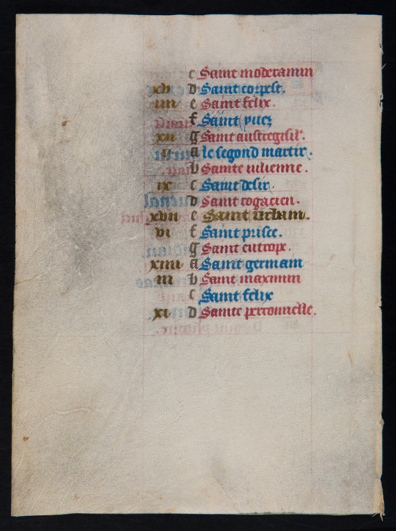

Slide 25
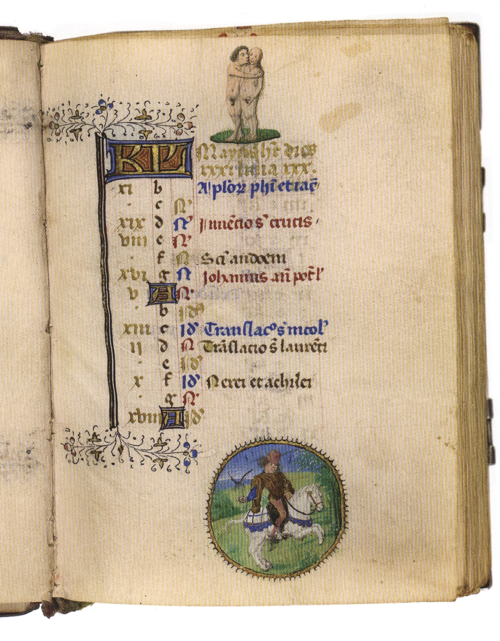
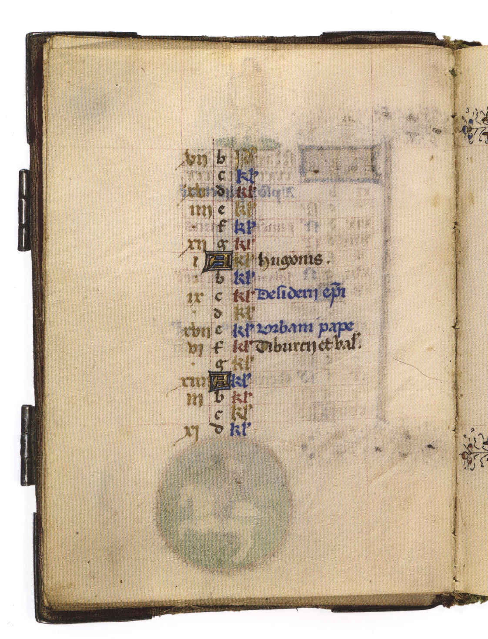

Slide 26
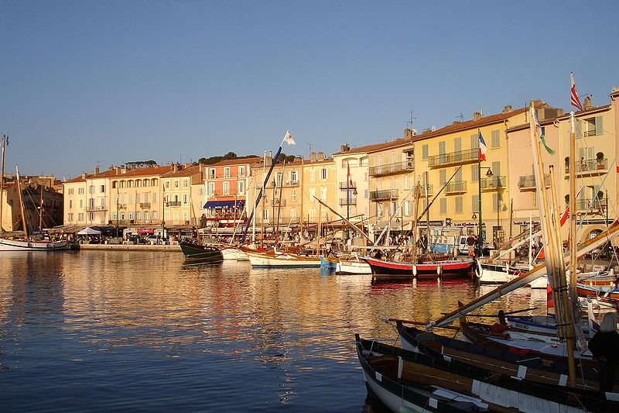
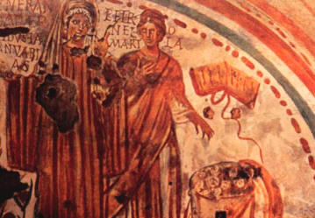
Saint Torpes of Pisa
Saint Petronilla

Slide 27
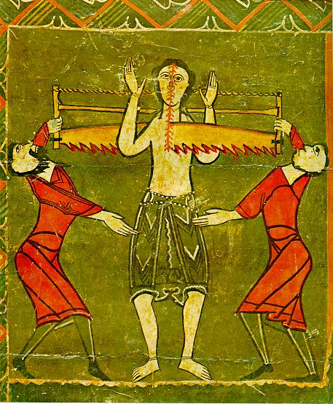
St Judas Cyriacus

Slide 28
KGC 15
Breviary, Feast of the Visitation of the BVM

Slide 29
KGC 15 recto
Breviary text
Italy, 15th century
Feast of the Visitation of the BVM
Material: Translucent Parchment
Dimensions: 5.2” x 4.25”, text block: 3.4” x 2.6”

Slide 30
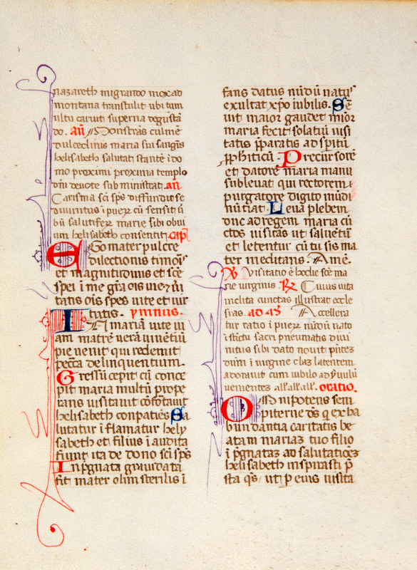
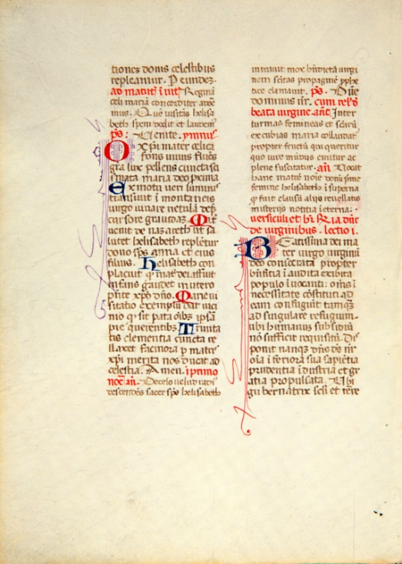

Slide 31
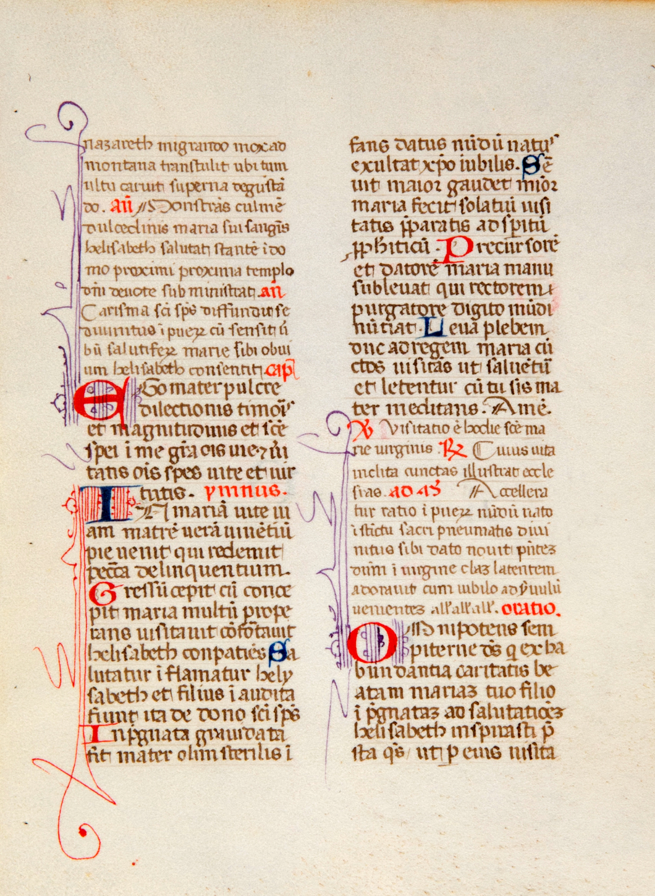
KGC 15 recto
First Vespers
Antiphons for psalmody
3rd antiphon conclusion
4th antiphon
5th antiphon
Reading
Hymn
Versicle & response
Magnificat antiphon
Oration beginning

Slide 32
KCG 15 verso
Matins
Invitatory antiphon
Hymn
First Nocturn
1st antiphon
2nd antiphon
3rd antiphon
Lesson 1

Slide 33
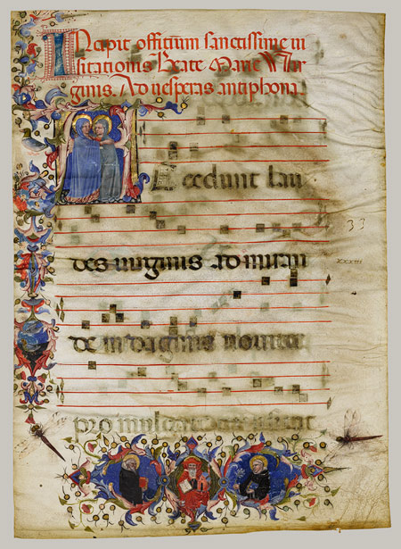

Slide 34
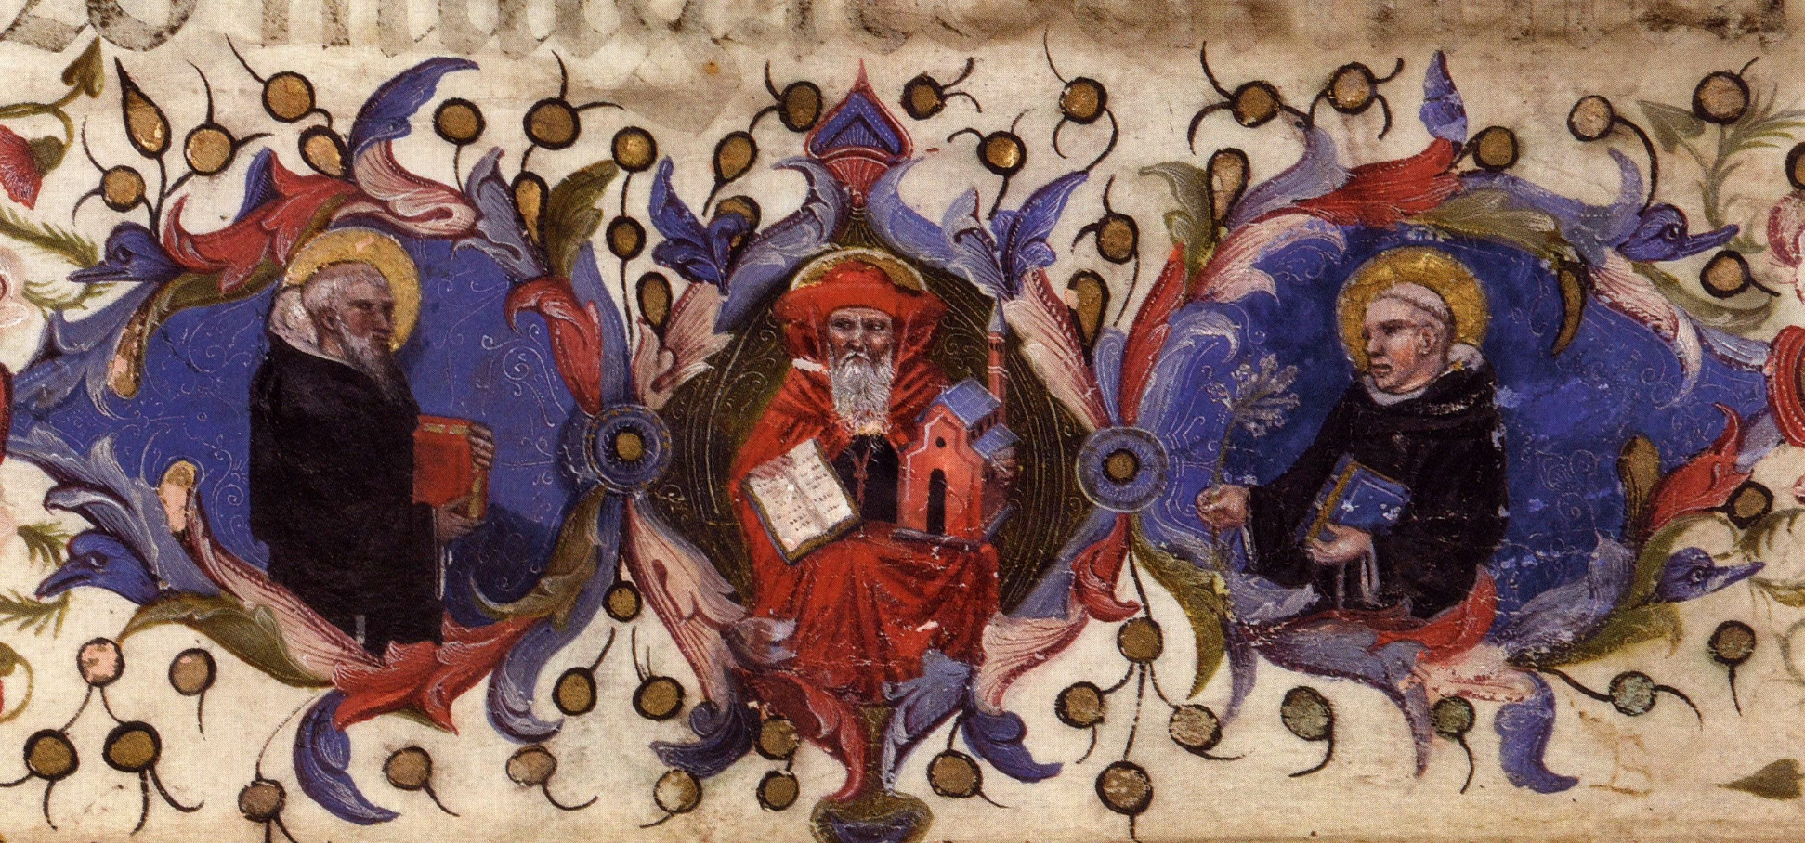

Slide 35
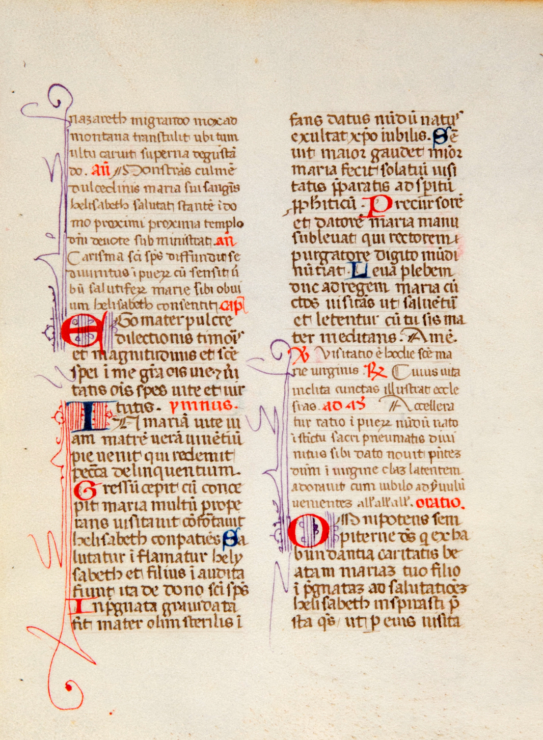
M
C
A

Slide 36
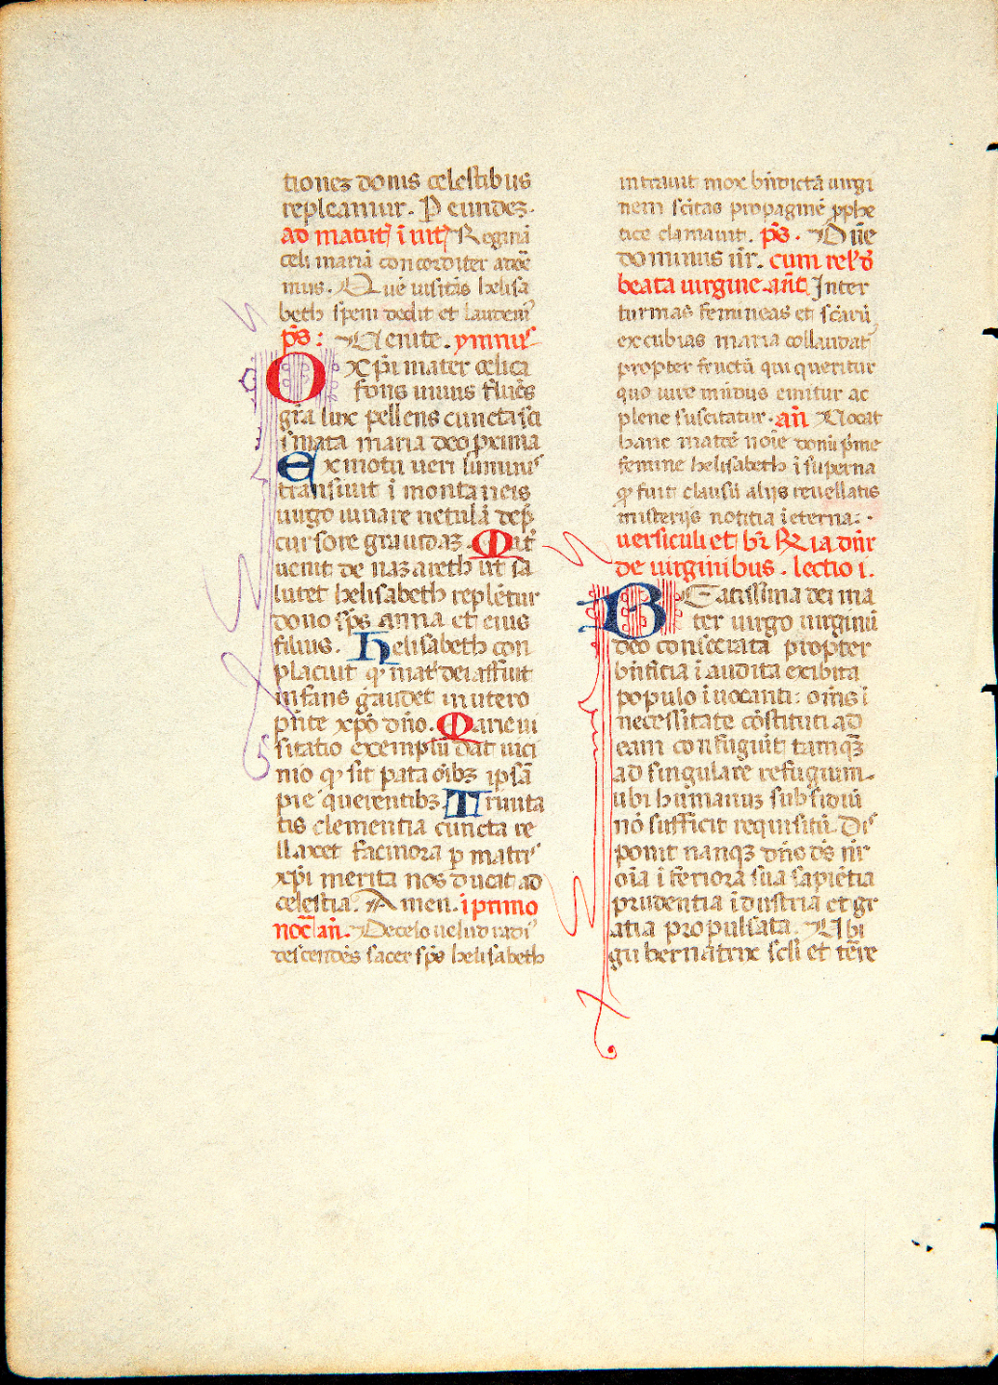
R
I
D

Slide 37
Karen Gould Collection
Type
Origin
19 manuscripts
11 incunables
1 post-1500
12 Italy
9 France
4 Germany
3 Low Countries
1 England

Slide 38
Karen Gould Collection
Date
Contents
1 from 12th century
2 from 13th century
3 from 14th century
21 from 15th century
4 from 16th century
8 liturgical texts (4 breviary, 2 missals, 1 graduale, 1 psalter?)
9 Books of Hours
14 other (1 Bible, 6 theology texts, 3 canon law texts, 2 letters, 2 literary texts)

Slide 39
Karen Gould Collection
New Additions

Slide 40
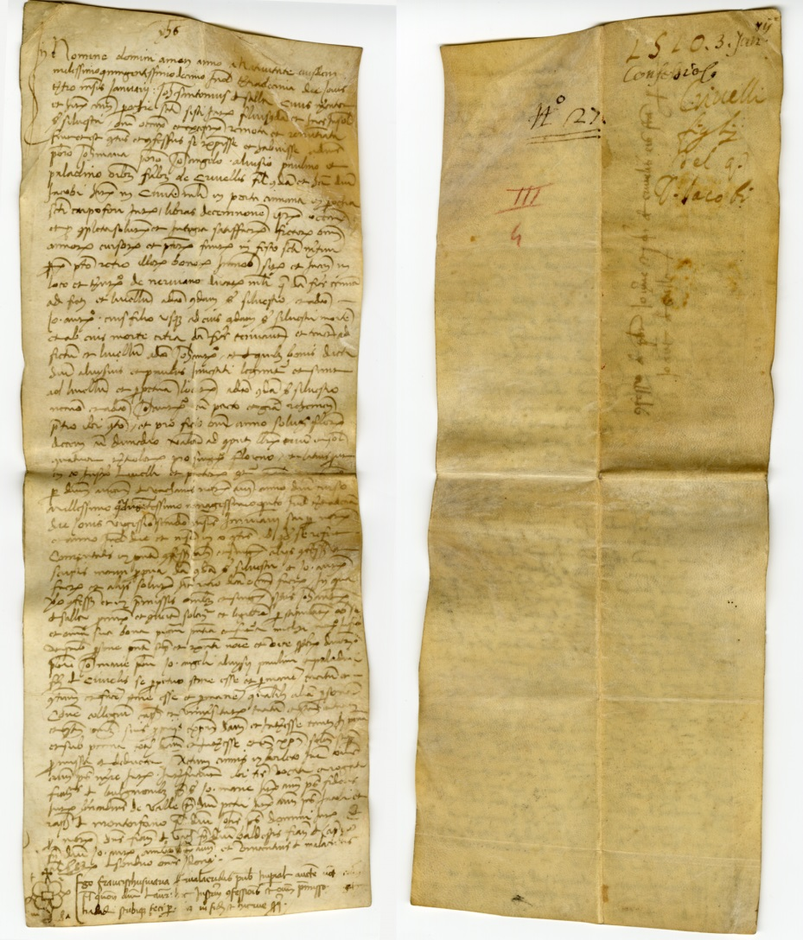
Notes:
KGC 32 Italy (possibly Milan), 1510. Confession of debt by one Johannes Antonius de Salla to 3 brothers, Notary Franciscus Marla _____, 1510

Slide 41
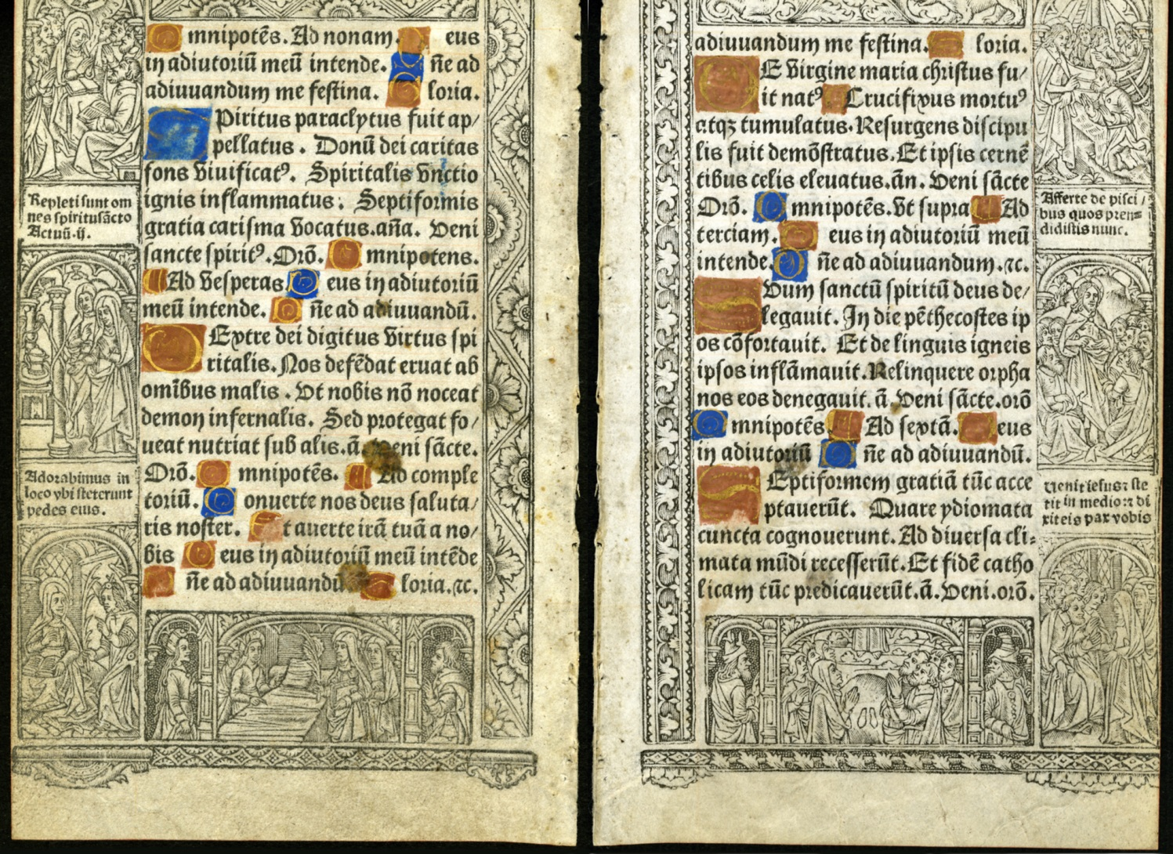
Notes:
KGC 33 Printed Parchment leaf containing prayers with illustrated borders (partial cropping at top and outer margin)
Latin, France (printed Philippe Pigouchet, 1510)

Slide 42
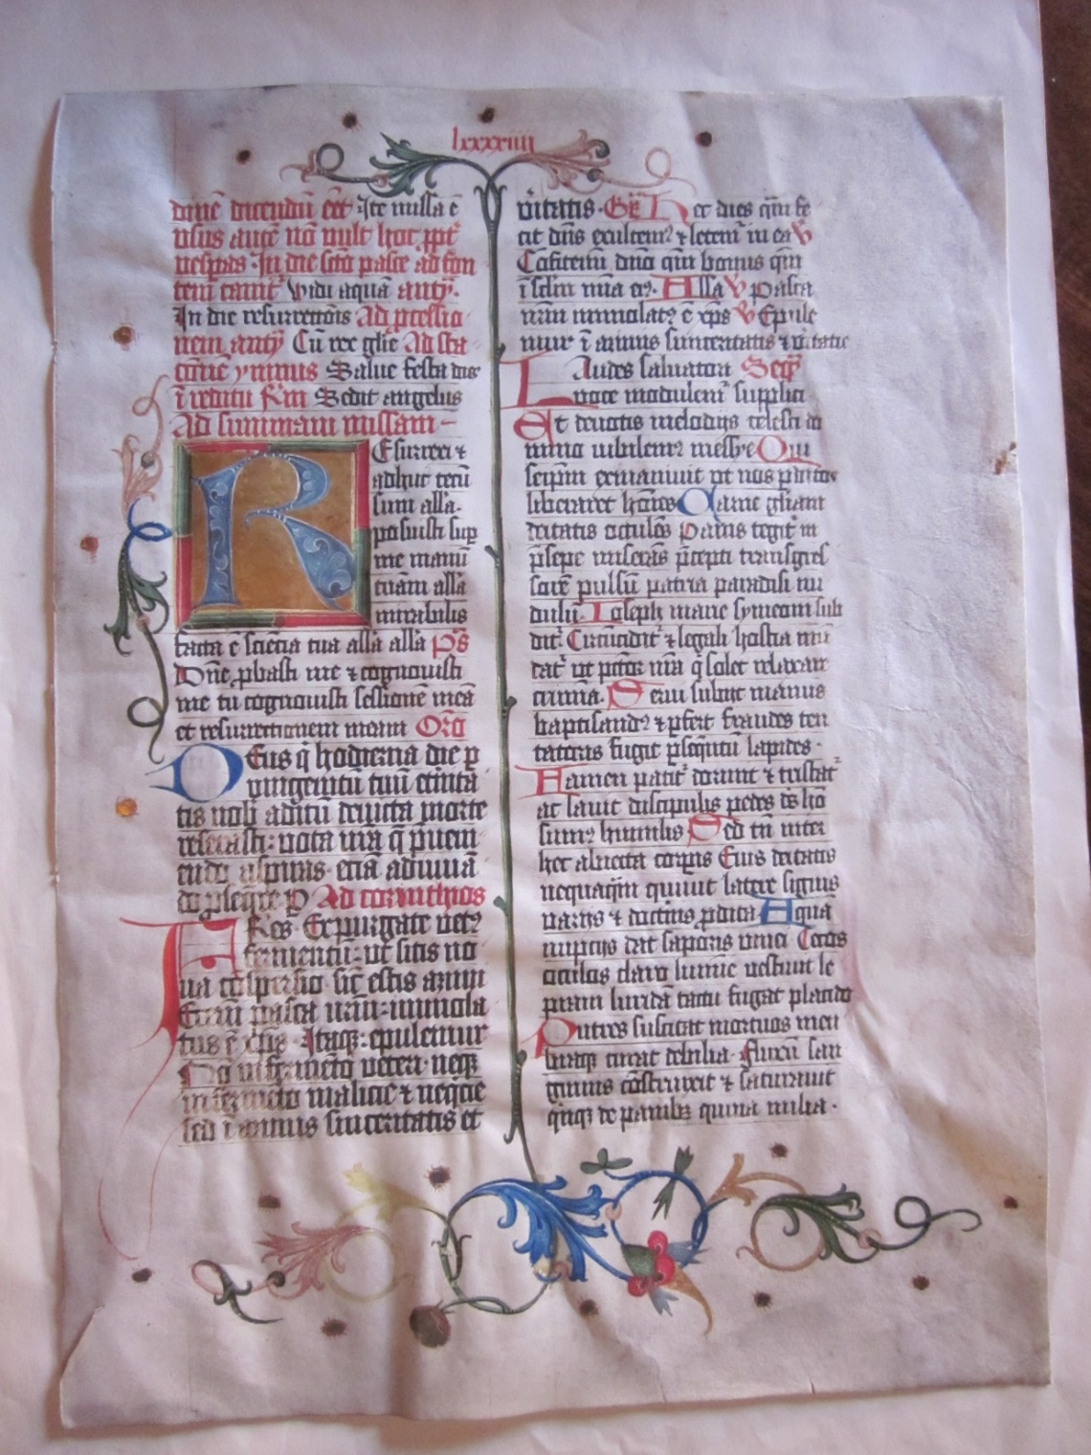
Notes:
New KGC-34 ¶Illuminated Missal, in Latin. Single large vellum leaf with a large painted initial ‘R’ against a burnished and tooled gold ground, marginal stylized foliate decoration. 15 x 11”. Southern Germany, 2nd half of 15th century.

Slide 43
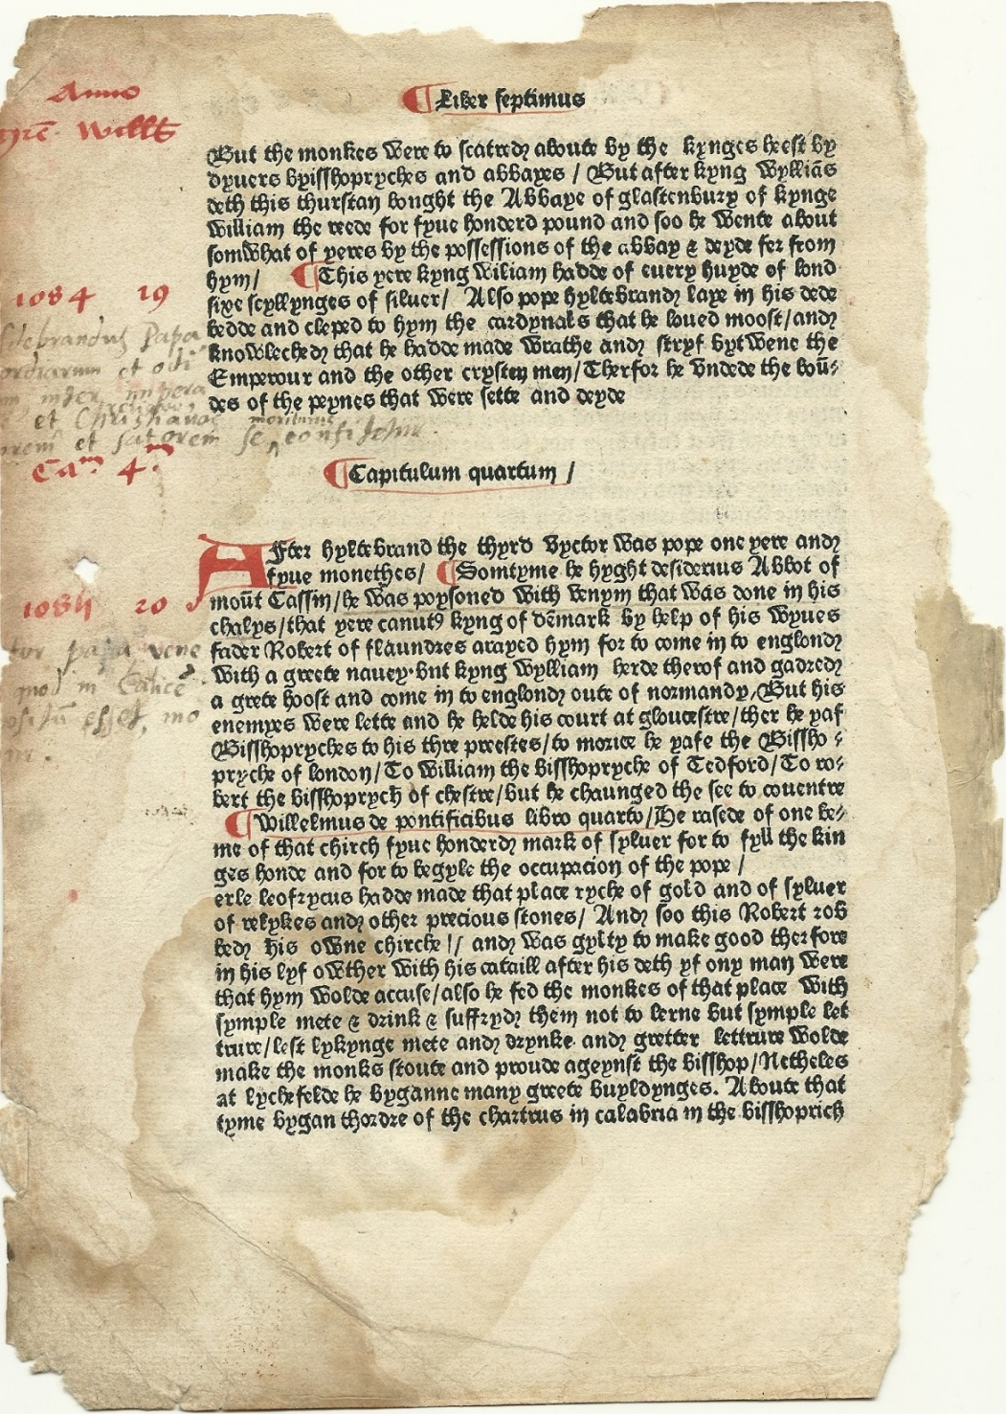
Notes:
NEW KGC-35 ¶ Ranulph Higden. Polycronicon. Westminster, William Caxton, after 2 July, 1482. Single leaf printed on paper, with a rubricated initial, paragraph marks & marginalia, other early marginalia on the verso. 10.6 x 7.6”. The text is the Middle English translat ion by John Trevisa (Benedictine monk of Chester, d. 1364) modernized by William Caxton. It is printed with Caxton’s Type 4.

